Slide 1
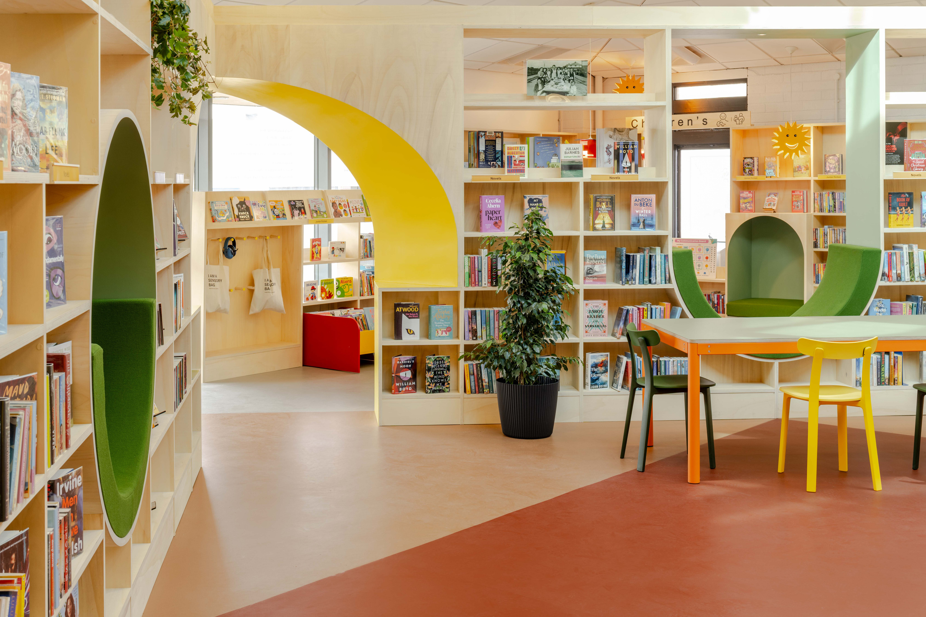

Designing Libraries Around
Human Experience
Inclusive Libraries Designed with Communities
REIMAGINING THE LIBRARY AS A SENSORY, SOCIAL AND CIVIC SPACE
Dr Emily Peasgood
Ben Allen
Haydock Library, Image by FRENCH+TYE, 2026
Notes:
INTRO
Emily: My Name is Dr Emily Peasgood - I am a specialist in creating inclusive spaces and artworks with communities.
Ben: Introduction
Emily: We recently designed Haydock Library with fund from the Libraries Improvement Fund for St Helens Council, and the design focused on designing a library around human experience.
We are going to present our findings on how we might consider library design of the future, using Haydock Library as an example.
Libraries are changing. They are no longer simply places for borrowing books.
They are becoming some of the last truly public indoor spaces where people can gather, regulate, connect, learn and belong without needing to spend money.
But many libraries are still designed as neutral civic interiors.
Our work asks: What happens if we design libraries emotionally, socially and sensorially, with communities rather than for them?

Slide 2
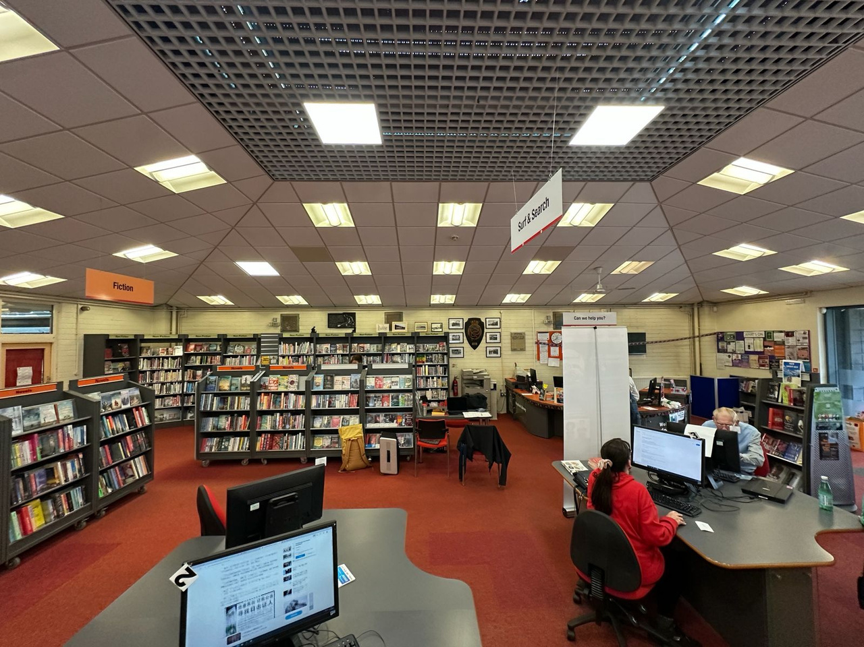
Why Many Libraries No Longer Work
FLEXIBLE
NEUTRAL
CORPORATE
But is it emotionally recognisable?
Is adaptability at the cost of a sense of space?
Haydock Library, pre-design. Image: Ben Allen, 2025
Notes:
INTRO / PROBLEM
Photo of library before instead of Urmston Library. Put them both in.
Emily:
Many contemporary civic interiors are designed to be flexible, efficient and multi-purpose.
But in becoming everything, they often become emotionally generic.
Furniture on castors.
Temporary layouts.
Spaces that could be anywhere.
These environments can feel overstimulating, emotionally cold or lacking identity, particularly for neurodivergent users, children and marginalised communities.
With Haydock Library wanted to ask: what would happen if a library felt grounded, sensory, recognisable and deeply connected to its community?

Slide 3
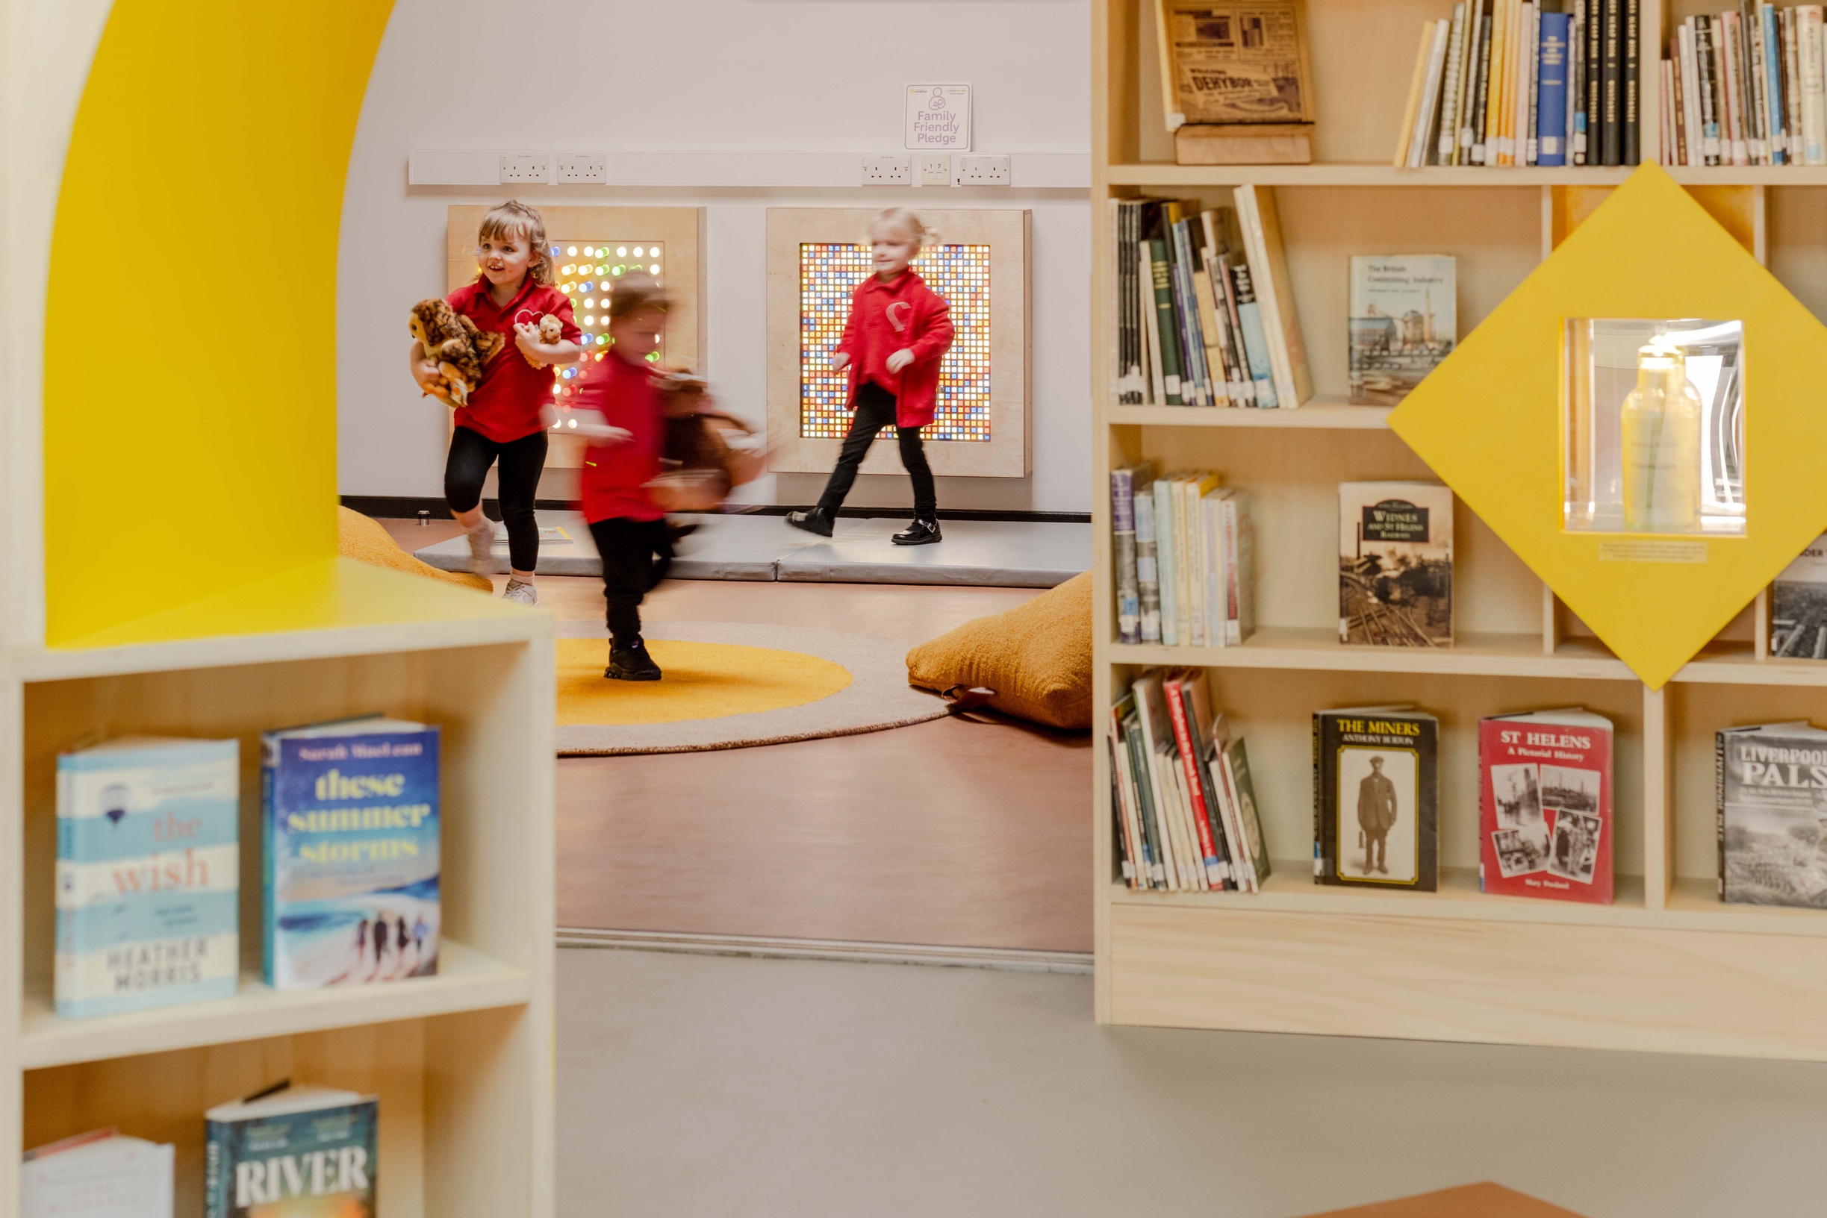
Designing with Communities
Co-design workshops with people with disabilities, library staff, carers, organisations, children and local residents.
LISTENING
PARTICIPATION
LIVED EXPERIENCE
Haydock Library, Image by FRENCH+TYE, 2026
Notes:
CO-DESIGN PROCESS
Add an image from the workshop
Emily:
When we designed Haydock Library, the project began not with drawings, but with listening.
We worked with library staff, carers, disability organisations, children and local residents through workshops, visits and creative activities.
One of the most important aspects of the process was speaking directly with people with disabilities themselves, not only through carers or institutions.
We wanted lived experience to shape the architecture.
Throughout the process we used accessible workshop formats, sensory materials, easy-read information and alternative ways for people to participate.

Slide 4
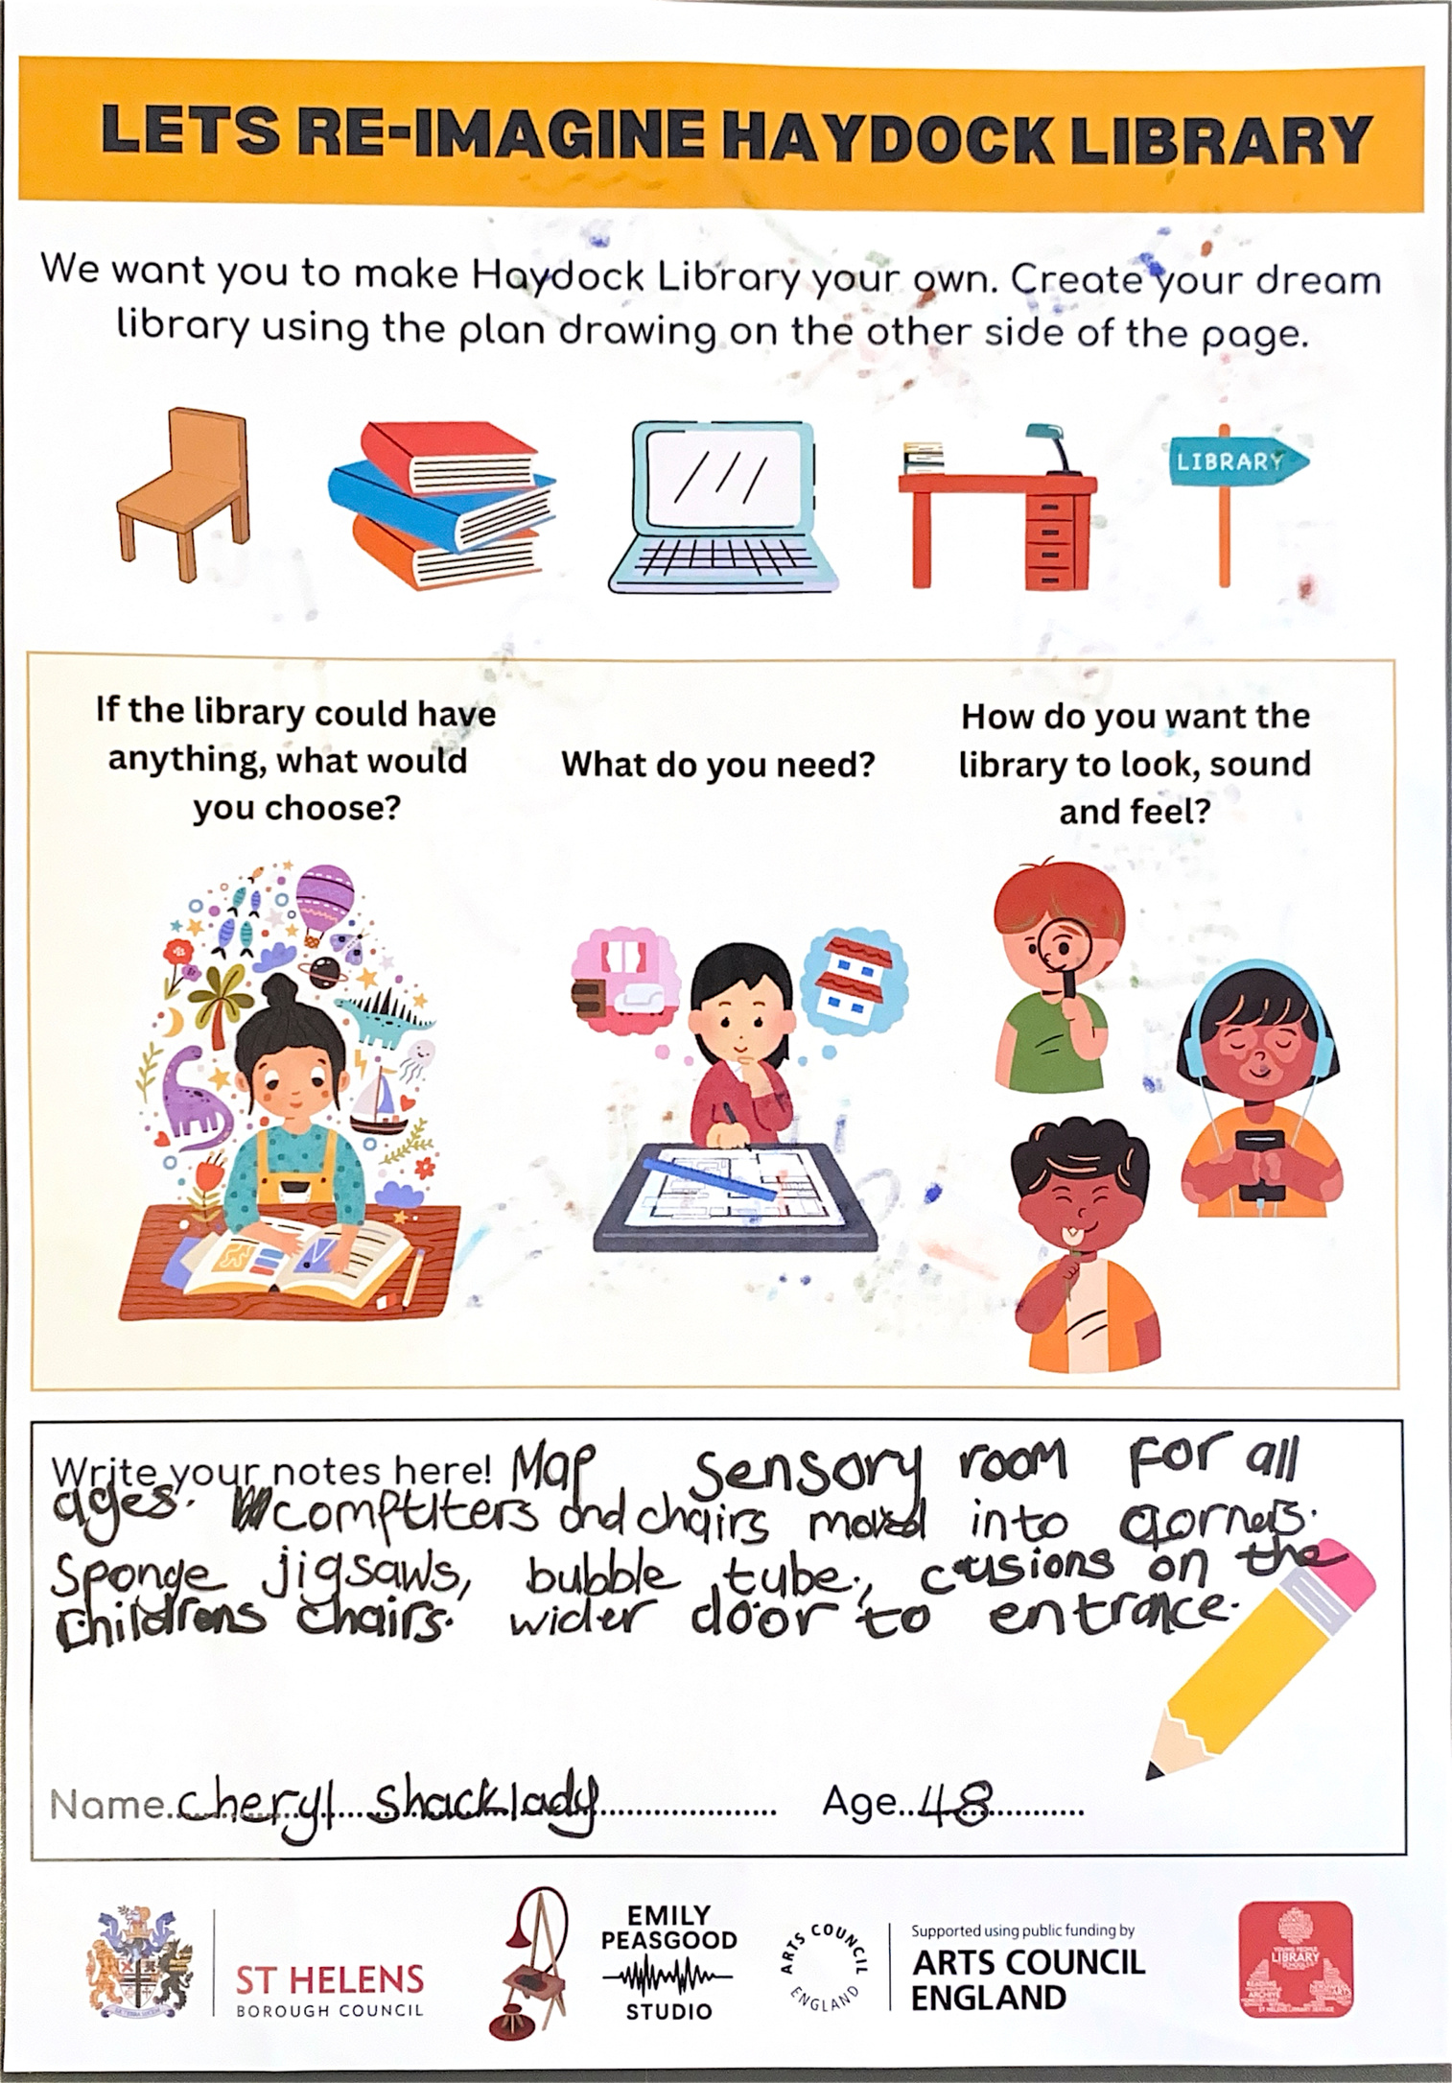
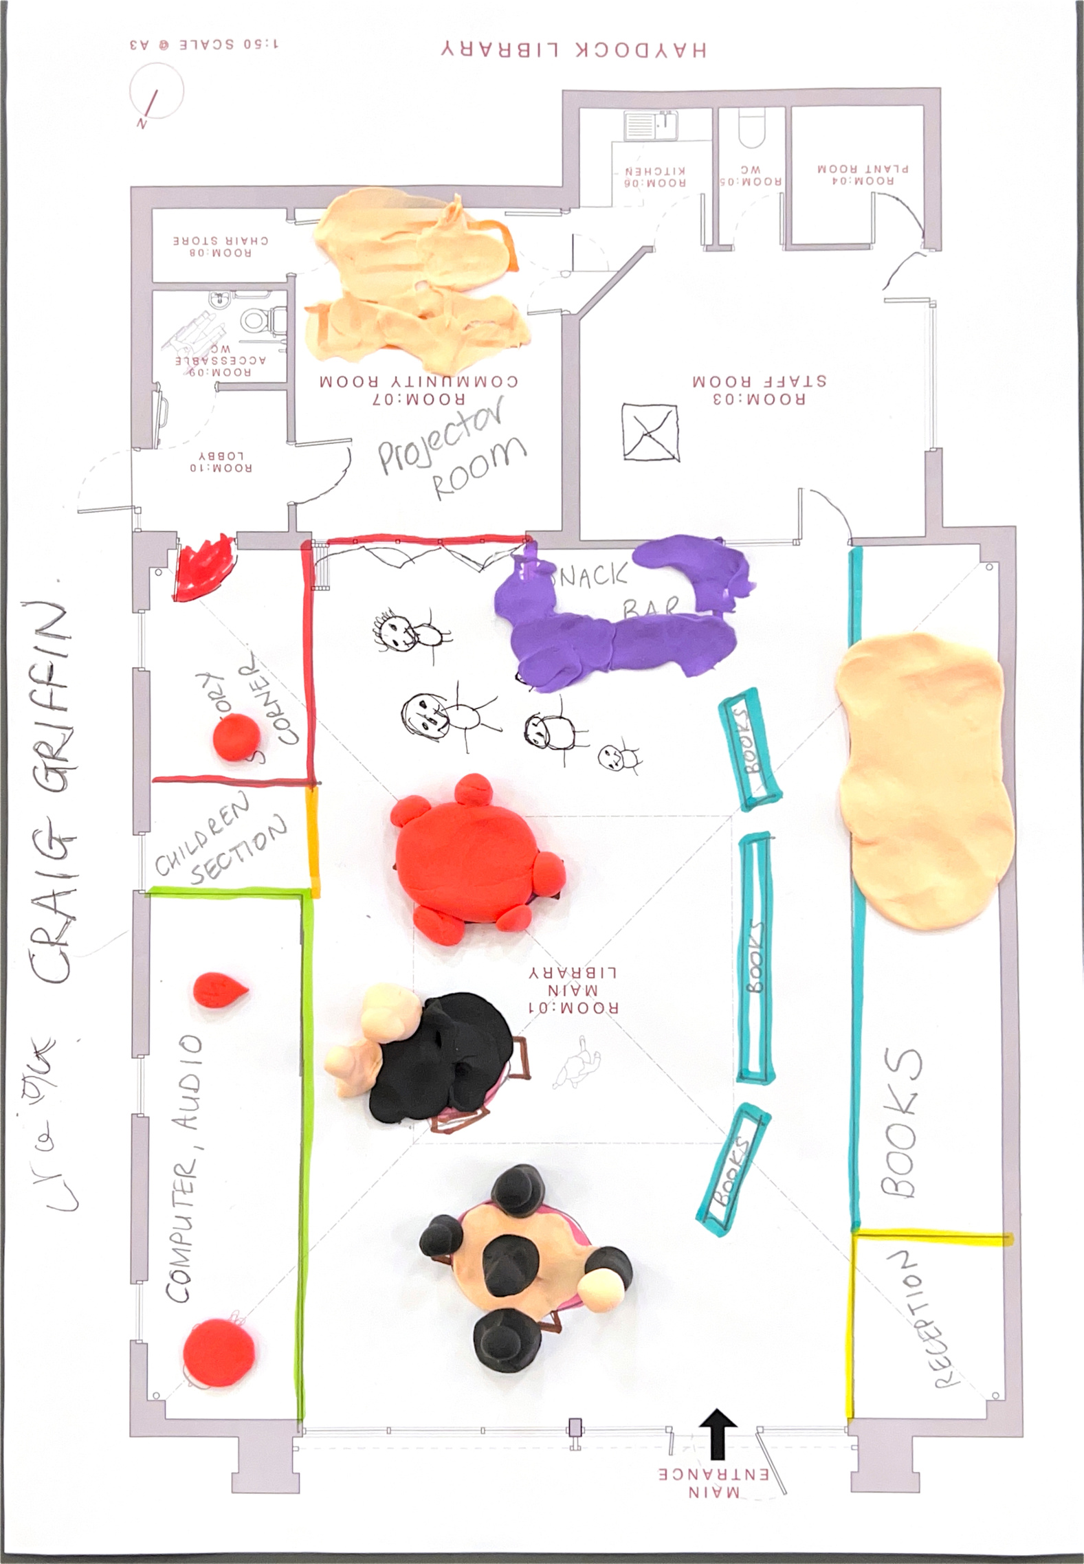
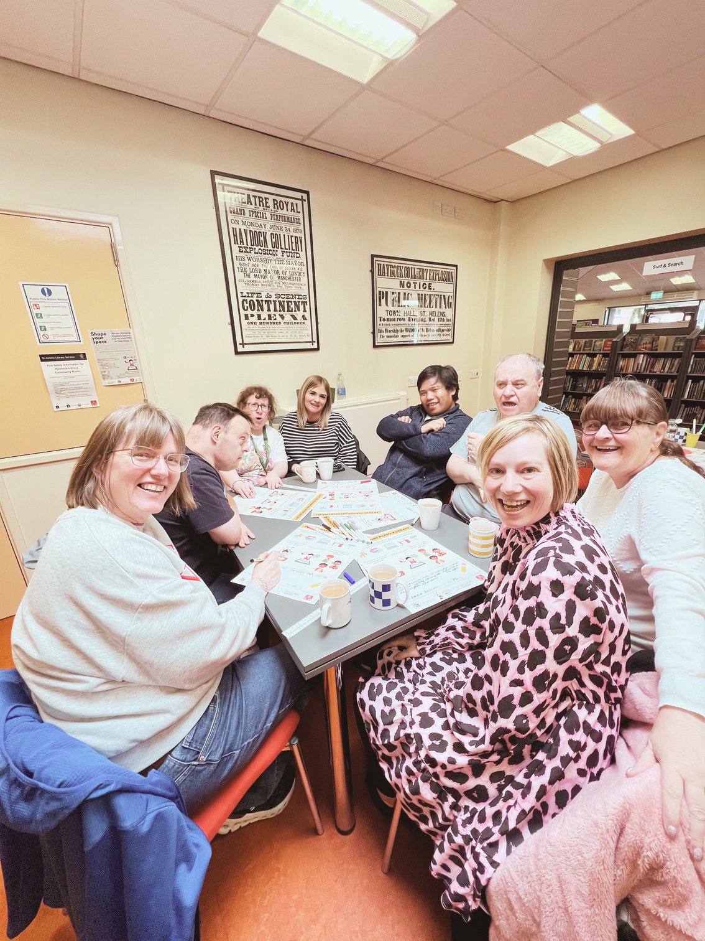
Notes:
We asked them to consider what their dream library looked like and used these ideas to identify key themes and inform the design.

Slide 5
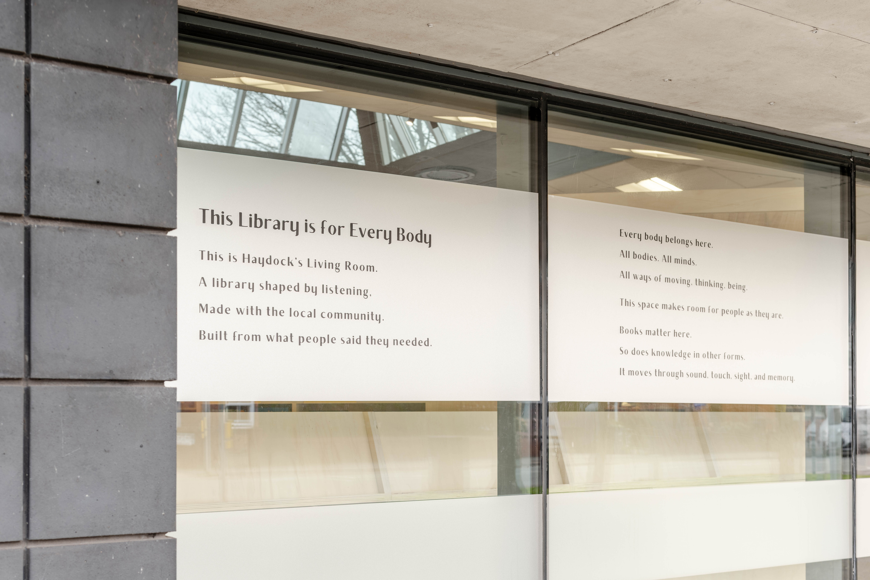
Creating a Shared Vision
A manifesto for an inclusive library.
A library shaped by:
BELONGING
CALM
CURIOSITY
COMMUNITY
ACCESS
IMAGINATION
Haydock Library, Image by FRENCH+TYE, 2026
Notes:
THE MANIFESTO
Emily:
As the project developed, we worked with the steering group to create a manifesto for the future library.
This became a way of capturing not just functional requirements, but emotional atmosphere:
how the library should feel, what values should shape it, and what kinds of interaction it should support.
The manifesto shifted the project from simply redesigning a building to imagining a new civic identity for the library.
It also became embedded physically into the building itself through window graphics and environmental design.

Slide 6
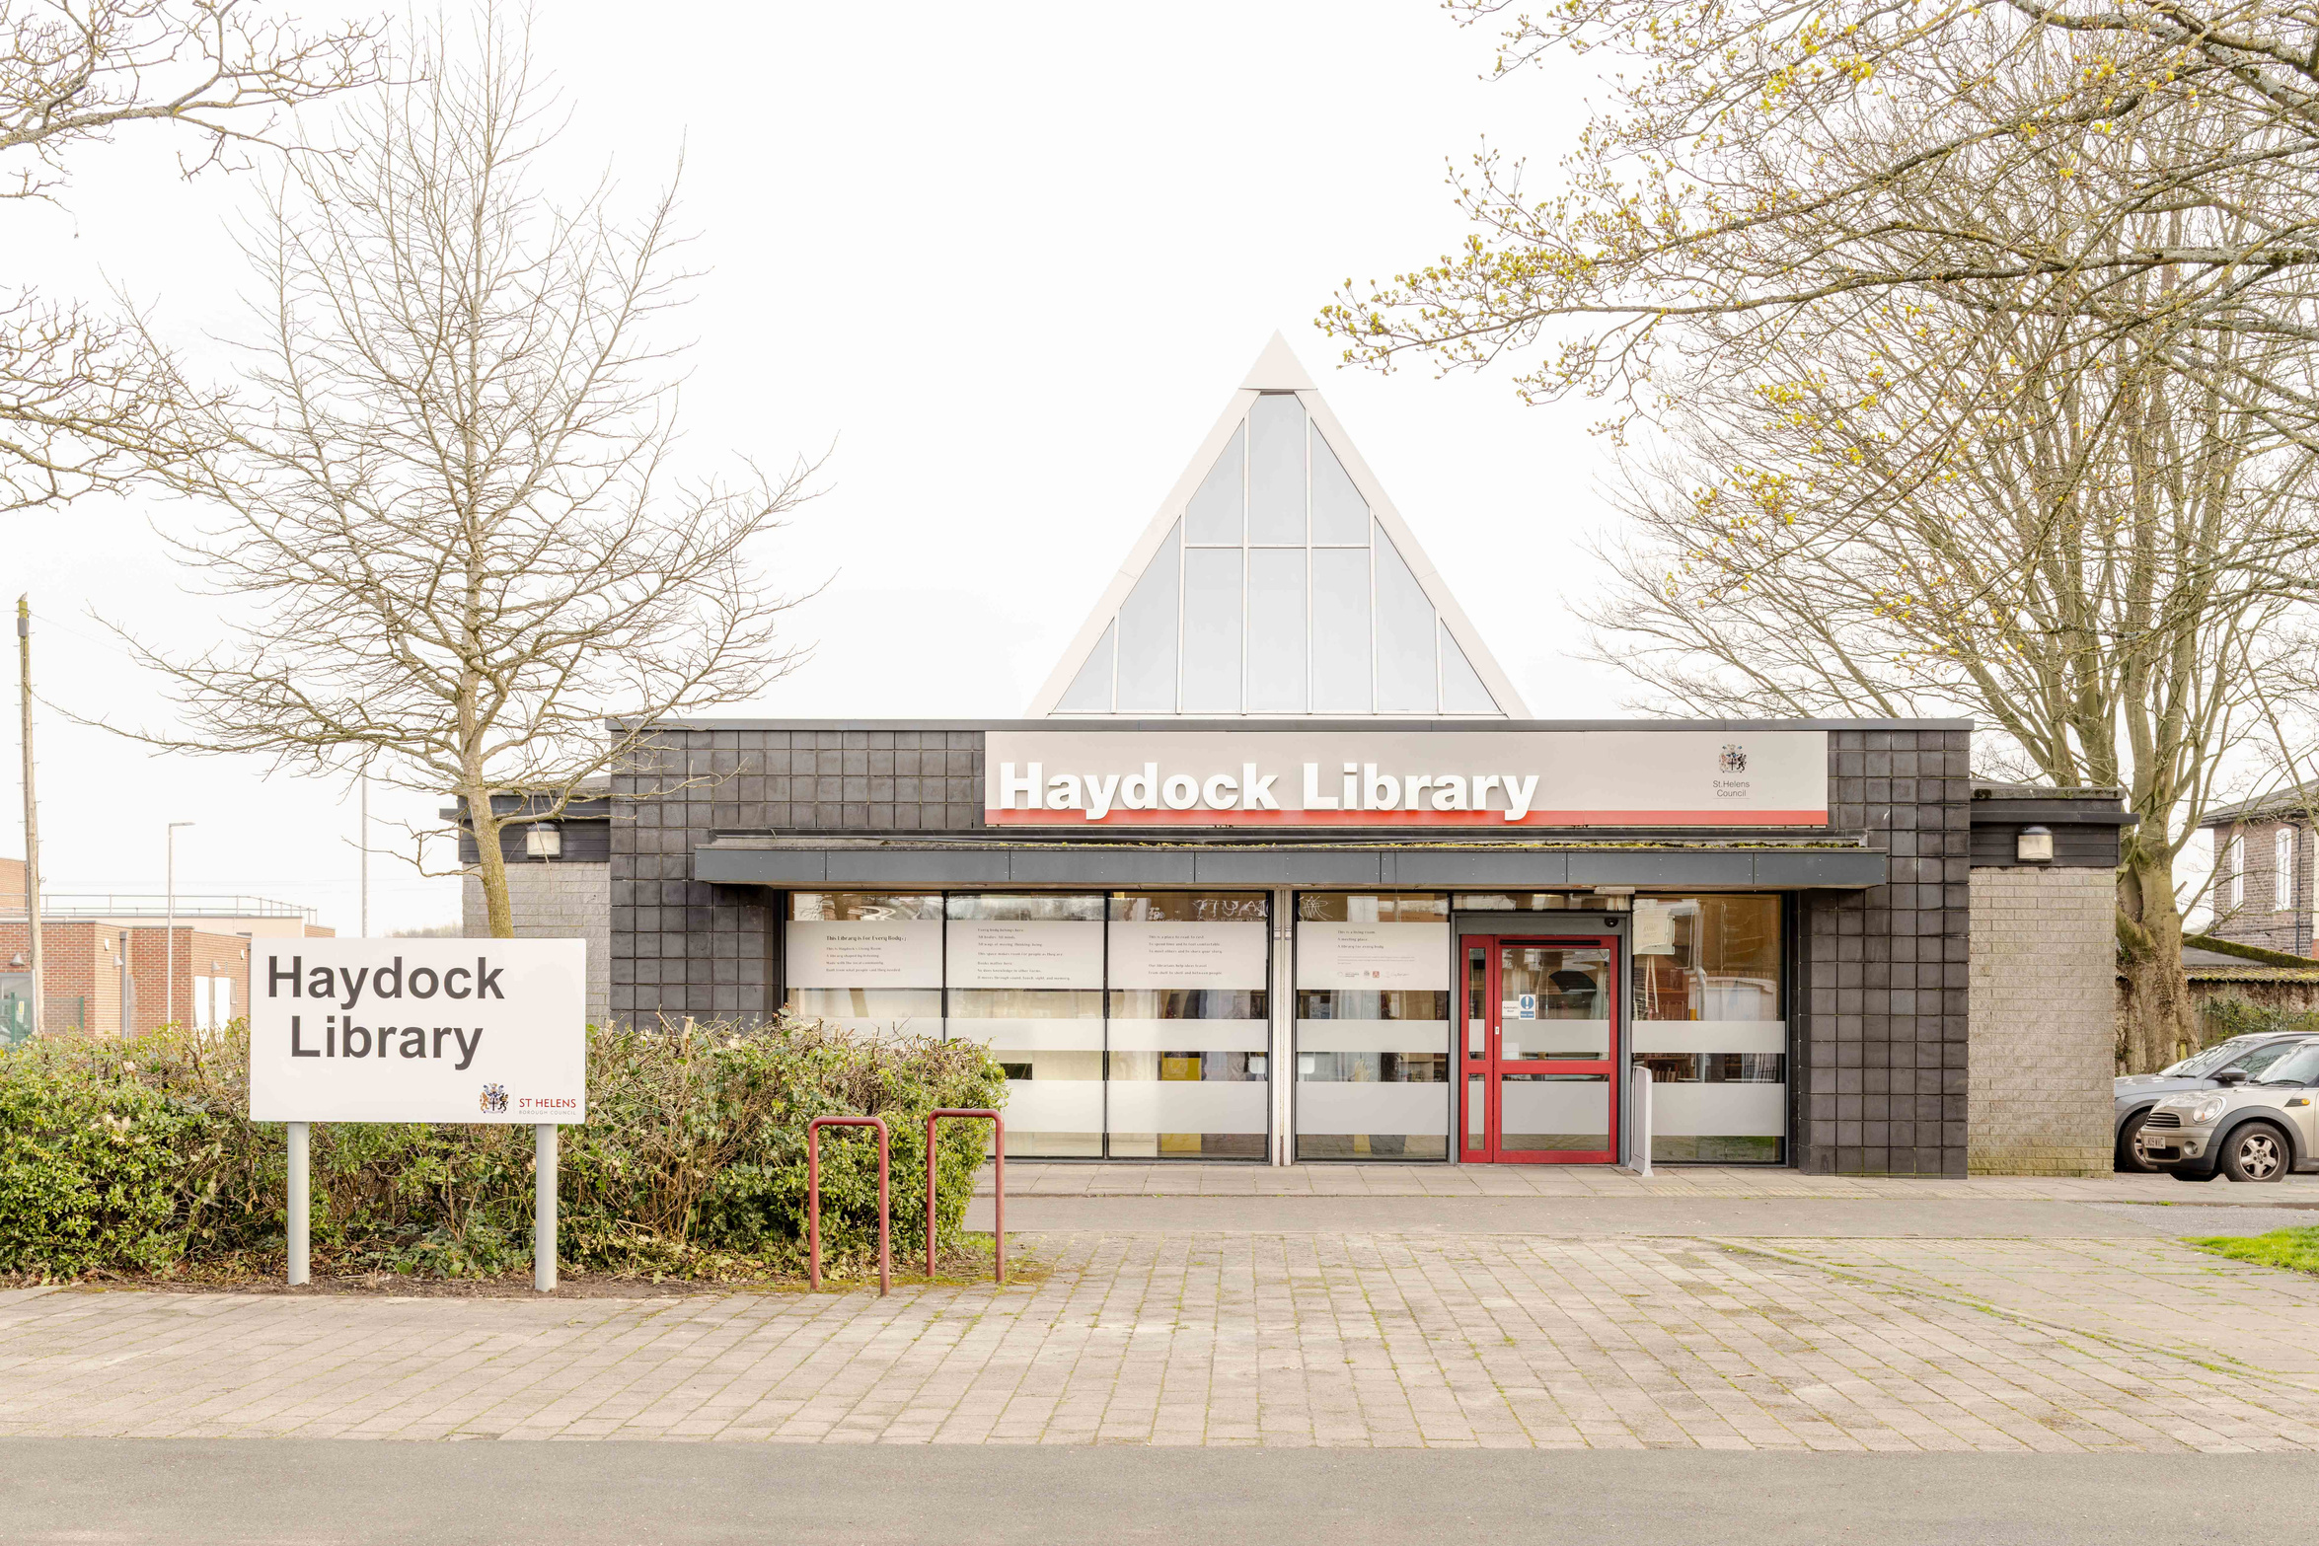
The Design Vision
Notes:
Emily:
We didn’t want to create a sensory playground or something that felt childish or chaotic.
The challenge was: How do you create a highly inclusive environment that still feels beautiful, calm and architecturally coherent?
Inclusion should not sit outside good design. It should be embedded within it, and it doesn't need to be allocated to a small space. We embedded it throughout the library with portable elements, sensory bags, and integrated sensory panels. You
We wanted the library to feel emotionally warm, grounded and recognisable, somewhere people actively wanted to spend time.
Hand over to Ben - before photo.
- Biophilia / The Clearing
- The nook as a refuge
- Permanence versus temporary
- Embedding sensory elements throughout
- We built in adaptability

Slide 7
M A I N
E N T R A N C E
FUNCTIONS
FUNCTIONS
FUNCTIONS
OPEN SPACE / EVENTS SPACE
FUNCTIONS
FUNCTIONS
FUNCTIONS
FUNCTIONS
1 0
L O B B Y
workshop ideas overview
Notes:
-

Slide 8
biophilic design concepts
Visual connections with nature
- views out to trees
- shadow pattern on floor
- indoor plants
- movement of light during the day
- natural materials (wooden shelving) / tactile materials

Slide 9
Non-visual connections with nature
- forest clearing
- geometry of space improves legibity

Slide 10
Refuge + Prospect
- smaller perimeter spaces provide refuge
- full height shelves provides a sense of enclosure
- fixed shelves provides a sense perminence and securituy / legibility
- reading niches provide refuge
- views across space provide prospect

Slide 11
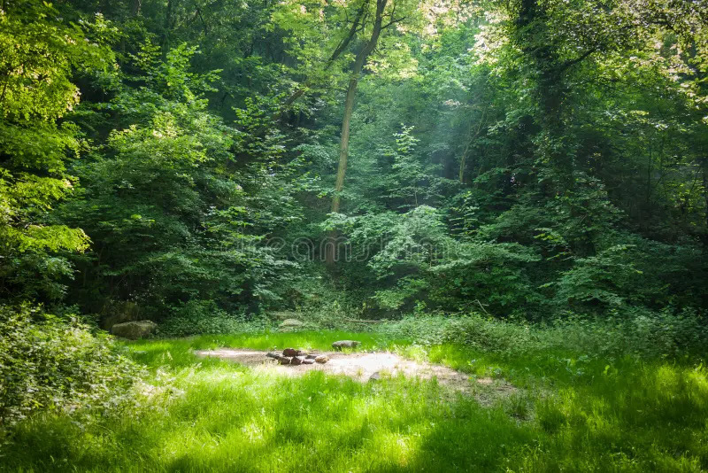
Forest clearing

Slide 12
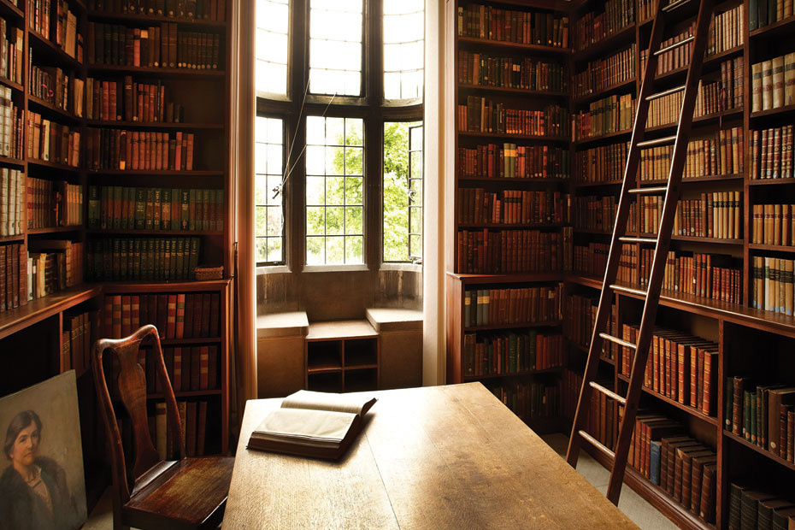
Library niche / Refuge space

Slide 13
M A I N
E N T R A N C E
b o o k s h e l v e s
b o o k s h e l v e s
b o o k s h e l v e s
s t a f f d e s k
k i d
sp a c e
s e l f - s e r v i c e
h u b l e t ( i p a d )
b o o k s h e l v e s
0 1
M A I N
L I B R A R Y
b o o k s h e l v e s
m u l t i p u r p o s e / r e a d i n g / c o m m u n a l
b o o k s h e l v e s
s p a c e
b o o k s h e l v e s
b o o k s h e l v e s
b o o k s h e l v e s
b o o k s h e l v e s
1 0
L O B B Y
square plan

Slide 14
M A I N
E N T R A N C E
b o o k s h e l v e s
b o o k s h e l v e s
b o o k s h e l v e s
s e l f
s e r v i c e
0 1 2
k i d s p a c e
h u b l e t ( i p a d )
b o o k s h e l v e s
b o o k s h e l v e s
0 1
M A I N
L I B R A R Y
b o o k s h e l v e s
0 1
m u l t i p u r p o s e / r e a d i n g / c o m m u n a l
s p a c e
b o o k s h e l v e s
s t aff
d e s k
t e c h. z o n e
b o o k s h e l v e s
b o o k s h e l v e s
b o o k s h e l v e s
1 0
L O B B Y
round plan

Slide 15
M A I N
E N T R A N C E
b o o k s h e l v e s
s e l f - s e r v i c e
b o o k s h e l v e s
b o o k s h e l v e s
s e l f - s e r v i c e
h u b l e t
( i p a d )
k i d
sp a c e
b o o k s h e l v e s
b o o k s h e l v e s
b o o k s h e l v e s
b o o k s h e l v e s
b o o k s h e l v e s
b o o k s h e l v e s
0 1
M A I N
L I B R A R Y
b o o k s h e l v e s
0 1
m u l t i p u r p o s e / r e a d i n g / c o m m u n a l
b o o k s h e l v e s
s p a c e
b o o k s h e l v e s
b o o k s h e l v e s
r e c e p t i o n /
h e l p
d e s k
b o o k s h e l v e s
s t aff
d e s k
b o o k s h e l v e s
b o o k s h e l v e s
t e c h. z o n e
b o o k s h e l v e s
b o o k s h e l v e s
b o o k s h e l v e s
1 0
L O B B Y
diamond plan

Slide 16
M A I N
E N T R A N C E
M a x.
C a p a c i t y : 4 8
b o o k s h e l v e s
s e l f - s e r v i c e
b o o k s h e l v e s
b o o k s h e l v e s
s e l f - s e r v i c e
h u b l e t
( i p a d )
k i d
sp a c e
b o o k s h e l v e s
b o o k s h e l v e s
b o o k s h e l v e s
b o o k s h e l v e s
b o o k s h e l v e s
b o o k s h e l v e s
0 1
M A I N
L I B R A R Y
b o o k s h e l v e s
0 1
m u l t i p u r p o s e / r e a d i n g / c o m m u n a l
b o o k s h e l v e s
s p a c e
b o o k s h e l v e s
b o o k s h e l v e s
r e c e p t i o n /
h e l p d e s k
b o o k s h e l v e s
s t aff
d e s k
b o o k s h e l v e s
b o o k s h e l v e s
t e c h. z o n e
b o o k s h e l v e s
b o o k s h e l v e s
b o o k s h e l v e s
diamond plan

Slide 17
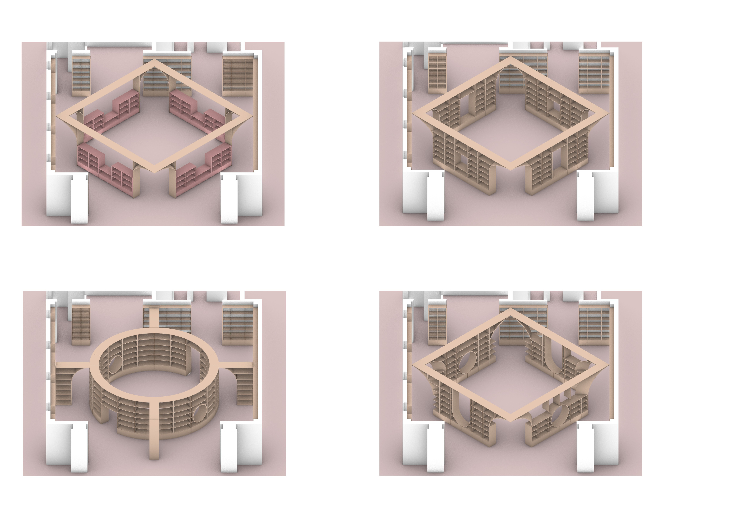
diamond plan

Slide 18
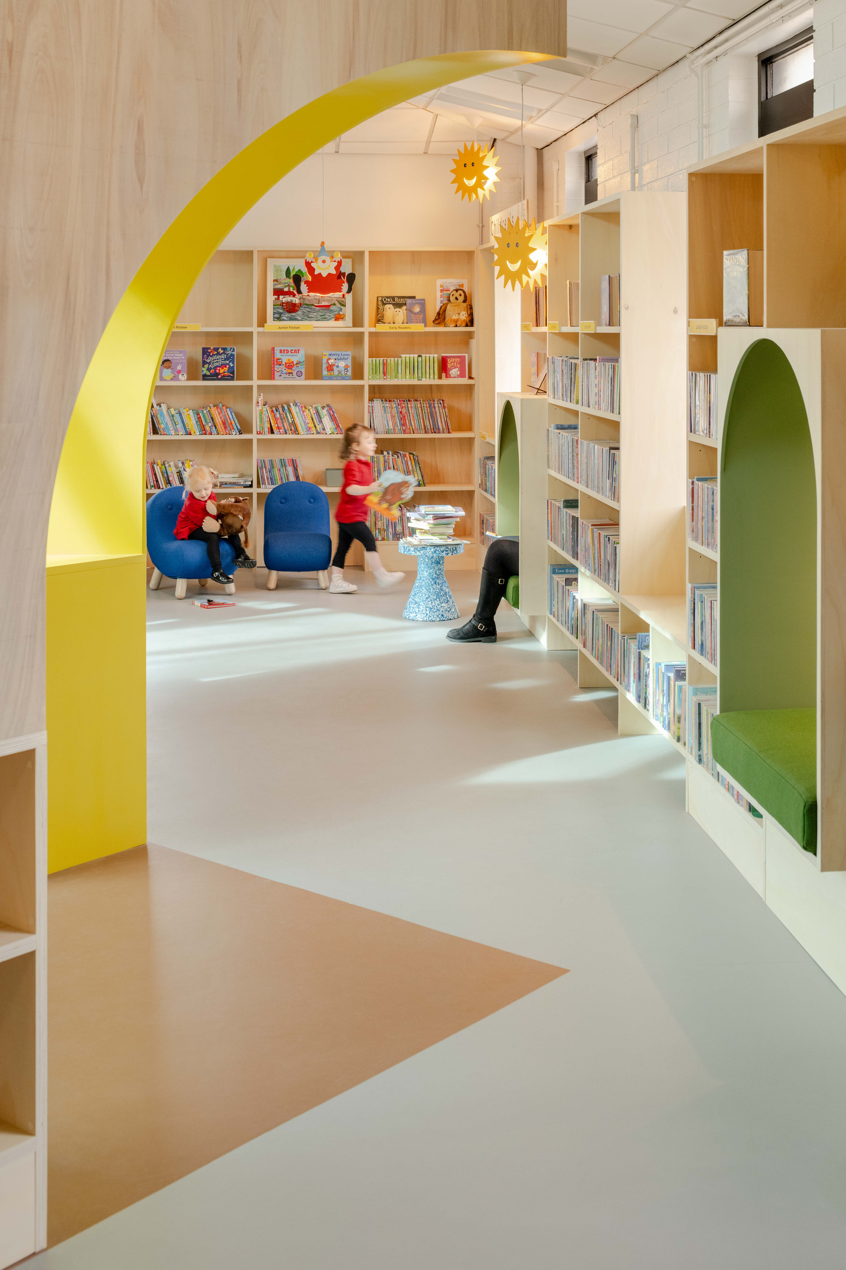
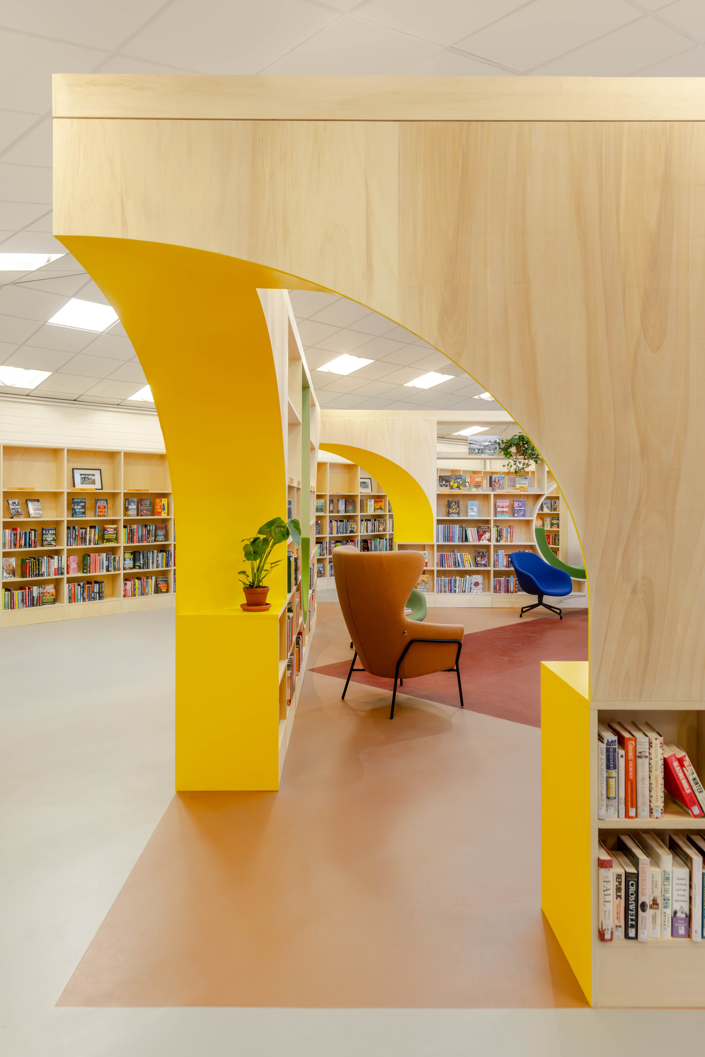
Notes:
- corners

Slide 19
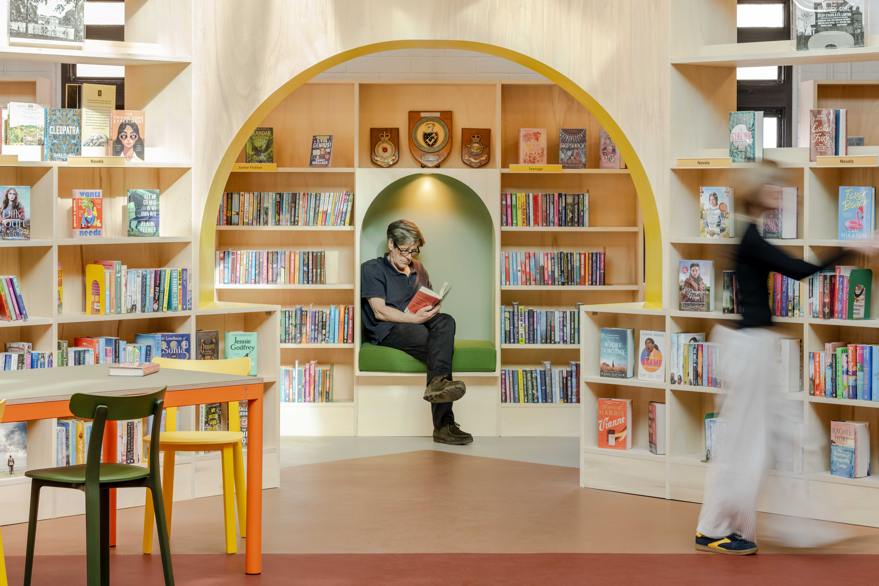
Notes:
- frames views + niches

Slide 20
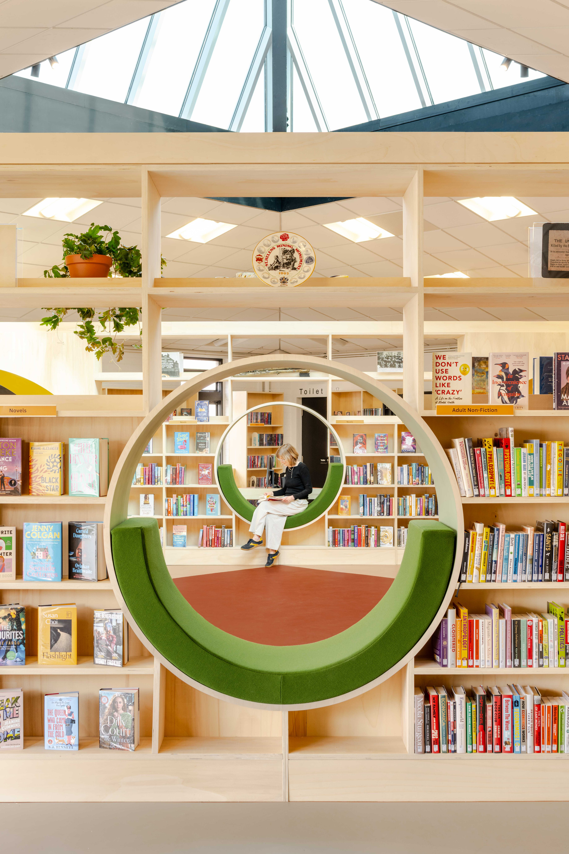
Notes:
- views across space

Slide 21
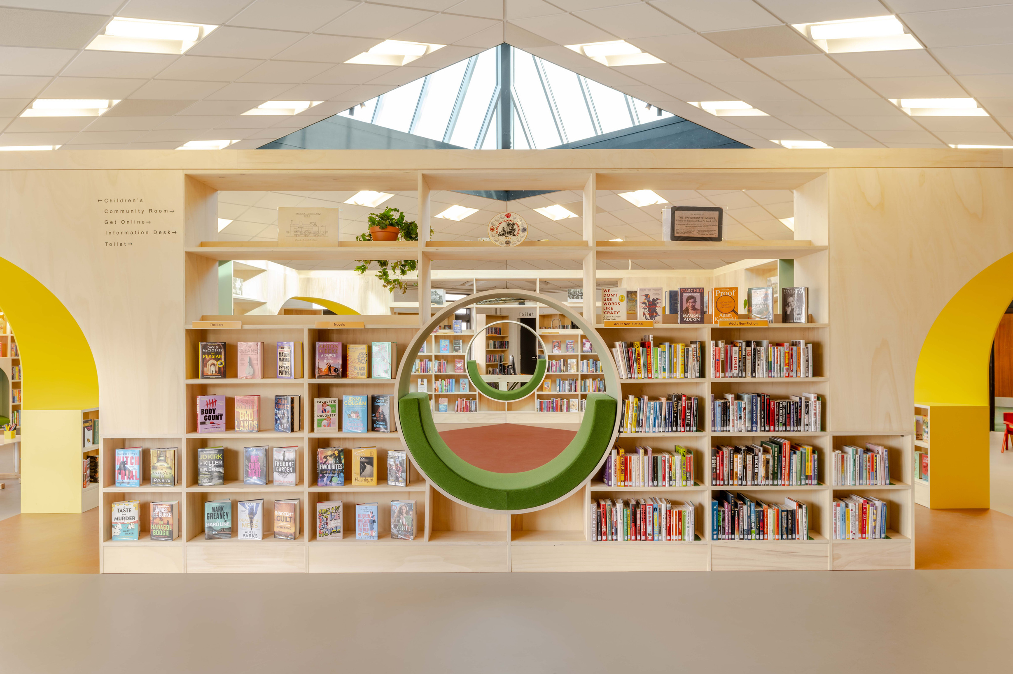

Slide 22
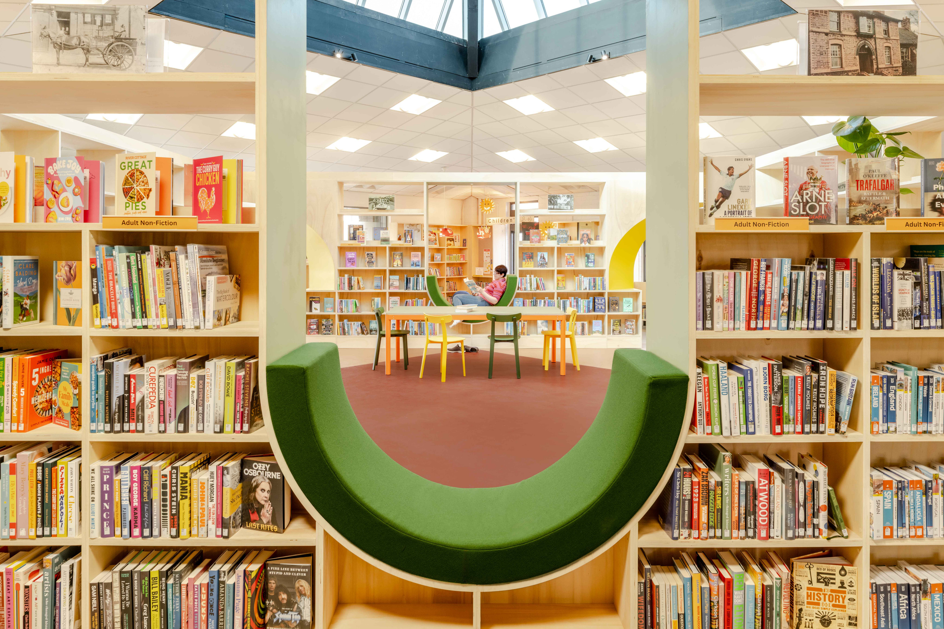
Notes:
- views other way across space (different shape)

Slide 23
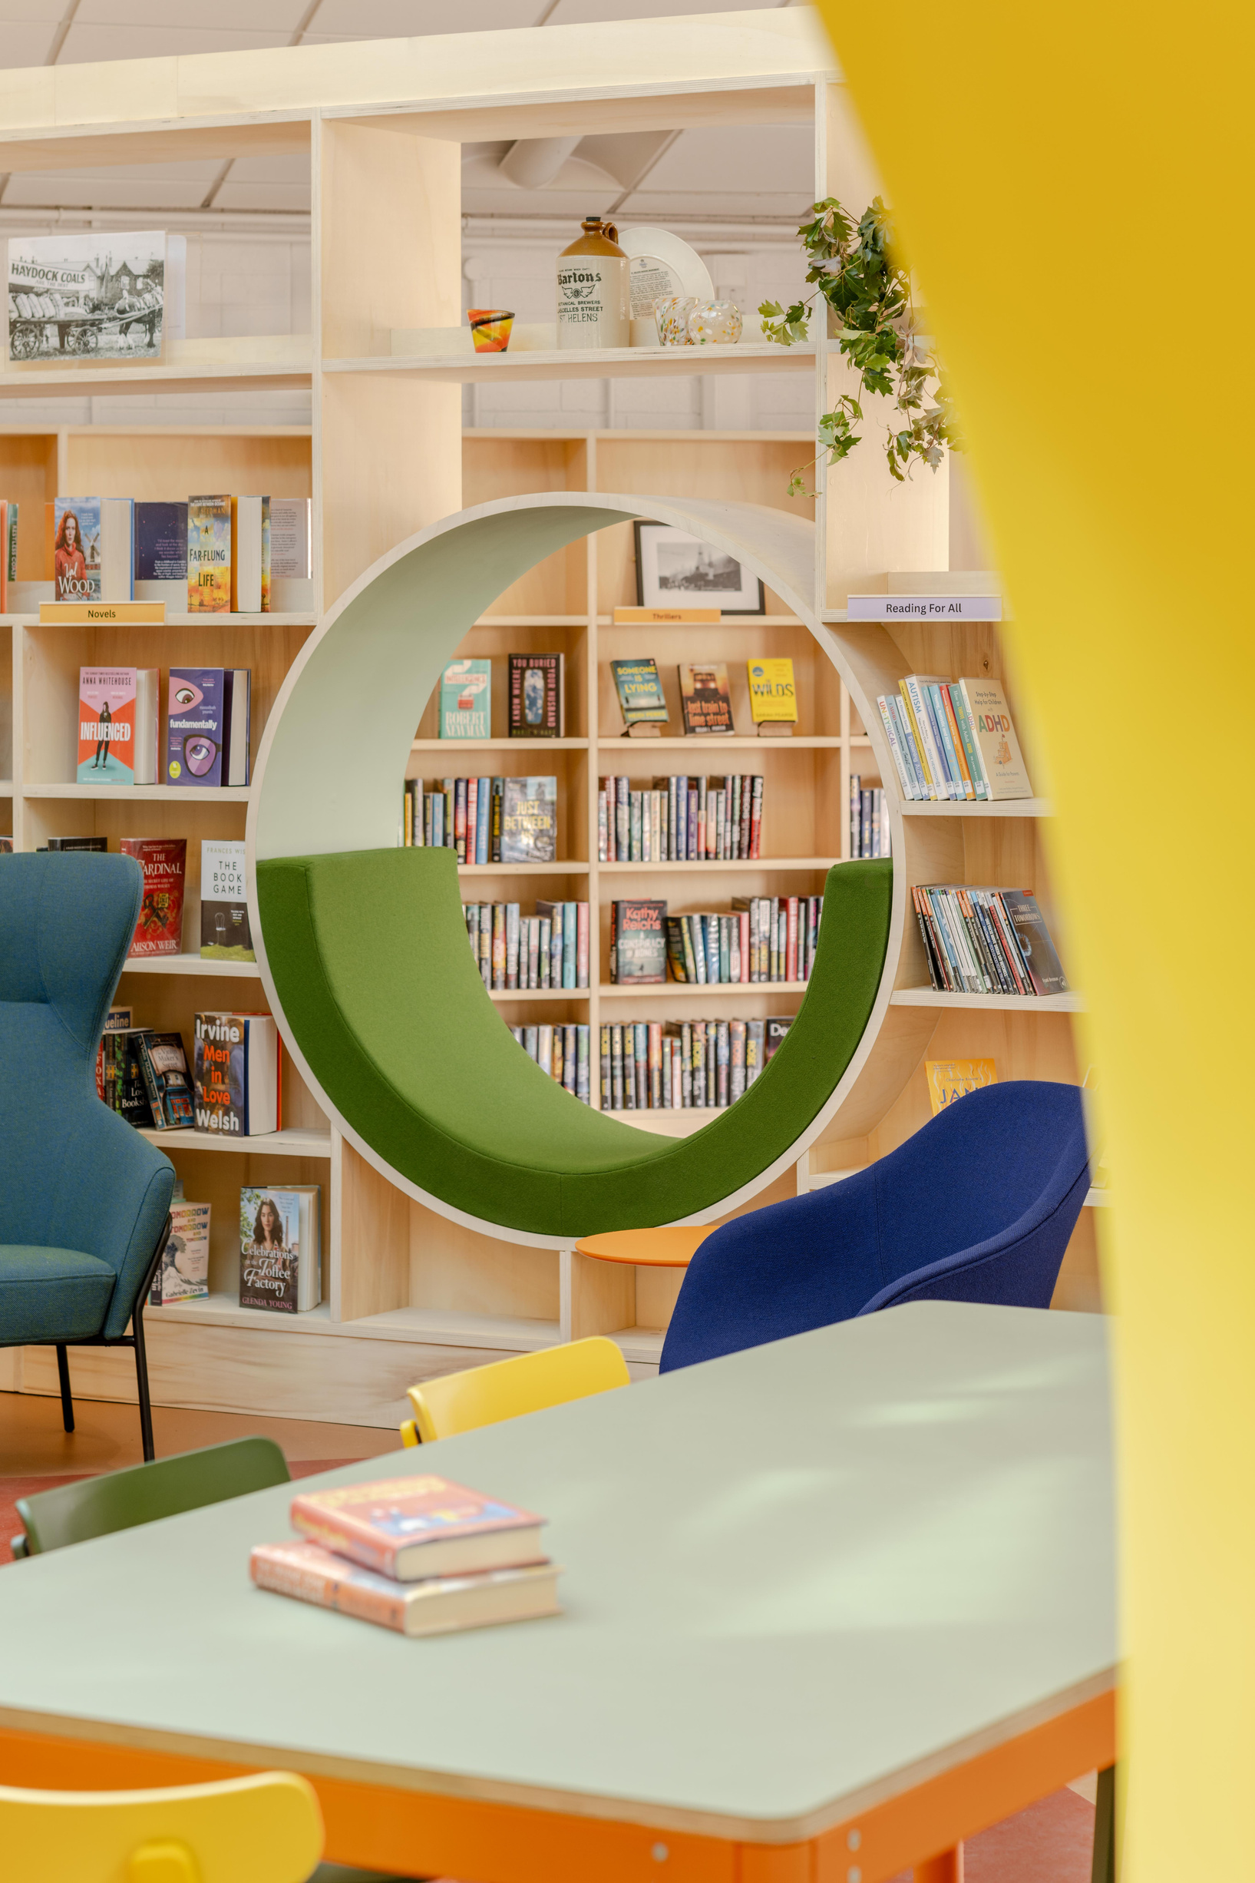
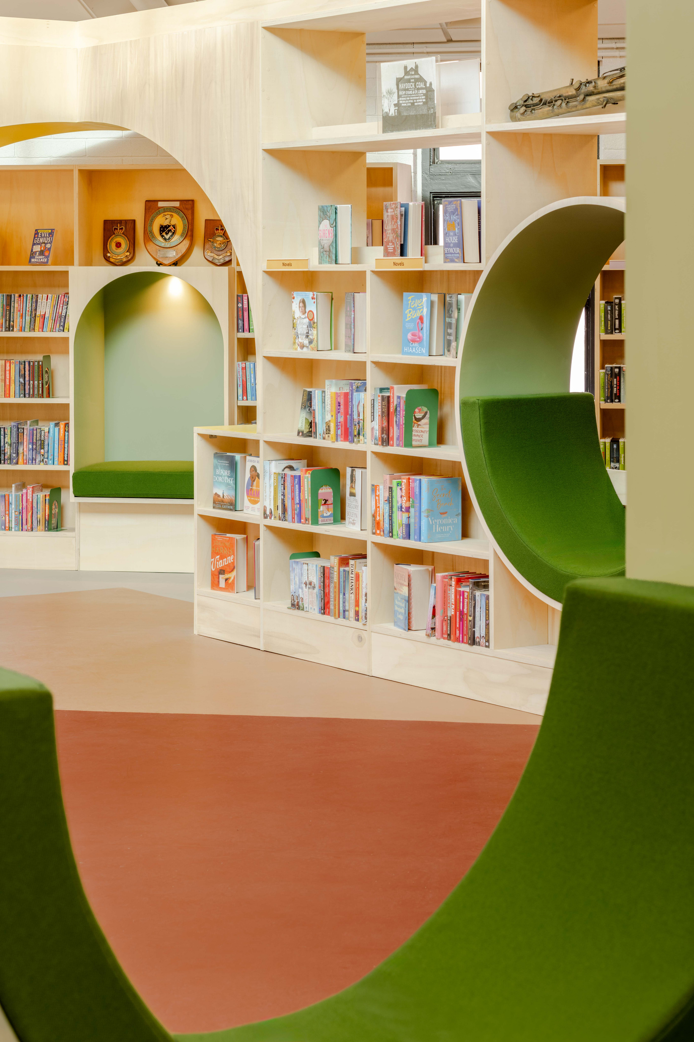
Notes:
- interesting other views

Slide 24
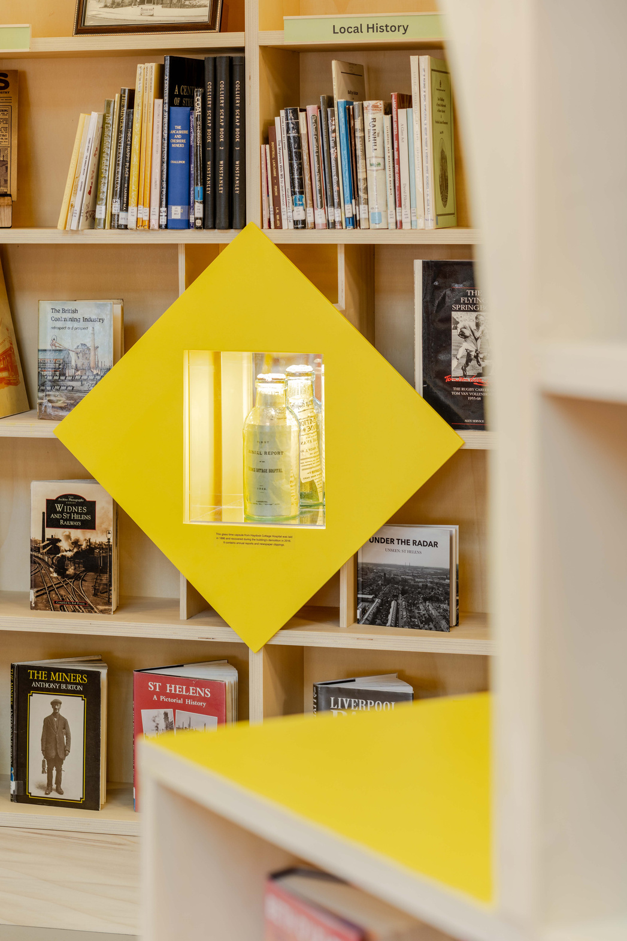
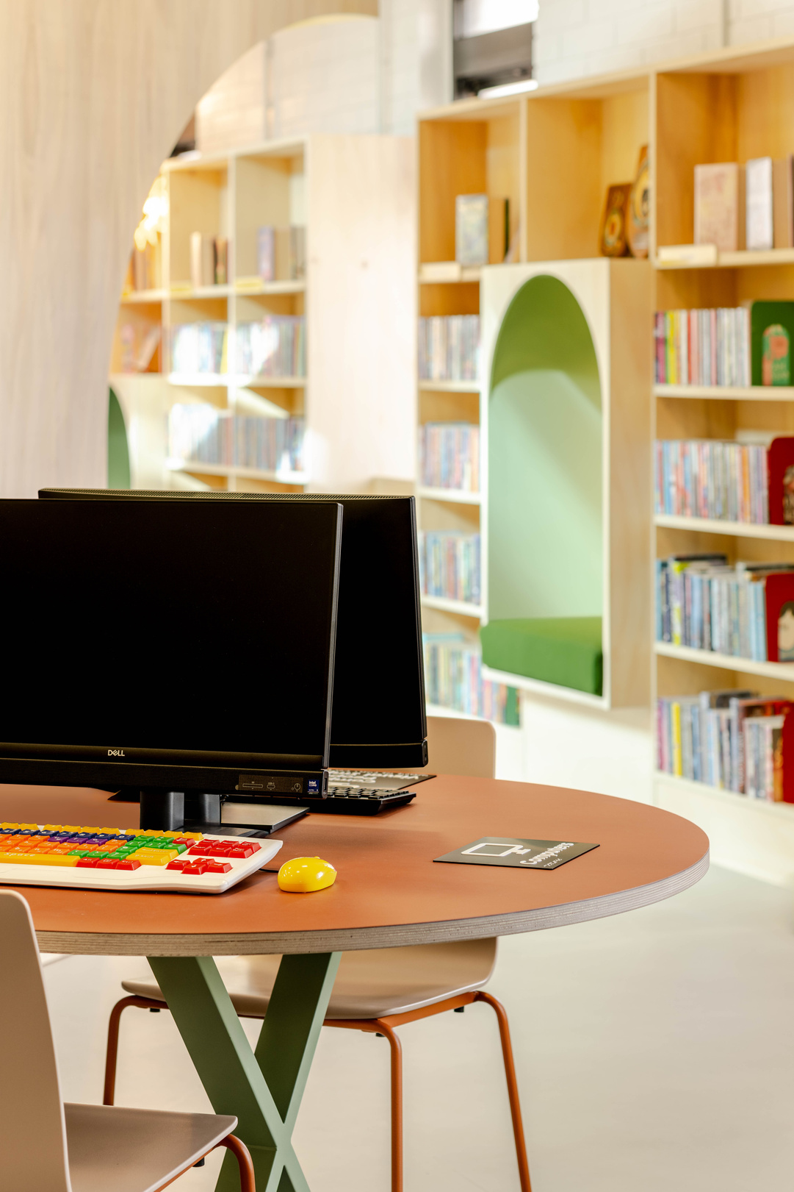
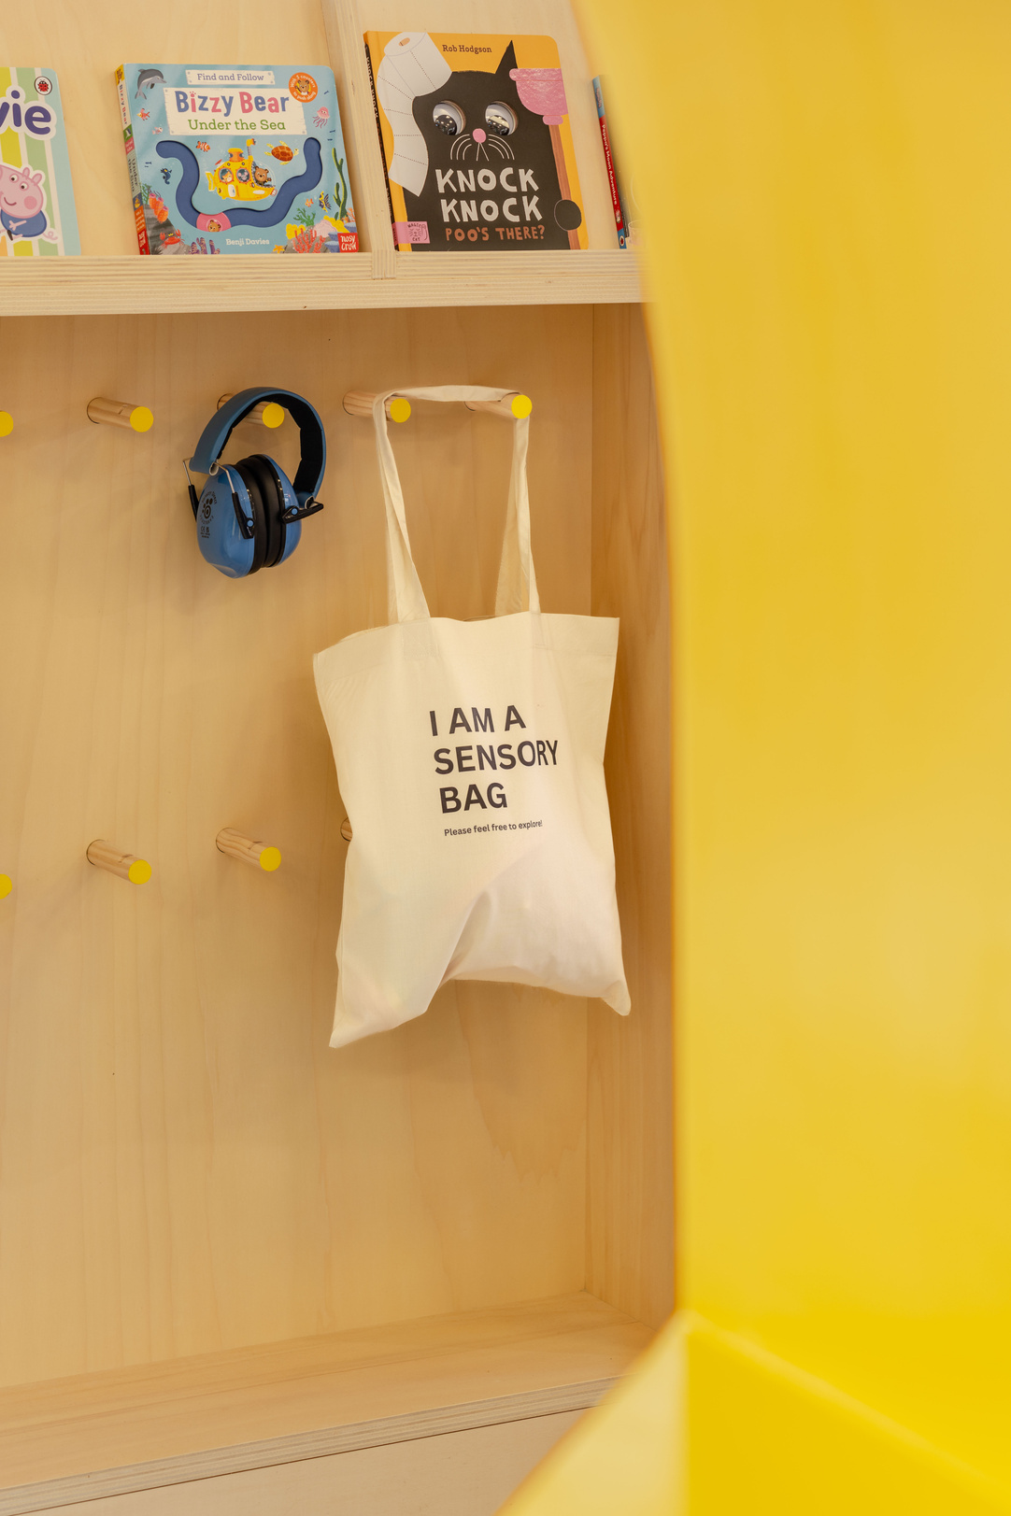
Notes:
Many sensory / SEND elements are movable can be located anywhere in the space.
Time capsule
Computer station

Slide 25
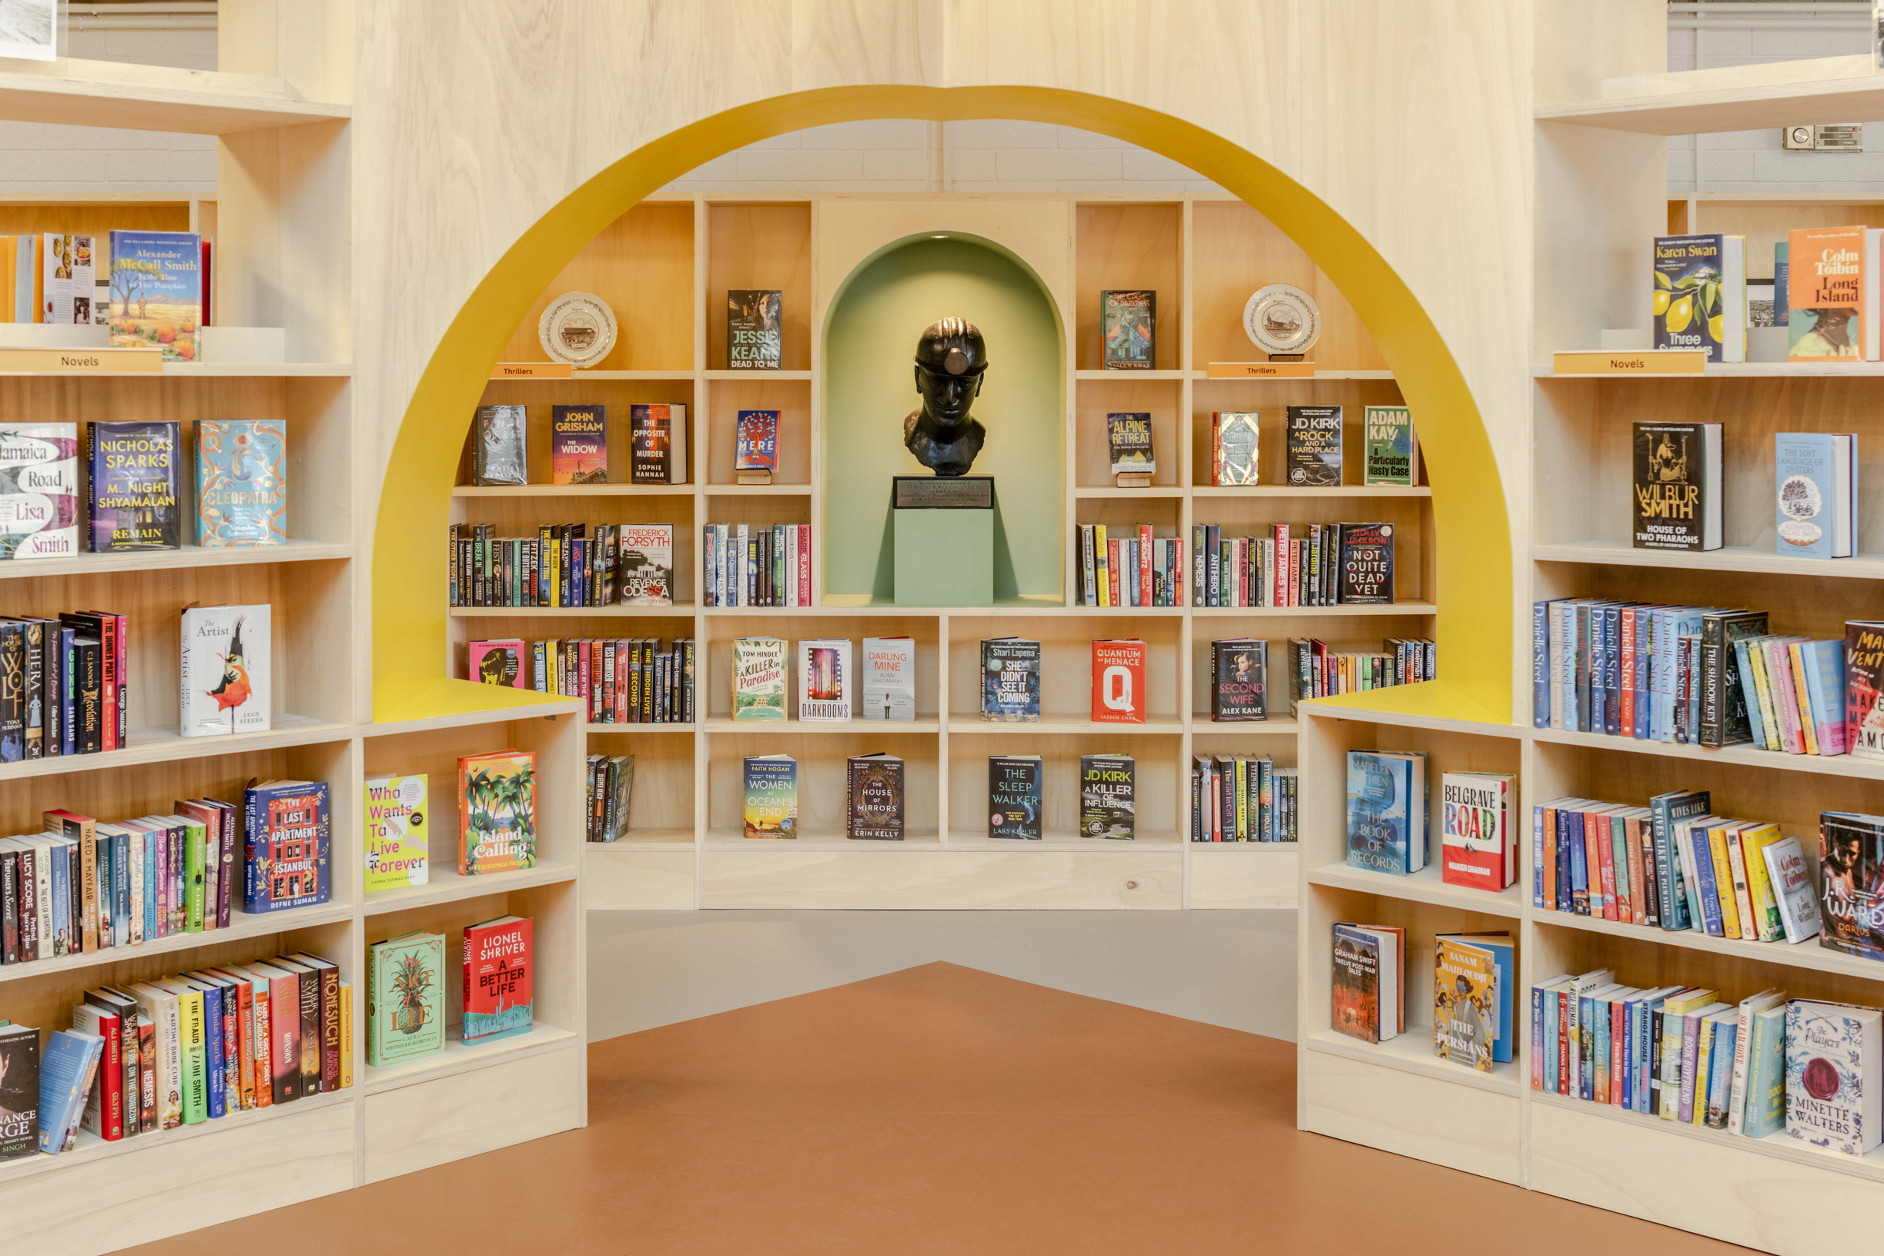
Notes:
Elizabeth frink sculpture now given fitting home
Summary of experience working on public projects.

Slide 26
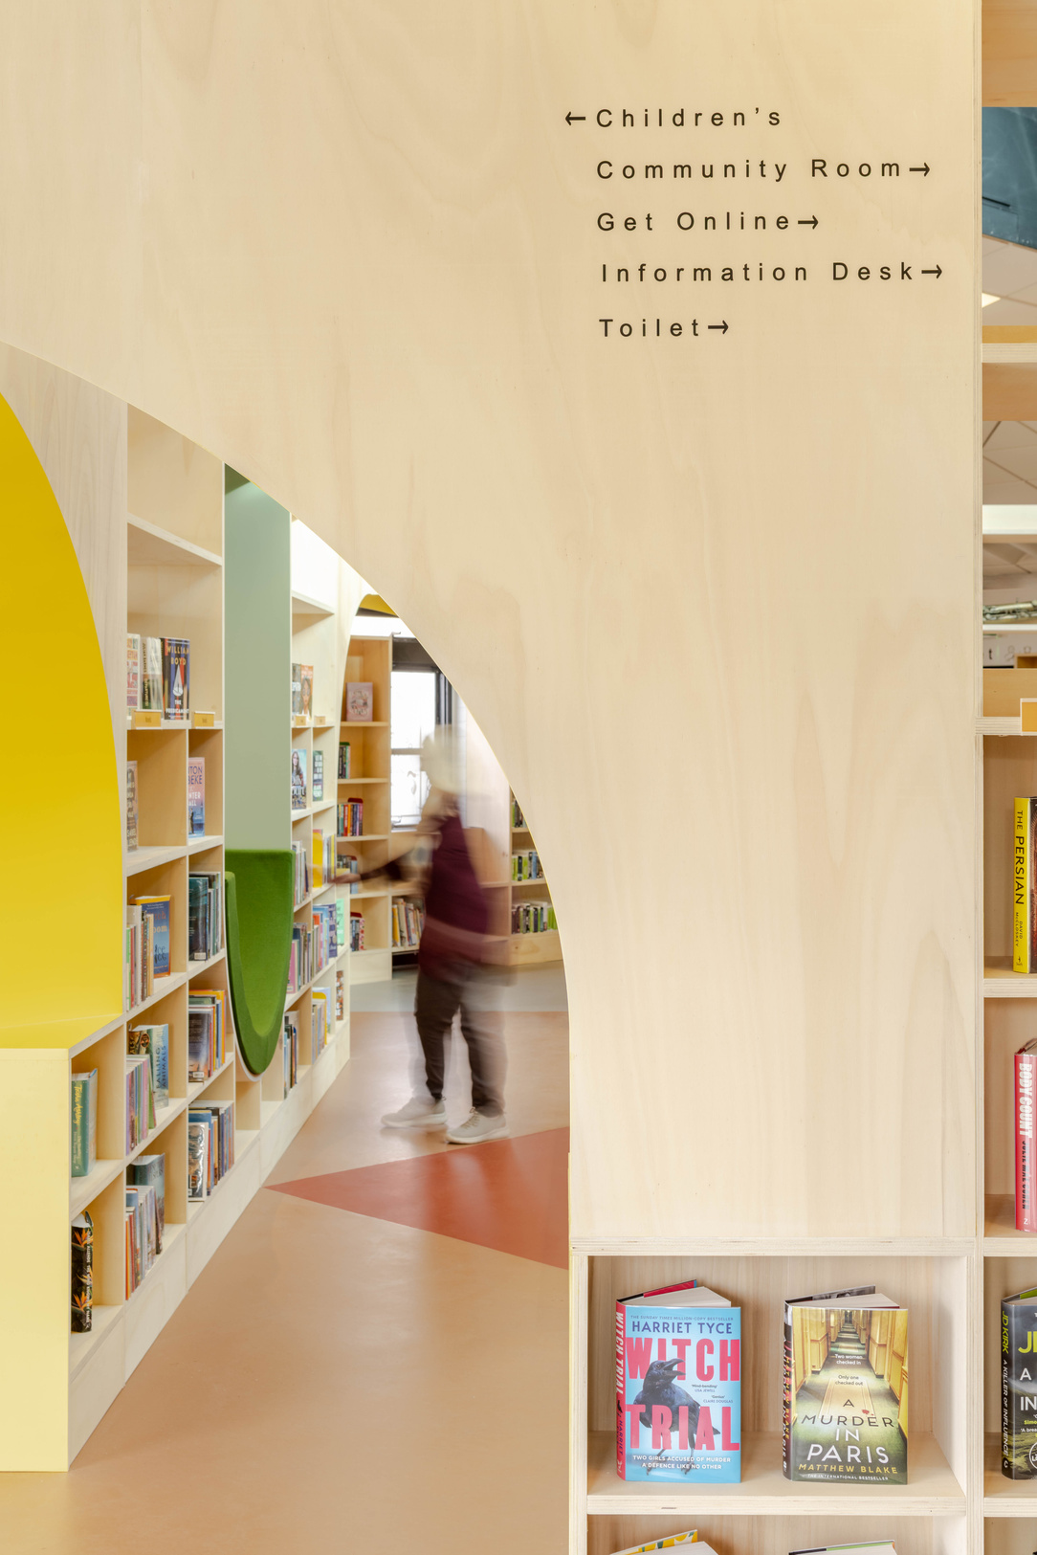
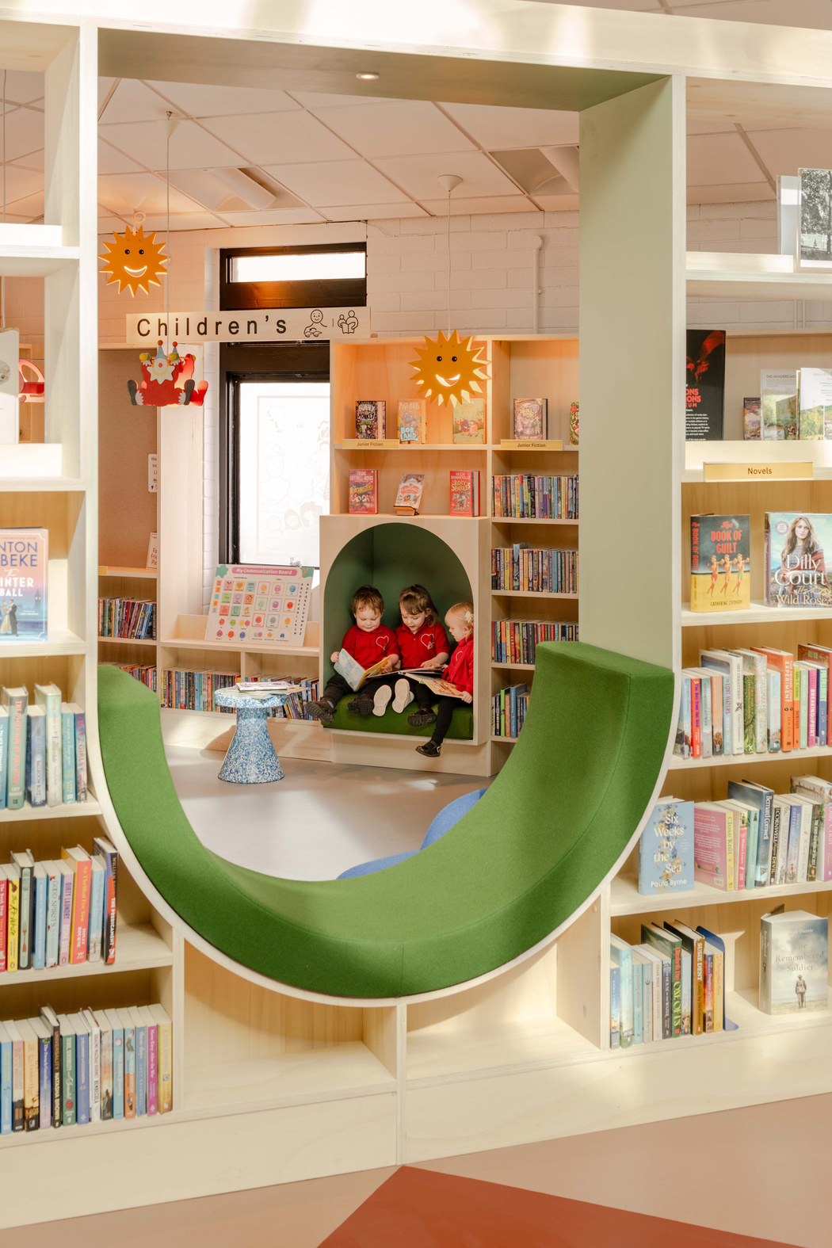
Summary: The Library as a Third Space
Not just a space for information: a space for connection, regulation, creativity and belonging.
Haydock Library, Images by FRENCH+TYE, 2026
Notes:
Emily:
Libraries are increasingly becoming community living rooms, places for social connection, regulation, support, creativity and intergenerational exchange.
That requires a different design language.
Not institutional neutrality, but emotional intelligence.
Not temporary flexibility for its own sake, but spaces people can identify with and feel ownership over.
We believe the future library must support many forms of knowledge, participation and human experience.

Slide 27
What might libraries become if there truly designed around human experience?
GET IN TOUCH
Dr Emily Peasgood
emilypeasgoodstudio@gmail.com
Ben Allen
studio@studiobenallen.com
All Haydock Library photographs by FRENCH+TYE
Notes:
Emily:
For us, inclusion is not a specialist feature. It is a way of thinking about public space altogether.
The question is no longer:
‘How do we make libraries accessible?’
But: What might libraries become if they were genuinely shaped around human experience, community identity and belonging from the beginning?
We have kept it short so there is time for a couple of questions. Please feel free to talk to us or email us if you have any questions.

