Slide 1

Designing Libraries Conference
17 June 2026
Swiss Cottage Library, London, UK
Philip Kent
Chair, IFLA Library Design Section

Slide 2

Over 1700 members including library associations, institutions and individuals from over 140 countries.
Well-established relations with the United Nations, UNESCO and other international organisations.
IFLA WLIC 2023 Rotterdam
Poster session, IFLA WLIC 2023, Rotterdam
A GLOBAL ORGANISATION

Slide 3
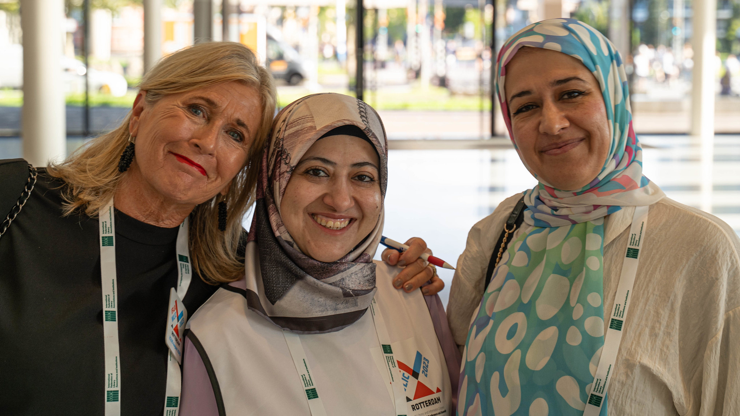
Sustainable futures for all through knowledge and information
IFLA WLIC 2023 Rotterdam
IFLA VISION

Slide 4
Libraries are connected and energized through vibrant, global professional communities
Libraries are recognised, respected and valued as partners
Libraries are enabled to deliver meaningful change at all levels
Future-proofing IFLA
IFLA Strategy
2024-2029
for all through
knowledge and information

Slide 5


Slide 6
Library Design Committee (23 members)
Australia, Canada, China, Czechia, Denmark, France, Jordan, Slovenia, South Africa, Uganda, USA, UK.

Slide 7
Library Design Section Action Plan 2025-2027
1. Diversity of Committee Membership
2. Relationships and partnerships with groups world-wide
3. IFLA Public Library of the Year Award (PLOTY) and associated activities.
4. Standards and guidelines for Library Design
5. Integrated Communications Program
6. Professional Development Activities
7. IFLA Centenary London 2027

Slide 8
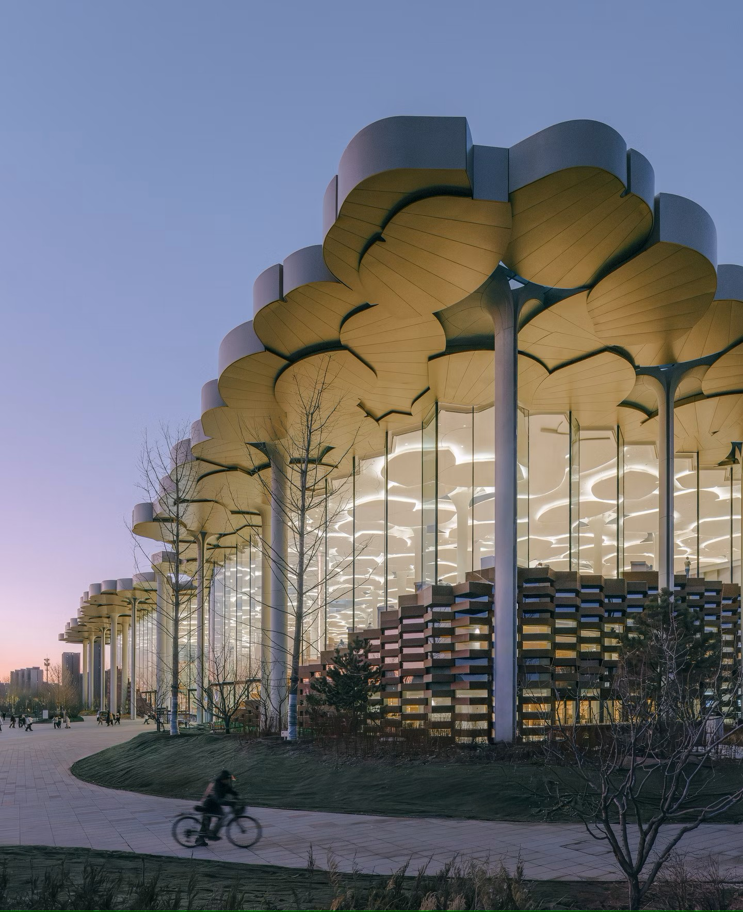
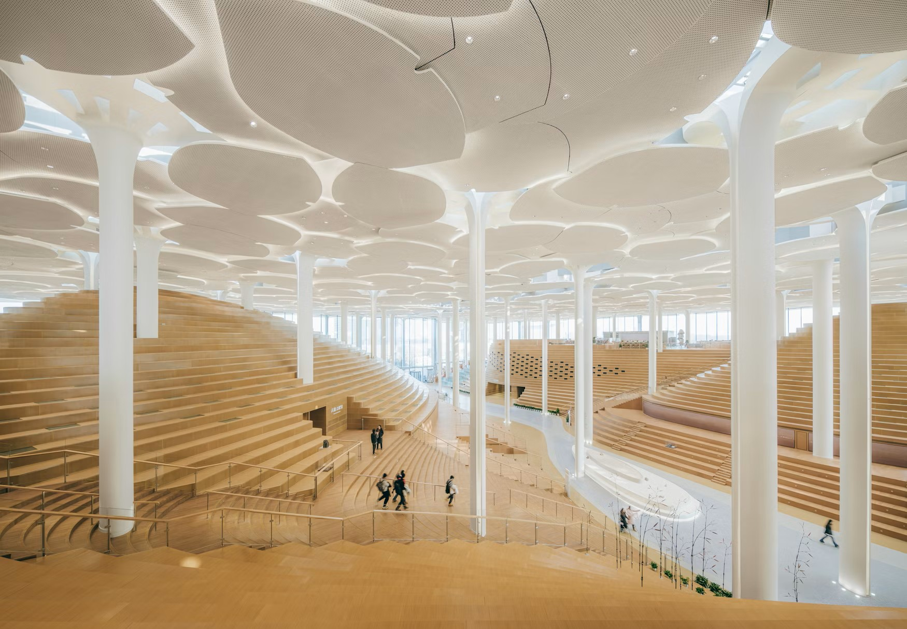
IFLA Public Library of Year Award
Beijing Library 2024

Slide 9
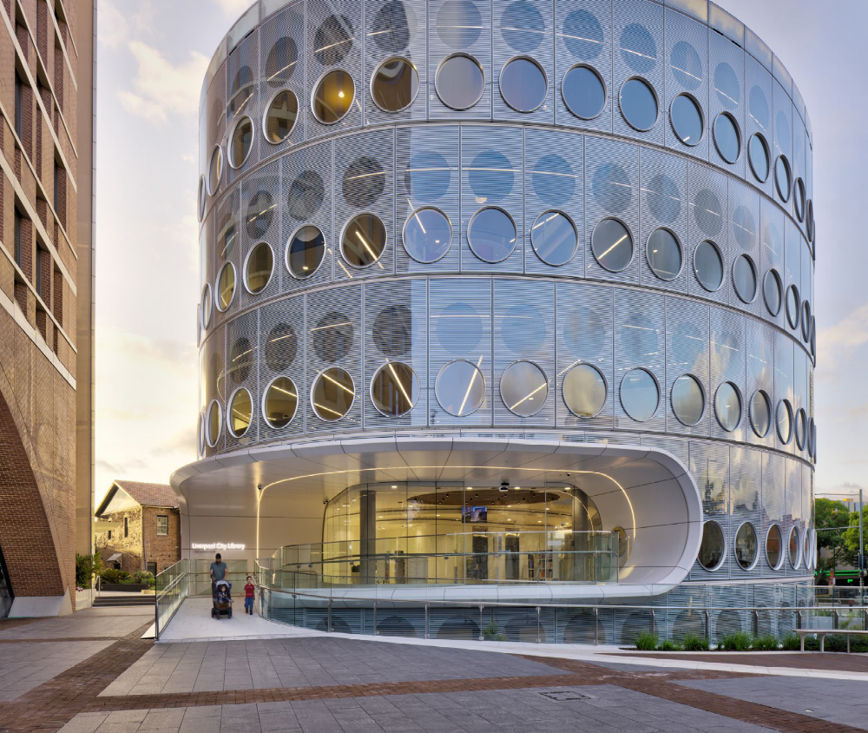
ALIA Library Design Awards 2026 – Public Libraries
Yellamundi Library & Gallery, Liverpool City Council, NSW

Slide 10
Common Themes in Library Design
An Analysis of the Design Characteristics of New Public Library Buildings. Wakeling et al (2026)
Aesthetics
Flexibility & Openness
Sustainability
Other Themes
Co-location of library and other public services
Next generation (incl sustainable) library and archival storage
24x7 access
Indigenous design principles

Slide 11
Thank You
philipkent1357@gmail.com
www.ifla.org/units/library-design

