Slide 1
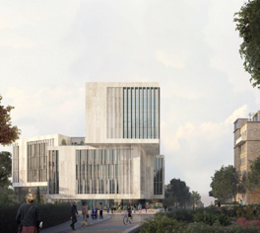
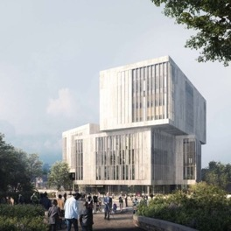
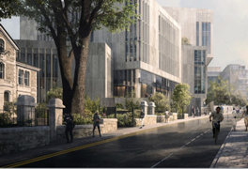

University of Bristol
New University Library
Ed Fay, Director of Library Services
Designing Libraries, June 2026

Slide 2

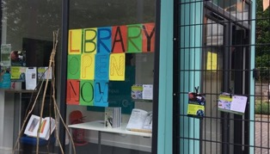
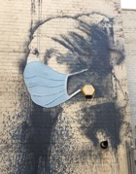
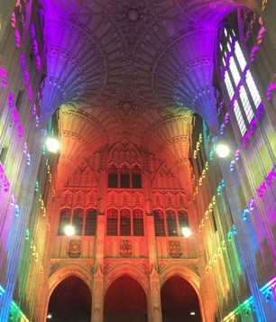
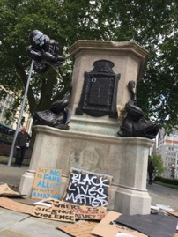


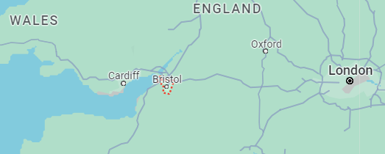

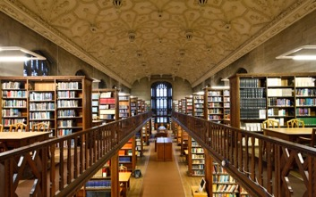
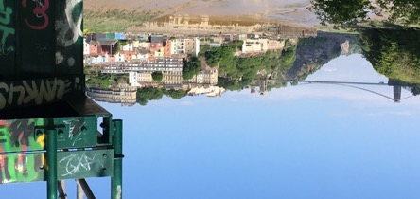
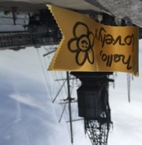
Notes:
Libraries are unique based on their history, culture, geography
(cf Roly Keating keynote – British Library, St Pancras expansion)
West Country, Wales, London >1hr
Brig-stow: “meeting place by the bridge”; cf Brunel’s famous suspension bridge (and SSGB)
Also known internationally: street art (Banksy) and the “Bristol Sound” (Massive Attack, Portishead)
Influenced by Jamaican sound system culture of the African Caribbean diaspora (St Paul’s Carnival)
Protest and activism
Colston statue, BLM June 2020; earlier: 1980s race riots,1960s bus protest → Race Relations Act 1965
University interrogated its own legacies of slavery → Reparative Futures programme, civic engagement
(also Greta, a city actively engaged with climate change, sustainability)
Libraries
Thirteen libraries, archives & museums, and study centres (18 locations in total)
Spectrum of spaces: FROM micro-campus shipping container TO gothic heritage “dark academia” (as seen in Netflix Sex Education, BBC Outlaws)
…this divergent architecture asks questions of the trust, authority, and privilege we design into the built environment…

Slide 3
Vision and Design Principles
01

Slide 4
A library empowers knowledge generation…
We connect people with ideas and each other…
Our library lies at the heart…
…enabling our community to meet, read, think, research, share, create new ideas, and make new discoveries.
…of a University of Bristol education, research, and civic endeavour.
Notes:
Key concepts: Empowerment, Connection, (“beating”) Heart
Interrogating “power”
Who do we empower? (from “neutral” → having “attitude” cf Reinert, Oslo public library)
As we are not neutral, what are we?
Inter-disciplinary? Yes
Third space (between curriculum and home)? Yes
Cultural institution in the life of the City? Yes
We should be a safe space, one that convenes and connects
That values diversity and centres freedom of intellectual enquiry
The cultural infrastructure necessary for inclusive debate and freedom of expression

Slide 5





Supporting well-being | a sense of relaxation and support
Inclusive and accessible | where diversity is valued
Inspirational | to delight and inspire innovation and creativity
Adaptable | seamless adaptation to new ways of working
Built to last | sustainable, contextual
Notes:
A place where people “meet, read, think, research, share, create new ideas and make new discoveries”
Supporting well-being
Innovations in design theory to create a sense of well-being, relaxation, and support
Fostering the psychological safety necessary to TRUST and ENGAGE with learning
Inclusive and accessible
Spaces that are accessible to all, where diversity is valued
Diversity of: learning preferences, global cultures, disabilities and neurodiversity
Inspirational
Spaces that create opportunities for intellectual pursuit and elevated thinking
Opportunities to encounter others and engage with the City and beyond
Adaptable
Over “long time”: new ways of learning and researching over a 50-100+ year horizon
And “short-time”: within individual learning journeys and rhythms of the academic year
Built to last
Lifespan AND signaling sustainability and dialogue with its surroundings

Slide 6
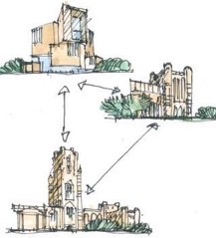
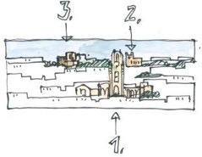
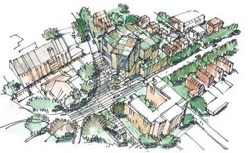
Landmark
Completes a trio of buildings
Context and Heritage
Addresses the wider cityscape
Integrates the urban landscape
Civic
A gateway to the University
Notes:
Context and Heritage
Contextually relevant and integrated with its surroundings
Historic context: conservation areas, and identity within the City skyline
Part of a key group of prominent civic and university buildings
Landmark
A true landmark has a significant historical, architectural, or cultural meaning
The role of the University in shaping the City, and symbol for the next 100 years
Civic
Library as connector: trustworthy hubs for knowledge creation, cultural hubs reaching out to their communities, partnership with external networks
‘Civic’ means togetherness, collaborating with shared purpose
…If we are creating conditions for connection, are we also facilitating situations…

Slide 7

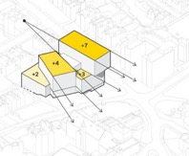
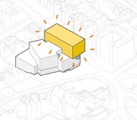
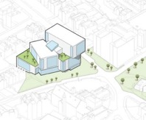
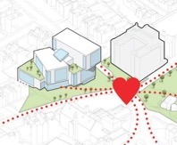
Development of the building form
Massing
Adjustment to scale
Address immediate context
Beacon
Architectural and conceptual landmark
Contemporary addition to the wider cityscape
Greening
Health and wellbeing
Sustainable landscape
Campus Heart
Becomes the beating heart
Notes:
Consultation
Librarian as “lead user” but really our requirements are defined by our communities
Engagement with: students, academics, residents, neighbours, community groups and target audiences, local architecture and design groups
Iterative development of the building form
Stepping & Fanning / Composition / Dynamic interplay of volumes
Massing
Mediates scale between domestic Victorian villas to the civic scale of Senate House
Beacon
Poised on the brow of a hill, the new library building is a gateway to the Clifton Campus
Bold, proud, and open, the building becomes a symbol of knowledge exchange, innovation and ideas
Key picture windows address 360 degrees of the surrounding and act as a signal to the city
Greening
Part of a wider urban landscape, connecting with Senate House, and providing a new civic square
The public realm extends into the ground floor of the library inviting the community within
Open terraces connect a high quality planted external environment to spaces throughout the building
Campus Heart
More space, more connection and more involvement for staff, students and the public
The library design is a place accessible to all where everybody feels welcome

Slide 8
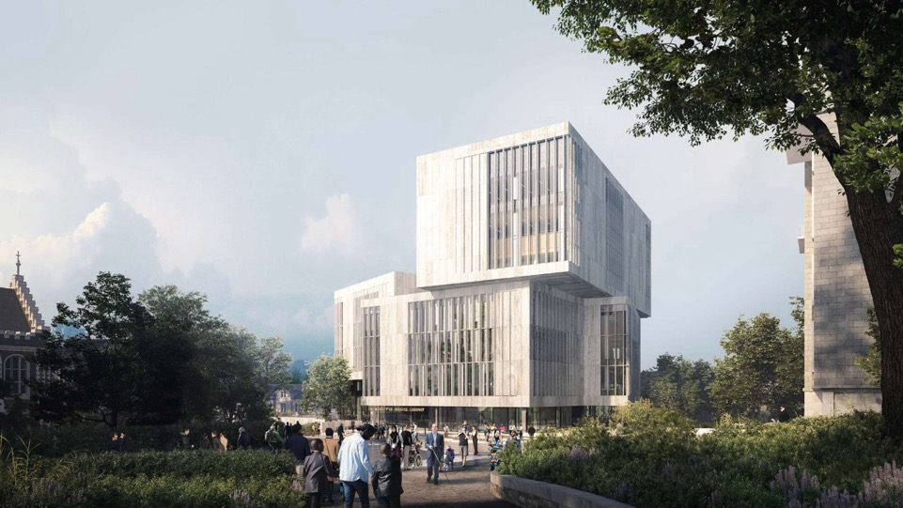
Notes:
Here it is…

Slide 9
Building Information
02

Slide 10
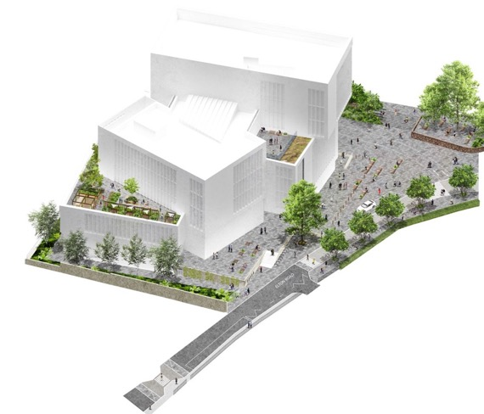
GIFA | 14,399 m²
Study Seats | 1,920
Books Open | 280,000
Mobile Racking | 100,000
Journals | 60,000
Cultural Collections | Passive Archive
Staff | 73 FTE
Environmental standard | BREAMM Excellent
Public ground floor
120 seat event space
2 exhibition galleries
40 seat café
Creative lab & maker space
Changing Places WC
Notes:
Building functions
Study spaces
Enabling the future curriculum and forms of assessment
Collections
Balance of physical and digital
Engagement with Cultural Collections
Services
People-centred expertise, digital-forward, integrated across the University

Slide 11
Roof mounted photovoltaics
Water efficient
fixtures and fittings
Highly efficient
building systems
Air source heat pumps recovers heat from computer servers
High performance facade
Designed to allow future layout and use changes
Atria to deliver daylight into the heart of the building
Enhanced ventilation levels
Biodiverse roof
terraces
Resilient to climate change
BREEAM Excellent
Drainage strategy to minimise impact
Cyclist facilities
Nearby public bus station
Notes:
Building sustainability
Minimal impact on the environment
University commitment to be Carbon Neutral by 2030
BREEAM (Building Research Environmental Assessment Method) rating of ‘Excellent’
Photovoltaics for electrical generation. Electric heat pumps for heating and cooling
Health and wellbeing of the occupants
High ventilation rates of fresh air
Enhanced daylight penetration
Material selections

Slide 12
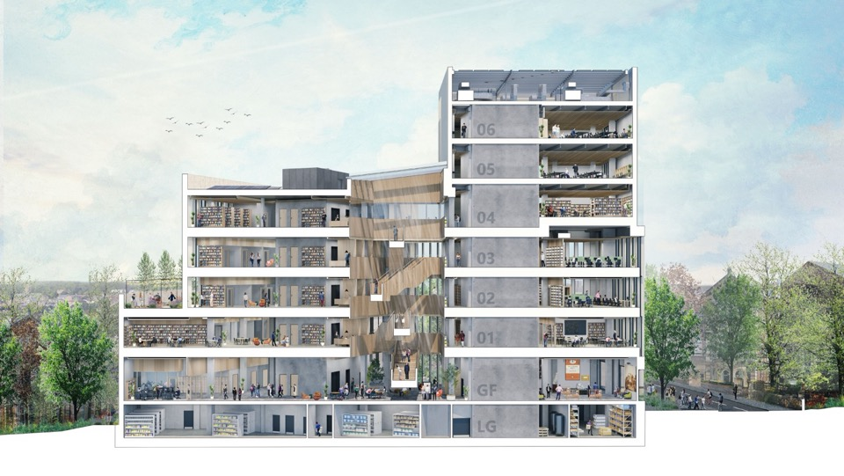
Notes:
Now the inside…
Basement: collections and digital facilities (AHRC and World-Class Labs)
Ground floor: public and open, inviting and welcoming
Level 1: security perimeter (24/7, urban campus)
Distributed through the floors: study and collections
Research(er) space: segregated by purpose not identity
Top floor: silent and inspirational views (flexible for events)

Slide 13
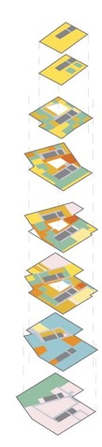
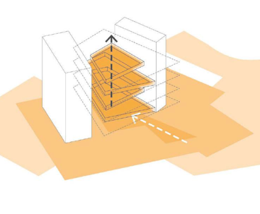

/7th Floor
(roof plant)
Services
Services
/6th Floor
(events)
Silent study
/5th Floor
Silent Floor
Silent study
/4th Floor
Collections Quiet study Collaborative study
Social study
PC
Services
/3rd Floor
Collections Quiet study Collaborative study
Social study
PC
Research
/2nd Floor
Collections Quiet study Collaborative study
Social study
PC
Research
Collaborative Study Spaces
Quiet Study Spaces
Staff
PC s
Social Study Spaces
Research Spaces
Library Collections
/1st Floor
Collections Quiet study Collaborative study
Social study Teaching
Staff
/Ground
Floor
Creative Lab Cultural collections Collaborative study
Social study
Public Access
Creative Lab
Centre for Cultural Collections
BOH Staff
/Lower Ground Floor
Collections
Cultural collections
Staff Services
Mobile Racking
Services
/Basement
Cultural collections
Services
Notes:
Centred around an atrium
Visible connections and legible navigation/accessibility
Natural daylight and ventilation to support sustainability and well-being
Study and collections distributed through the floors
Social and collaborative on the lower floors
Quiet/silent spaces increase as you progress up the building
Digital and SMART throughout
Human interface: accessibility, navigability, sense of ownership and permission
Technical interface: building management, efficiency, sustainability

Slide 14
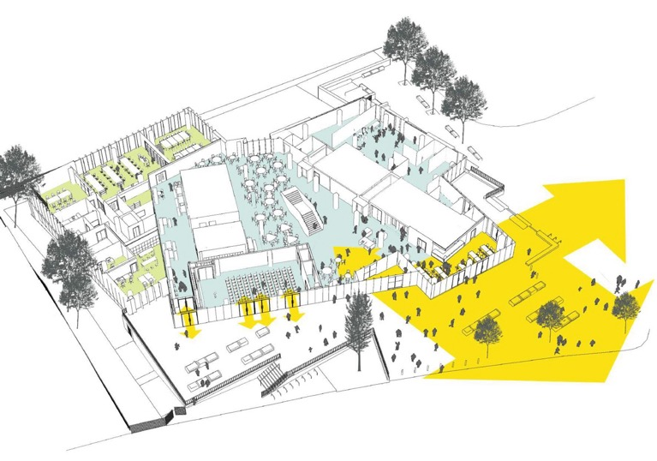
Cultural Collections Reading Rooms
Exhibition Spaces
Changing Places WC
Creative Lab
Senate House
Atrium
Cafe
Events
New Public Realm
“Libraries are vital spaces … What, I’m allowed in? I can just read and write? It’s such a gift, you don’t even have to be a student.” (Writer-in-residence, Centre for Cultural Collections)
Notes:
A powerful civic commitment from the University to the City
Public benefit, balanced with University need, heritage and conservation
Not just maintaining the status quo, but enhancing our lived experience
Addressing educational inequality and contributing to a sustainable city
Delivered through the Centre for Cultural Collections
World-class archive and museum collections with public art and exhibitions
Anchoring transformative learning experiences and opportunities for collaboration
“Traditional” reading rooms, augmented as virtual reading rooms and collaborative seminar spaces,
Creative labs and maker spaces (“wet to tech”) for research-led education and civic engagement
Public art, mediating inside/outside engagement, and externalising our collections and their encounters
We will animate sense of place, identity, memory and engage diverse communities
Audience development roadmap – SPECIFICALLY, how does this make a difference to ACTUAL people
Our pilots: Virtual Museum (curated by Young Bristolians 14-24), Making a Scene (reaching young offenders with creative technologies), Pinney Papers (reinterpreting historical narratives with local Black communities and Bristol Museums)
Narratives of authority and trust: what voices are welcome, how do we co-curate and co-create
WRITER-IN-RESIDENCE QUOTE
Deanna Rogers: young woman of Black heritage, now an established poet and author
Kevin Elliot endowment: collections residency for under-represented groups in creative arts

Slide 15
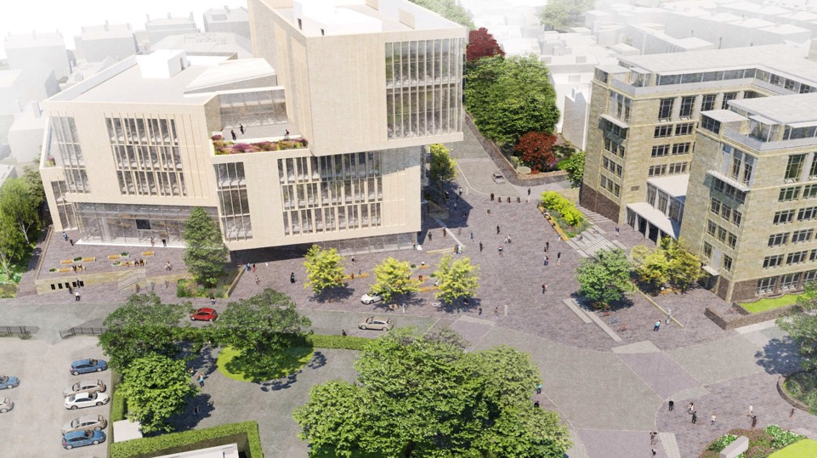
Notes:
Senate House as Student Centre
Complementary spaces to New Library
The other half of a holistic vision for Campus Heart
Responsive to student need and hugely successful
Food hall
SU living room
Global Lounge
Study Skills Hub and PhD Hub
Study spaces (social and focussed)
Student Services
Faith rooms

Slide 16
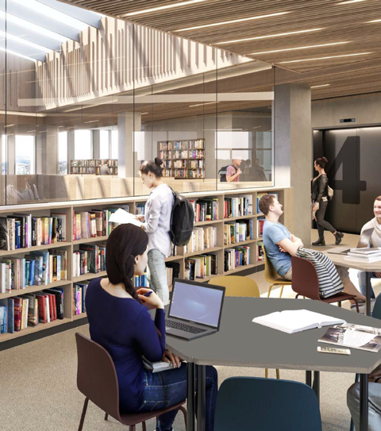
Post-pandemic design review
Diversity of blended learning styles
Digital-forward services and learning content
Cross-university approaches to digital inclusion
Open research and virtual reading rooms
Social inequality, isolation, and digital divide
“The digital divide is growing … these facilities would change this narrative, enabling all students, especially the marginalised and disadvantaged, to access the equipment critical to academic success.”
(Bristol Scholar, statement to planning committee)
Notes:
We stress-tested the design and found it to anticipate accelerated trends. We made minor adaptations to the distribution of study and research spaces, digital scholarship facilities, and creative maker spaces.
Social inequality and isolation
Digital poverty and exclusion
Education and Student Experience
Office for Students (pandemic research)
71% lacked access to quiet study space
52% impacted by slow/unreliable internet
18% without access to a computer
From “blended” curriculum to ACTIVE LEARNING and AUTHENTIC ASSESSMENT
Spaces for collaboration and connection, digital-forward services and learning resources
Cross-University approaches to well-being and inclusion, personalisation and cultural inclusion
Research and Innovation
People, culture, and environment—research data, engagement (students/city)
Digital scholarship—virtual reading rooms, digital methods (AR/VR, 3D, A/V)
Research space—segregated by purpose not by identity
Civic
Increasing diversity of student population (widening participation, skills)
Local/regional/global partnerships – University FOR Bristol (not just OF Bristol)
BRISTOL SCHOLAR QUOTE
Ethan Osborn-Clarke: young man of Black heritage, local community with low rates of progression to HE
Hugely eloquent public statement to the City planning committee about the accentuated need for the New University Library amongst the most “marginalised and disadvantaged”

Slide 17
Nice Pictures ☺
03

Slide 18
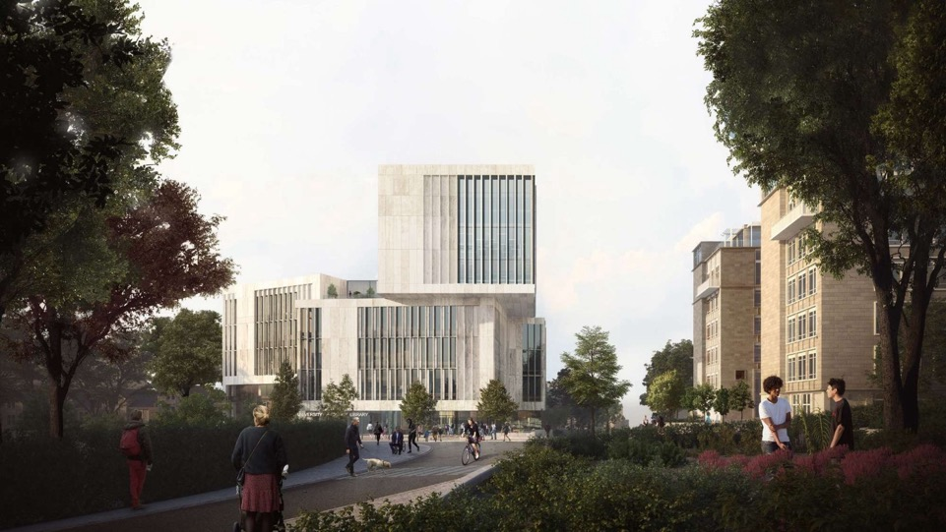
Notes:
Human-eye view…

Slide 19
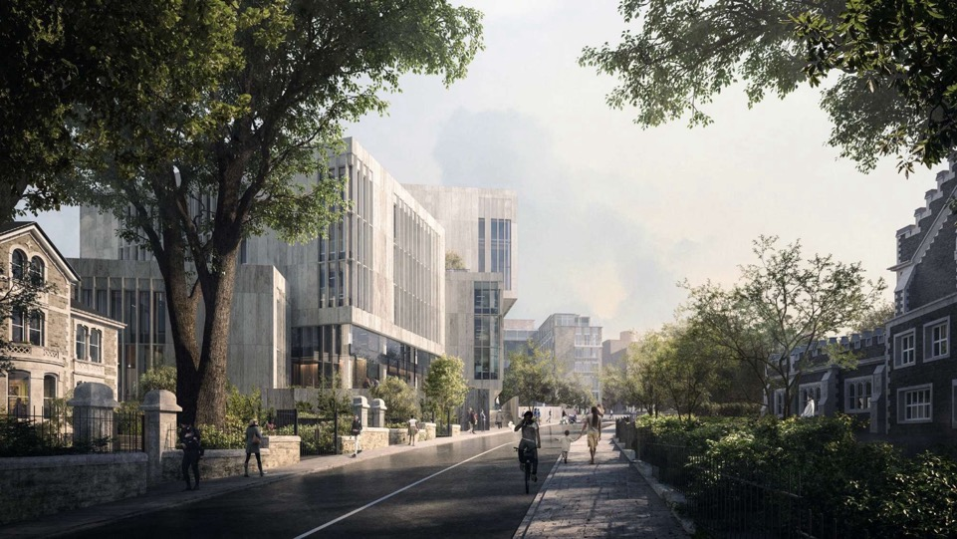
Notes:
Mediating the scale of the urban gain…

Slide 20
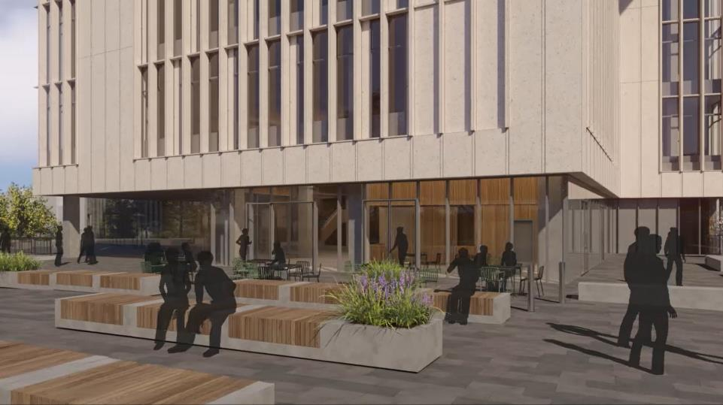
Notes:
Let’s go inside…
Main entrance ahead and low-distraction entrance to the left-hand side for neuro-diversity

Slide 21
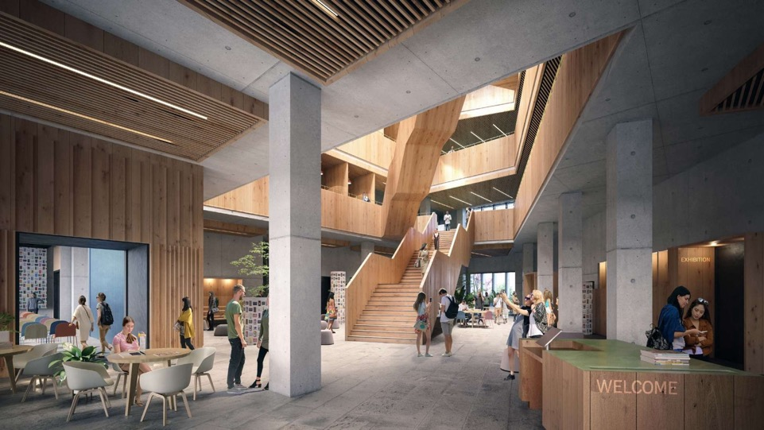
9
Notes:
Spaces that are open to all…
Welcome area
Event space to the left
Exhibitions to the right
Reading rooms to the rear
Creative lab and maker space
Security perimeter on the 1st floor

Slide 22
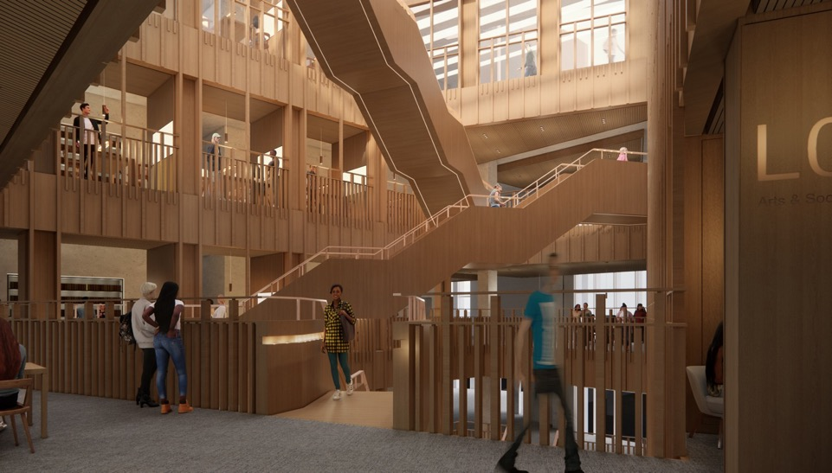
Notes:
Spaces for connection, encountering, togetherness…

Slide 23
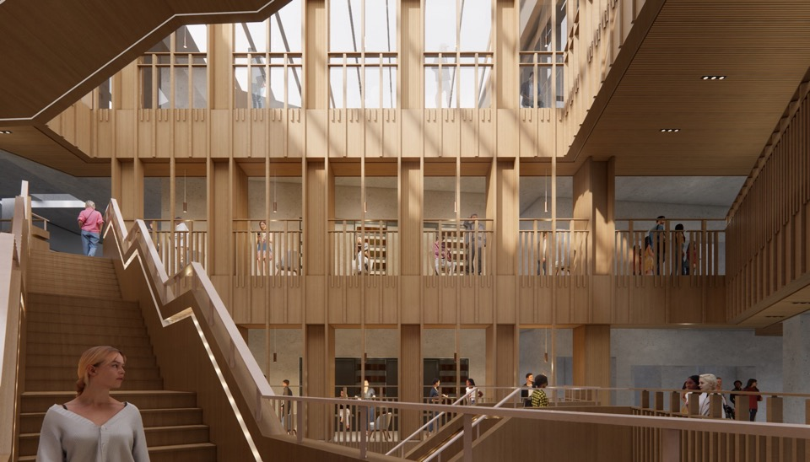
Notes:
Spaces for inspiration and connection…

Slide 24
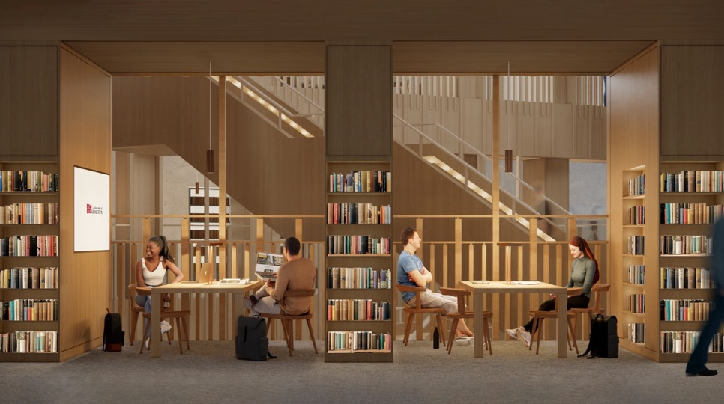
Notes:
Spaces for collaboration, partnership…

Slide 25
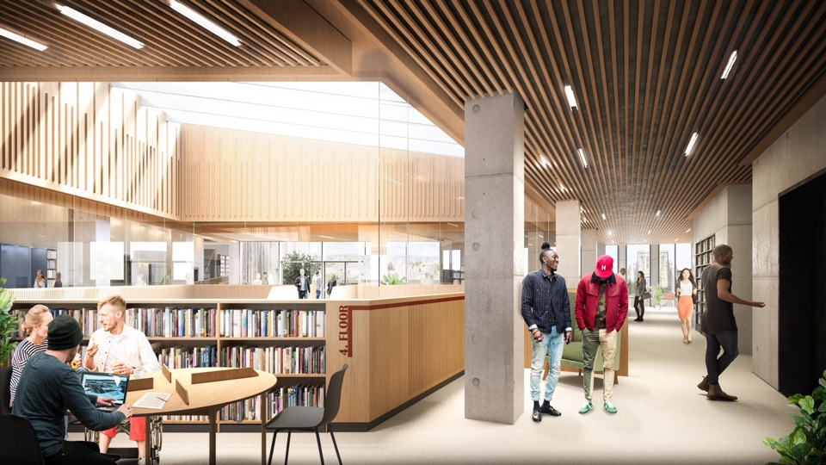
Notes:
Spaces that are open to the City and beyond

Slide 26
