Slide 1
Key Challenges in Library
Design
Karen Latimer
Chair Designing Libraries Advisory Board

Slide 5
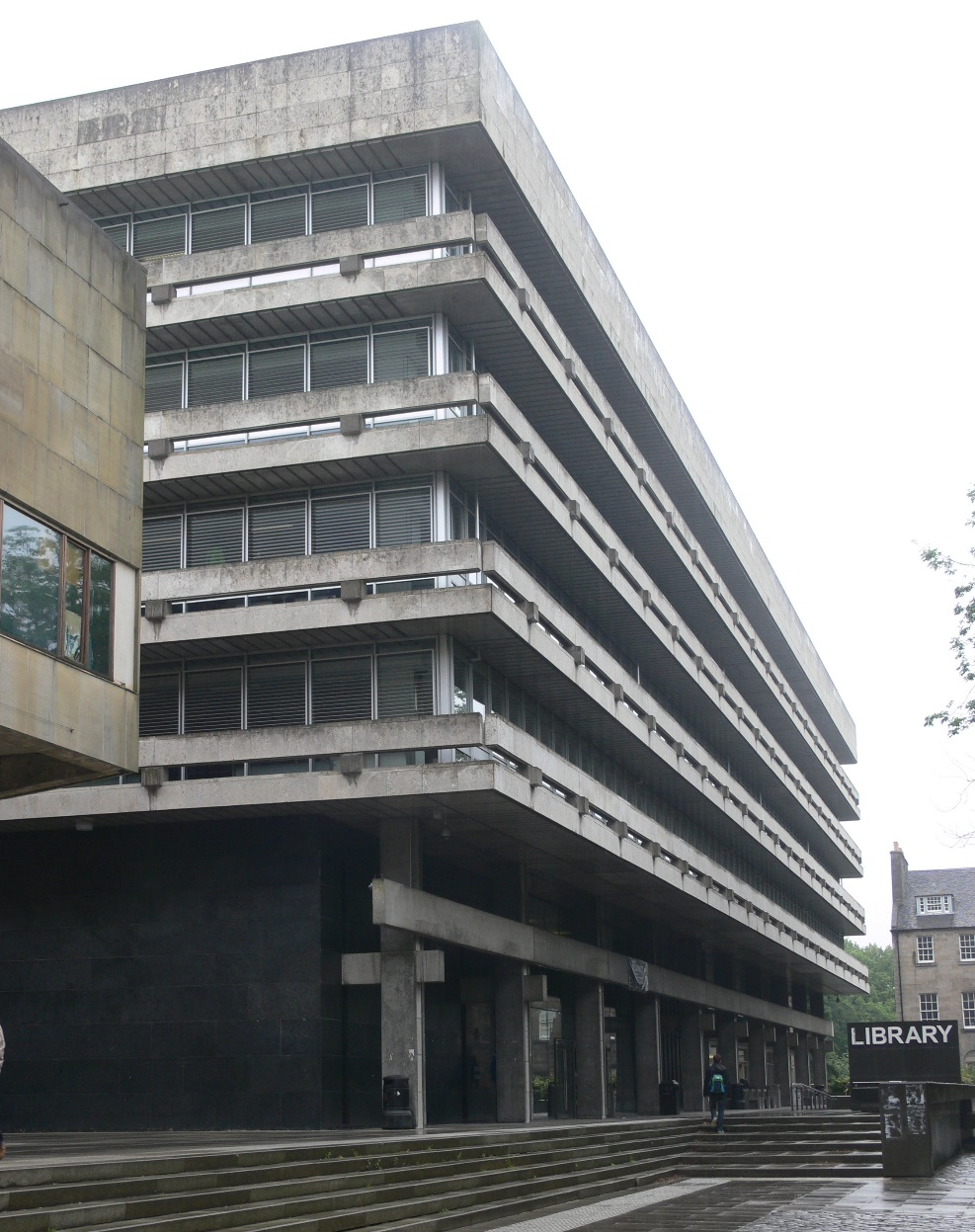
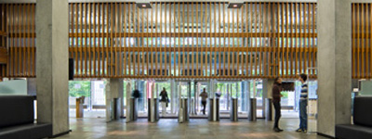
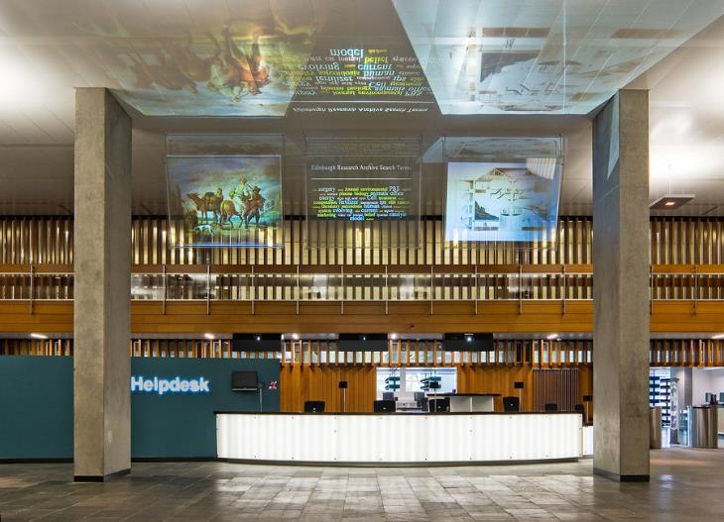

Slide 6
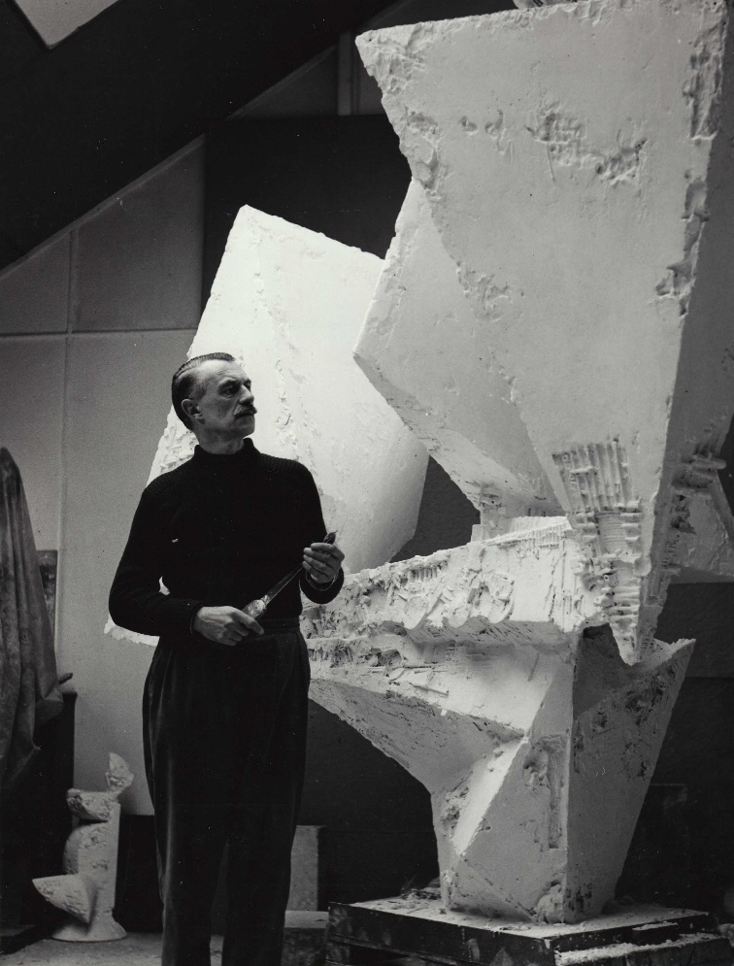
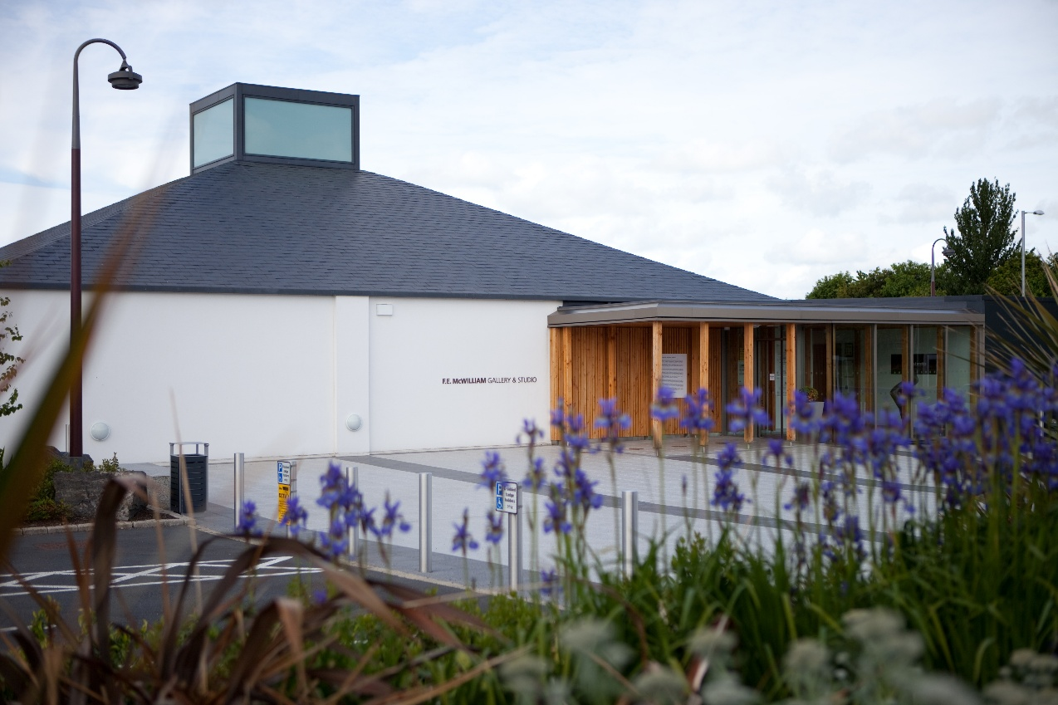

Slide 7
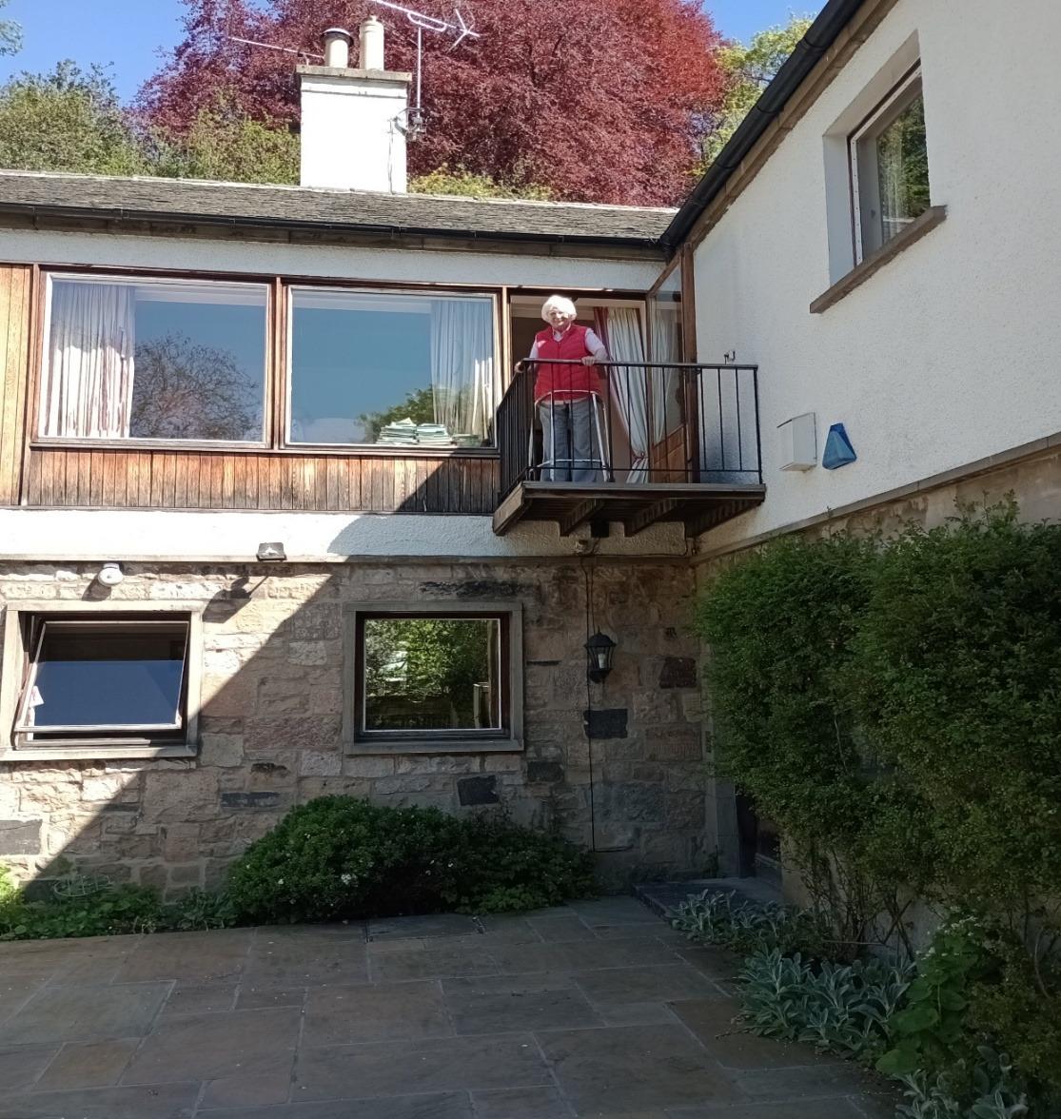
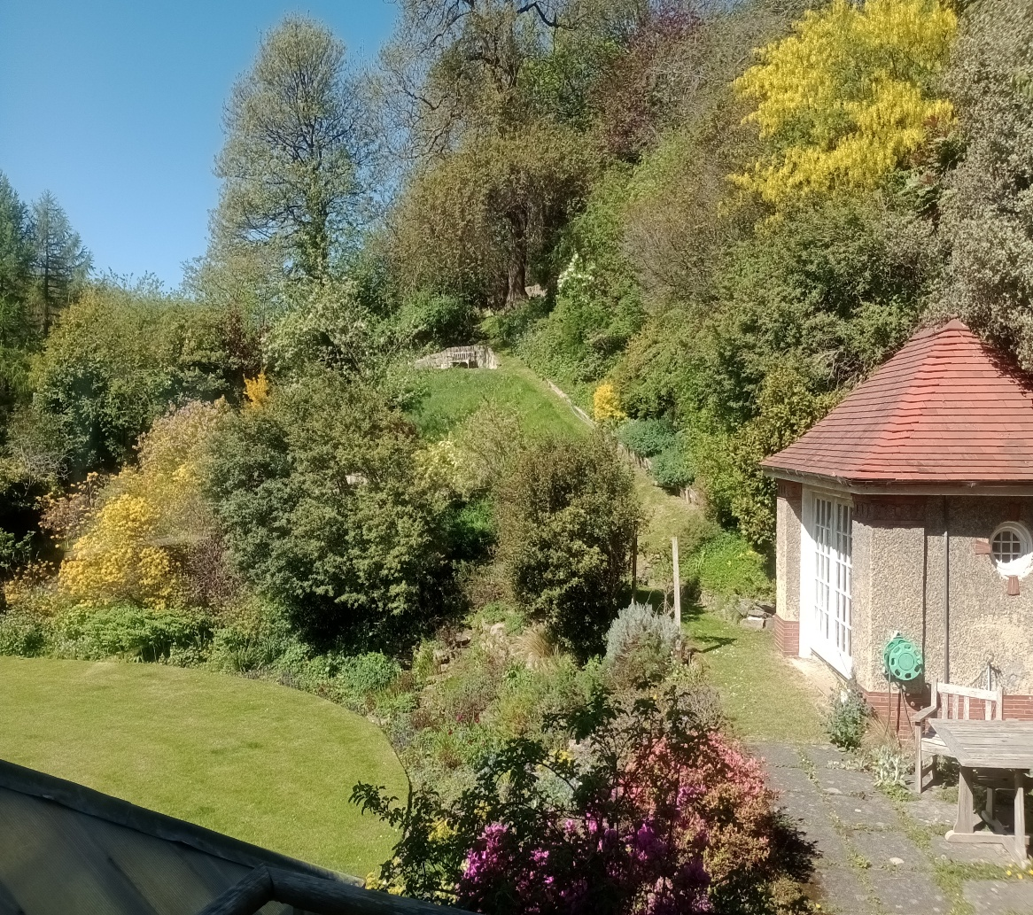

Slide 8
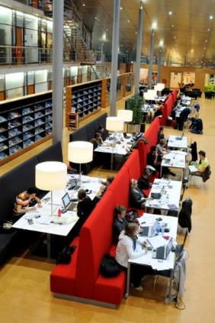
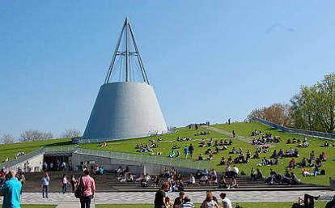
Delft Technical University

Slide 9
Outline
Challenges at key stages in library building projects
  The vision
  Writing and developing the brief/programme
  Final stage :from vision to reality
  Post-occupancy evaluation

Slide 10
Challenges : Vision
Balance : a vision can be as vague as a dream or as precise as a goal or mission statement
Imagination and knowledge; learning, fun
Discuss, engage, communicate
Hold firm to the vision but be flexible

Slide 11
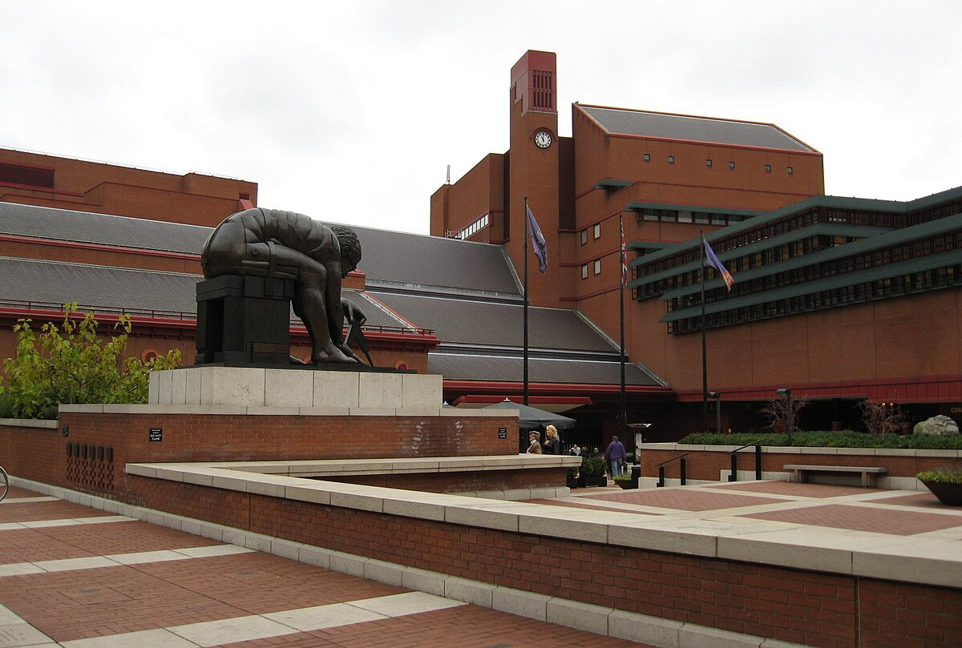

Slide 12
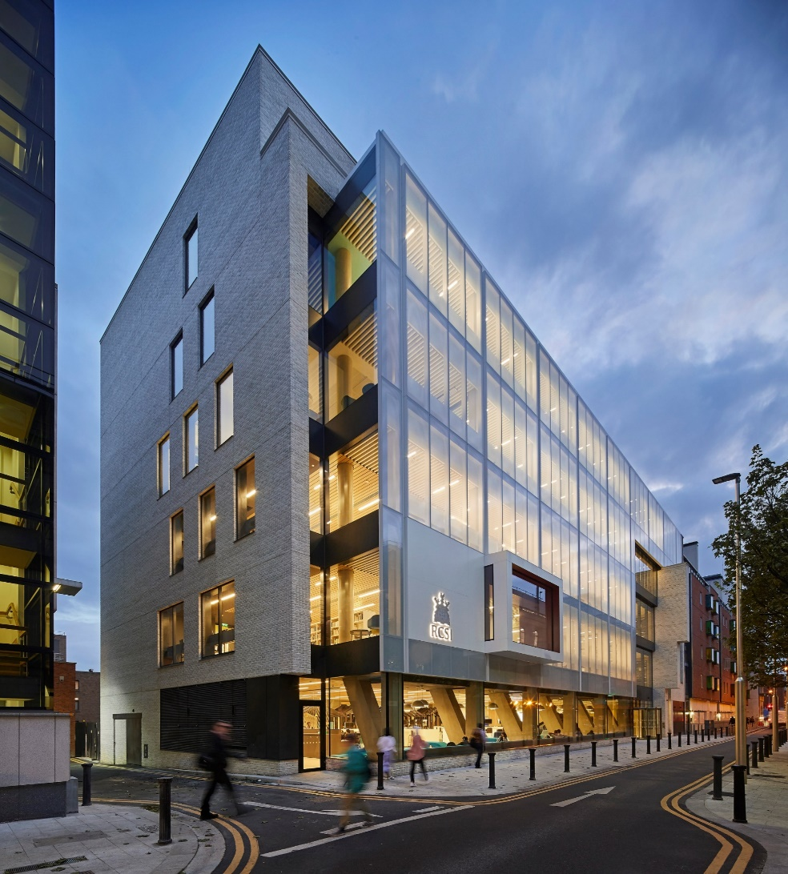
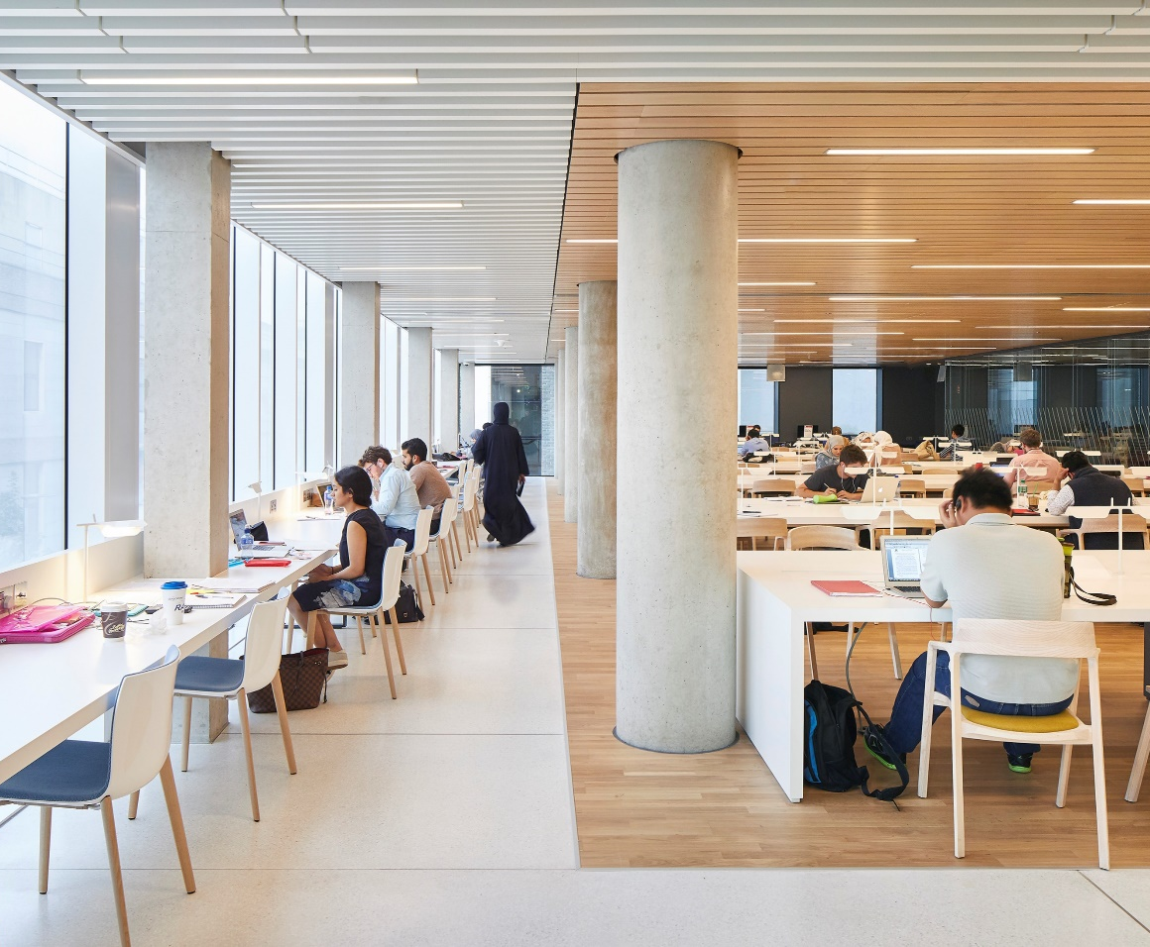
RCSI Library, Dublin

Slide 13
Vision: British Library
“Libraries should aim to be uplifting, innovative and inspiring cultural, social and intellectual spaces, encouraging debate and collaboration, and desirable as places to be in, even in the age of ubiquitous internet access.”
  Dame Lynne Brindley

Slide 14
Vision: RCSI Library
Create a vibrant state of the art learning space
Provide a range of learning spaces (individual/group/formal/informal)
Be user-centred
Support different needs (visual-verbal, social-solitary)
Get the basics right (WiFi/lighting/power points etc)

Slide 15
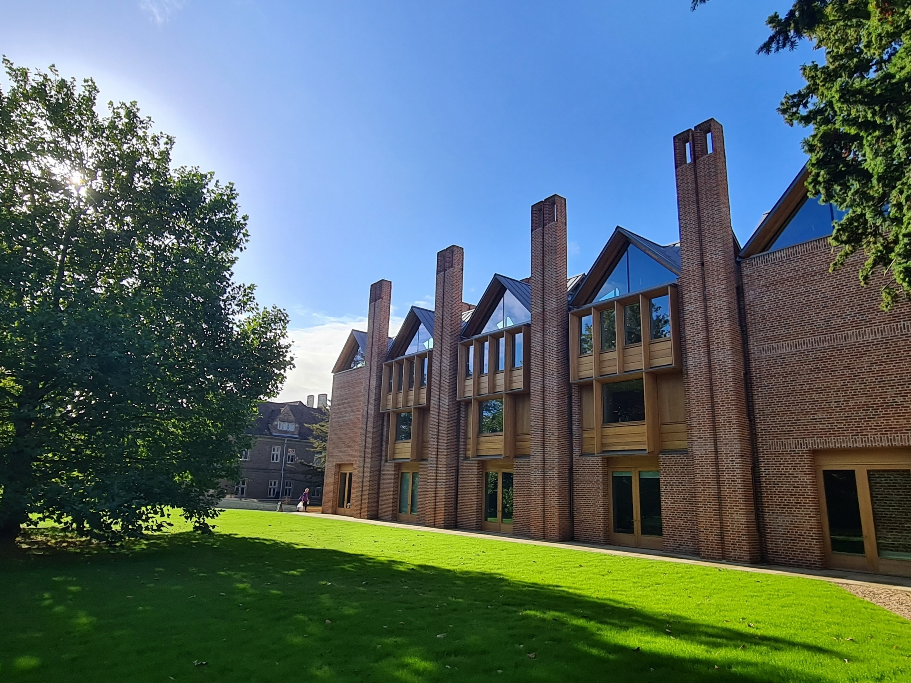

Slide 16
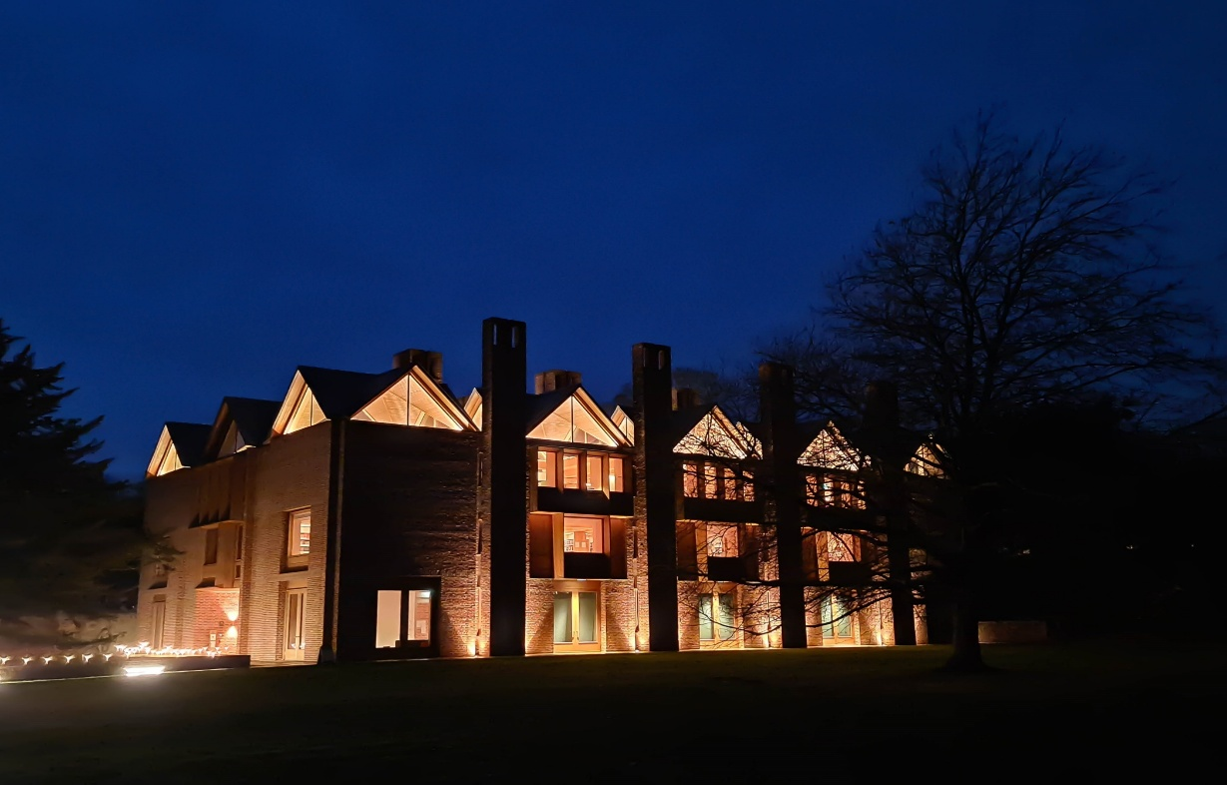
Magdalene College, Cambridge. Niall McLaughlin.
On a starry night, this warmer glow meets the eyes of those emerging from dinner as a lure to scholarship

Slide 17
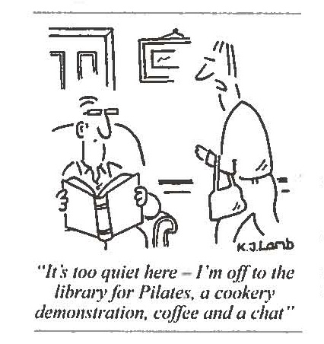

Slide 18
Programming Challenges
Think about:
Balance between past data and creative view of future
Functionality v iconic landmark
How to capture the minds & values of users
How does space enhance well-being
What do good digital spaces look like?
No one size fits all – horses for courses

Slide 19
Programming: guiding principles
Everyone feeds into the process – users, potential users, staff
Align with wider goals & strategies, articulate the vision, stick with it but be flexible!
Learn to read prelim plans – ask questions, walk/fly through
Well-designed space enables good service; poor spaces limit developments

Slide 20
Developing the brief
Identify users/potential users and their various needs
Engage with users – ask, observe
Look at strengths & weaknesses in current space and service - mind the gap
Envisage future services & delivery
Don’t forget staff spaces
Communicate throughout

Slide 21
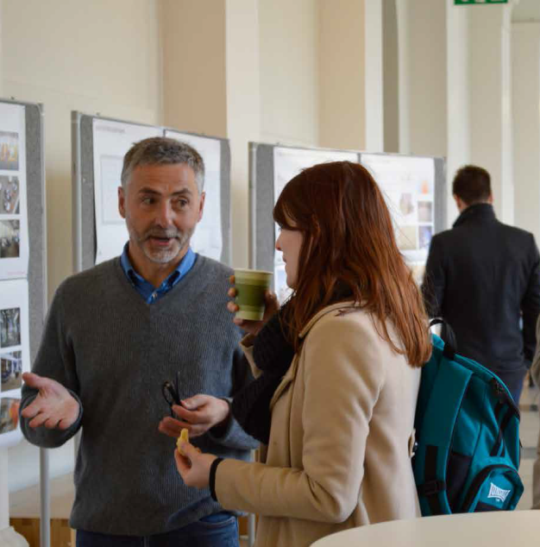
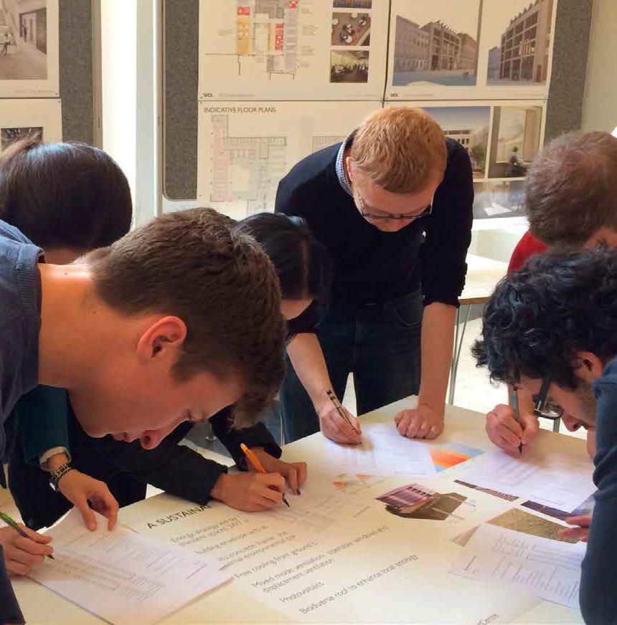
Notes:
Example

Slide 22
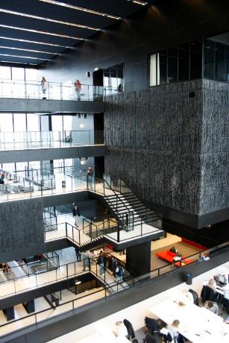
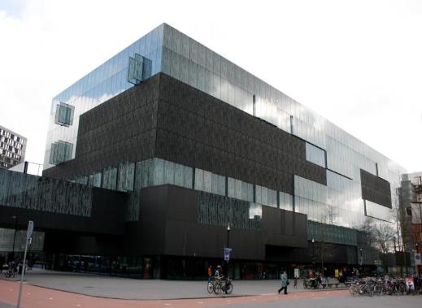
Utrecht University

Slide 23
Trends
Consider trends but be wary
One size does not fit all
Have a clear vision for your library
Does the trend align with your vision?
Know your users
Look at successful libraries/learn from others

Slide 24
Fred Schlipf’s deadly sins!
Wrong location
Poor lighting
Inflexibility
Noise (in wrong places)
Insufficient workspace
Complex maintenance
Security issues
Poor HVAC

Slide 25
Advisory Board Discussion
Co-location
Open library
Community spaces
Well-being/sensory rooms diverse needs
Indoor/outdoor connections
Sustainability – biophilic design
Technology – robots, makerspaces etc
Multi-use
Flexibility

Slide 26
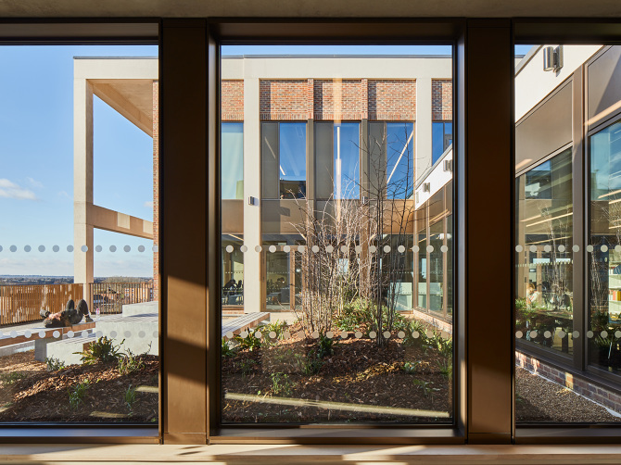

Slide 27
POE challenges
The time and the will – fear of failure
Librarians used to like measuring – loans, acquisitions, visits, enquiries…
Now need to measure outcomes - service quality, learning benefits, community wellbeing, user satisfaction
Need to show better space encourages more and diverse users and enables better service, better learning and a better experience

Slide 28
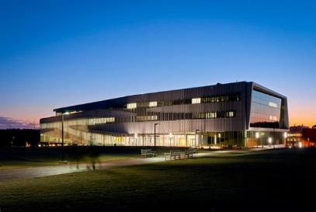
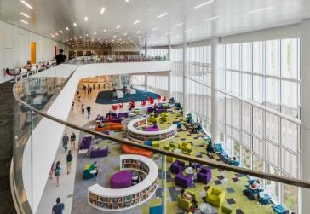
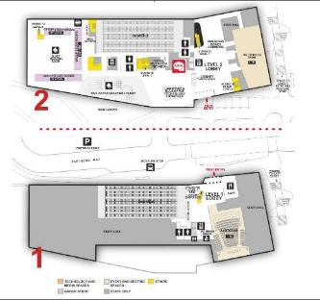
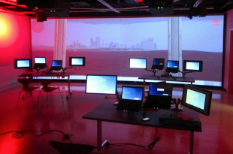
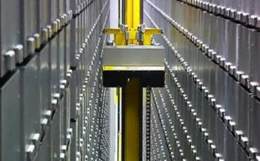
James Hunt Library, North Carolina

Slide 29
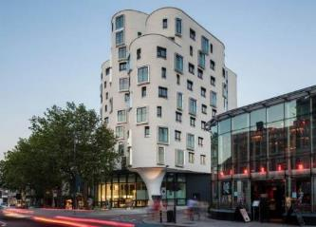
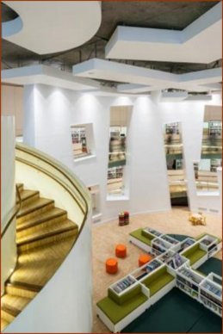
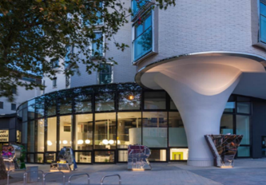
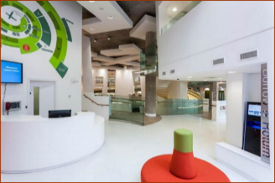
Clapham Library, London
Notes:
All photographs of Clapham Library are copyrighted to Gareth Gardner

Slide 30
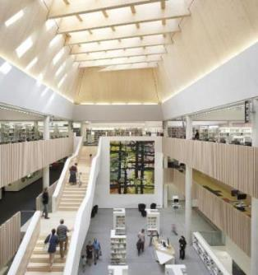
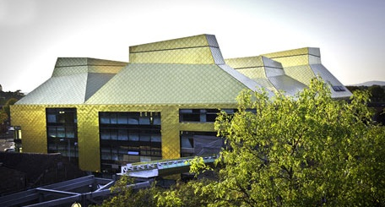
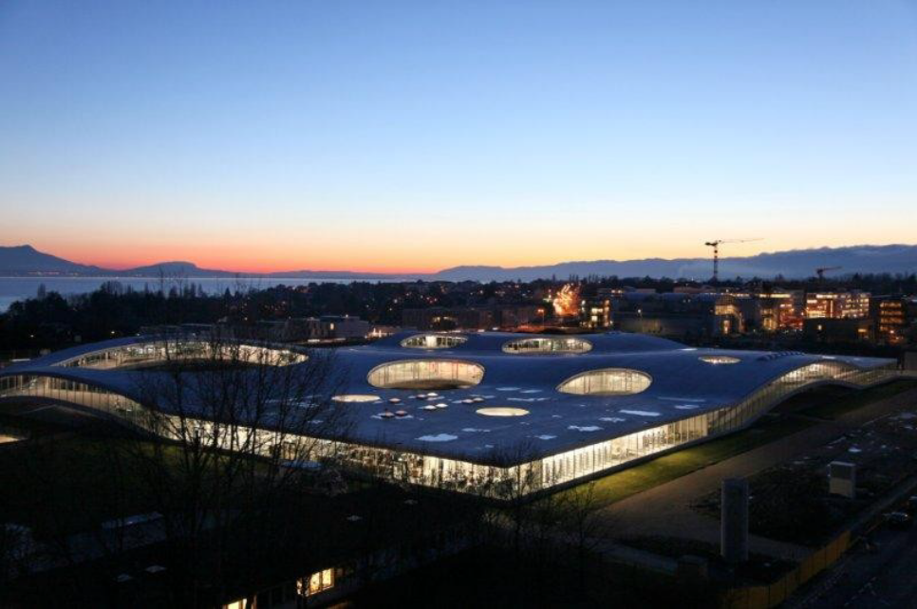
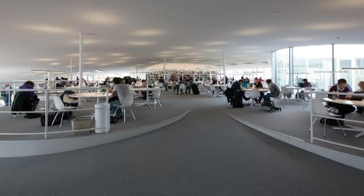
The Hive & Rolex

Slide 31
Final Stage Challenges
Leadership – hold to the vision
Troubleshooting , unforeseen demands – pick your battles
Evaluate time and costs v new opportunities
Decisions, decisions, decisions – furniture, signage etc
Keep communicating with everyone
Plan the move, plan the opening
Exhaustion and (we hope) euphoria

Slide 32


Slide 33
POE tools & approaches
IFLA POE questionnaire, focus groups, surveys , map users etc
Use a consultant?
Check against brief
Welcoming, safe, attractive
Enough of the right spaces and right adjacencies
Easy to find your way around
Flexible and open to change
Anything you would change?

Slide 34
Libraries anchor communities. They are places for both individual development and social engagement.
Good design elevates any project with a thoughtful process that delivers both beauty and function in balance.
Dahlgren, A and Forrest, C. Eye-popping, show-stopping libraries. Rowman & Littlefield, 2022.
Thank you for listening
KAREN LATIMER
K.Latimer@qub.ac.uk

