Slide 1
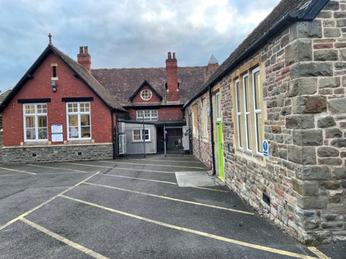
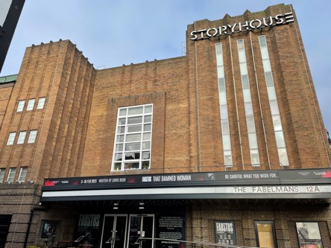
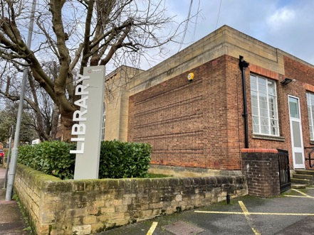
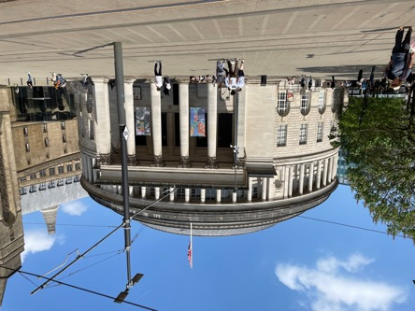
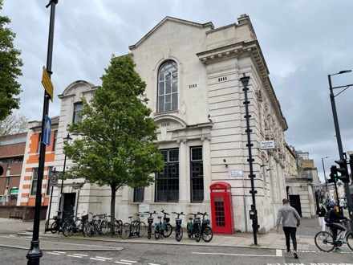
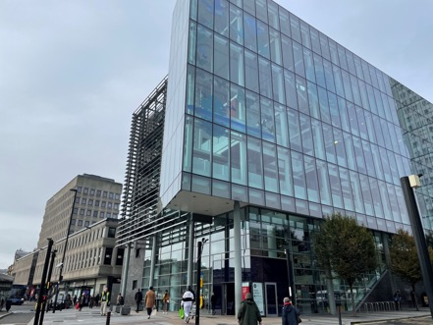
Libraries and Placemaking
Laura Dyer, MBE
Deputy Chief Executive, Places, Engagement & Libraries
Arts Council England
Notes:
Should point out the rest of the photographs in this presentation are of libraries funded through the Libraries Improvement Fund.
These photos give a flavour of the range of libraries in England

Slide 2
What we’ll cover today
Introduction
Libraries and placemaking
Libraries Improvement Fund (LIF) Rounds 1-4
Libraries Improvement Fund Round (LIF) 5 (Current round)
Future Rounds
Notes:
Introduction-
Arts Council England is the national development agency for public libraries in England having taken on responsibility for them when the Museums, Libraries and Archives Council (MLA) was disbanded in 2012.
The Arts Council’s role is to develop and advocate for libraries using our experience to support and encourage their development.
Our national role means that we are well-placed to stimulate debate and offer support to the development of public libraries through funding, advocacy, and collaboration.
Our libraries team are champions in the sector across all 152 local authorities.
We work closely with the DCMS Libraries Team who inform policy and support the Secretary of State in their duties under the Public Libraries and Museums Act 1964. The Arts Council and DCMS play complimentary but distinct roles: we support services with development and manage challenges, DCMS enforce the public library act.

Slide 3
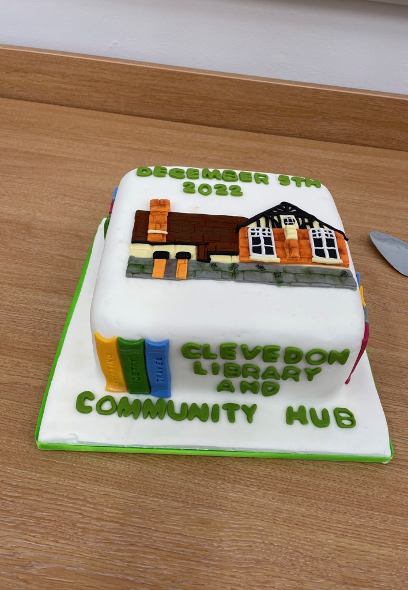
Libraries and Placemaking
Opening of Clevedon Library and Community Hub, North Somerset Council.. Photo by Luke Burton
Notes:
Throughout this presentation all the pictures are of projects that have been funded through one of the Libraries Improvement Fund rounds.
For simplicity I will also refer to the Libraries Improvement Fund as LIF which is the shorthand we use.
Although this picture may not be of a library it important to point out that an integral part of any library opening, LIF funded or otherwise is cake!

Slide 4
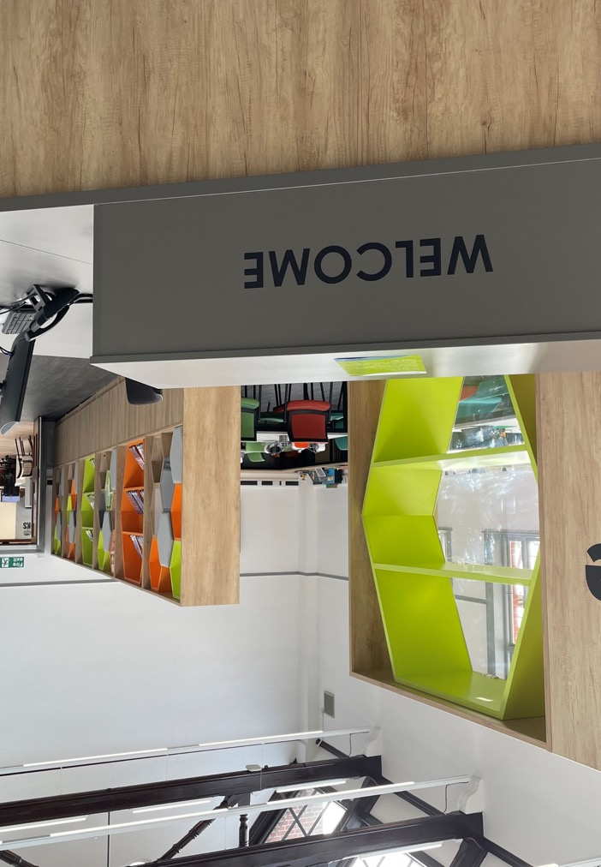
Libraries and Placemaking
Creative inclusive civic spaces
Reducing inequalities
Hubs for local services
Encourage community participation
Safe and adaptable public spaces
The Hive at Darlington Library. Photo by Luke Burton
Notes:
Creative and inclusive civic spaces
-Libraries are often the only free to access space left on high streets and in communities (no expectation to spend money)
-We know that libraries are many people’s first or inly cultural experience
-They do a lot of heavy lifting for culture and creativity for under-5s- think of the craft or story sessions on a wet Tuesday morning
Reducing inequalities
-At the heart of public libraries is equity of access to knowledge and information
-Libraries are safe trusted spaces staffed by trusted and knowledgeable people
-Libraries lower barriers to access and inclusion.
-People may worry about visiting a doctor or business support centre or feel that a large theatre or cultural venue is not for them
-Not to say there are no barriers but they are lower and libraries engage beyond the buildings (placemaking doesn’t just happen in the library)
Hubs for local services
-Co-location of services has increased to provide joined out services in communities
-It has also been driven in part by the need to make the most from public spaces including revenue generation
-We know people will come and ask anything and everything in libraries
-As I have said, in many places they are the front door to many council and community services
-EG- Newcastle City Library has council employment support, Equal Arts (creative charity), Citizens Advice and UK Visa and Immigration Service
-EG- Barking Library includes a Library of Things, a council one stop shop, access to showers and clothing for people experiencing homelessness
Encourage community participation
-Libraries provide opportunities to see events and participate in programmes that are delivered by people from their communities
-They see themselves represented in the activities and opportunities at libraries
-Libraries across the country support communities as Libraries of Sanctuary: “a network of librarians, library staff, community groups and book lovers who are raising awareness of the issues facing people in the asylum system, offering support and participation opportunities, and contributing to a culture of welcome in the wider community.”
- As you will see in some of the upcoming examples libraries provide adaptable spaces that can be used for performances, author events, celebrations or even in as we have seen in Leigh, Bradford and Wimbledon- wrestling!

Slide 5
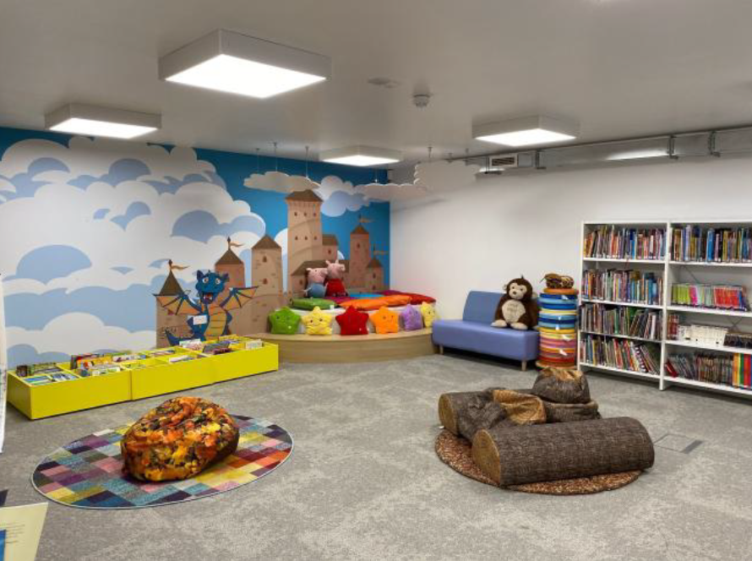
Libraries and Placemaking
Supporting placemaking partnerships
Support health and wellbeing
Digital inclusion
Part of/catalyst for regeneration
Social/Cultural/Digital infrastructure
Artizan Street Library and Community Centre, City of London Corporation
Notes:
Support placemaking partnerships
-Libraries are at the heart of their communities and not only are they venues for cultural and creative activity but thye are also critical partners in placemaking partnerships.
-We have seen this through projects like Colours of Redbridge East London and in Bolton with The Fabric of Bolton both of which are Creative People and Places programmes which funds partners in local areas to empower residents to decide what kind of creative activity they want to experience on their doorstep.
Support health and wellbeing
-We know that access to health and wellbeing advice in places can be difficult and daunting for some people as well as prohibitive through travel costs
-Library services not only provide access to health related resources and books (such as The Reading Agency’s Reading Well collections)
- Also access to programmes and services
-EG- Reading for Wellbeing founded by Anne Cleeves which collaborates with local partners to support people to benefit from the power of reading for pleasure and share their experiences with others to improve their wellbeing. 9 community reading workers across the North East of England.
-EG- Merton Libraries have dedicated health and wellbeing zones. Including massage chairs), health monitors to check your blood pressure, plus machines which check your height, weight, BMI and pulse.
-EG-Wellbeing pods in Leeds Libraries- A joint initiative between the NHS in Leeds and Leeds Libraries, the pods are small, clinical rooms converted from old interview rooms, or added in as stand alone, enclosed pods. Pods in each library are booked by midwives and other NHS services, who then manage their appointments and timings directly with patients. Each of the pods can be used by midwives or other healthcare professional and are complete with an examination bed, sink, seating area, and leaflet rack.
Digital Inclusion
-Libraries provide access in safe spaces to wifi, computers, printing, digital skills and support with accessing online services
-Access to support with basic skills such as Techy Tea Parties in Newcastle where people can bring along their own device and get help to complete your basic settings
securing your device and downloading and navigate apps
-Also an opportunity to provide access to new and emerging technology and experience it in and with their community.
-EG- Memoryverse where Explore York (commissioned to deliver library services in the city) are putting the archive collection into an immersive/VR environment
-EG- Digital Spaces, lead by The Space in the midlands touring VR content to 9 library services in England (including Coventry, Leeds and Inspire) and also supporting them and their communities to create their own immersive content.
Part of/catalyst for regeneration
-New libraries being created even integral to regeneration projects such as Library @ The Lightbox in Barnsley or the soon to open Culture House in Sunderland that have been at the heart of town and city centre redevelopment.
-Or The Word in South Sheids that have become destination venues bringing new audiences to towns.
Social/Cultural/Digital infrastructure
-Libraries fulfil a range of functions locally that speaks to the needs and demands of their local communities and to where they sit within a local authority.
-Whilst libraries are hyperlocal offers delivered at a local level they are all a part of critical social/cultural and digital infrastructure
-They provide access, opporunity

Slide 6
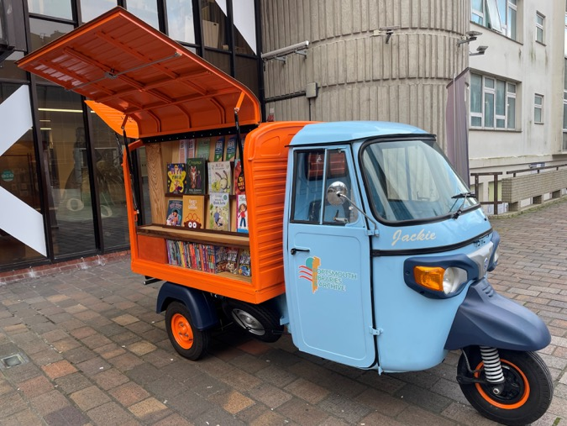
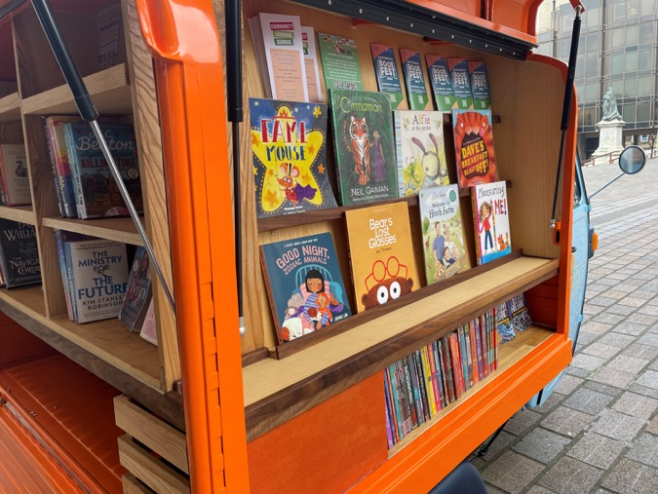
Libraries Improvement Fund Rounds
Capital investment in English public libraries
Portsmouth Libraries’ “Tuk Tuk Library”. Photo by Luke Burton
Notes:
This photograph is of Portsmouth Libraries’ “Tuk Tuk library” funded through LIF.
Just to demonstrate that the range of projects that have been funded.
As colleagues at Portsmouth would want me to point out this is not technically not a tuk tuk but is actually a Piaggio Ape, but I think you will agree it looks great.
This is used at festivals and events all across the city and draws crowds

Slide 7
Libraries Improvement Fund (LIF) Rounds 1-4
Department for Culture, Media and Sport (DCMS) funding administered by Arts Council England
~£26 million across four rounds
To “enable library services across England to invest in a range of projects to upgrade buildings and technology so they are better placed to respond to the changing ways people are using them.”
Notes:
-LIF is now a well-established programme of capital support for public library services in England.
-DCMS funding administered by Arts Council England and we/I have chaired the EOI and selection panel each year.

Slide 8
Libraries Improvement Fund (LIF) Rounds 1-4
2023 Round 1: 25 projects
2024 Round 2: 27 projects
2025 Round 3: 43 projects
2026 Round 4: 28 projects
Total: 123 projects
Notes:
Process
-Across the previous 4 rounds we have funded a total of 123 projects
-There was an EOI process followed by a review and the invitation to a full application
-The process was about a year from start to finish with applications opening around the start of the financial year
-Decisions panels took place at the end of the year with applicants finding out results in advance of public announcements
-As I say panels were chaired by ACE/me with representatives from ACE, DCMS and former heads of service on panels
- Wouldn’t have been possible without the co-ordination and support from our brilliant Capital colleagues
-Some of these will include multiple sites (one application actually supported refurbishment work at 10 libraries in Sandwell)
-You may have noticed that in 2025 we funded significantly more projects
-This was a “bumper” round with nearly double the budget of other rounds
-We try to get a balance of project type (building, refurb, digital), geography and budget
-Library services can/have received more than one round of funding

Slide 9
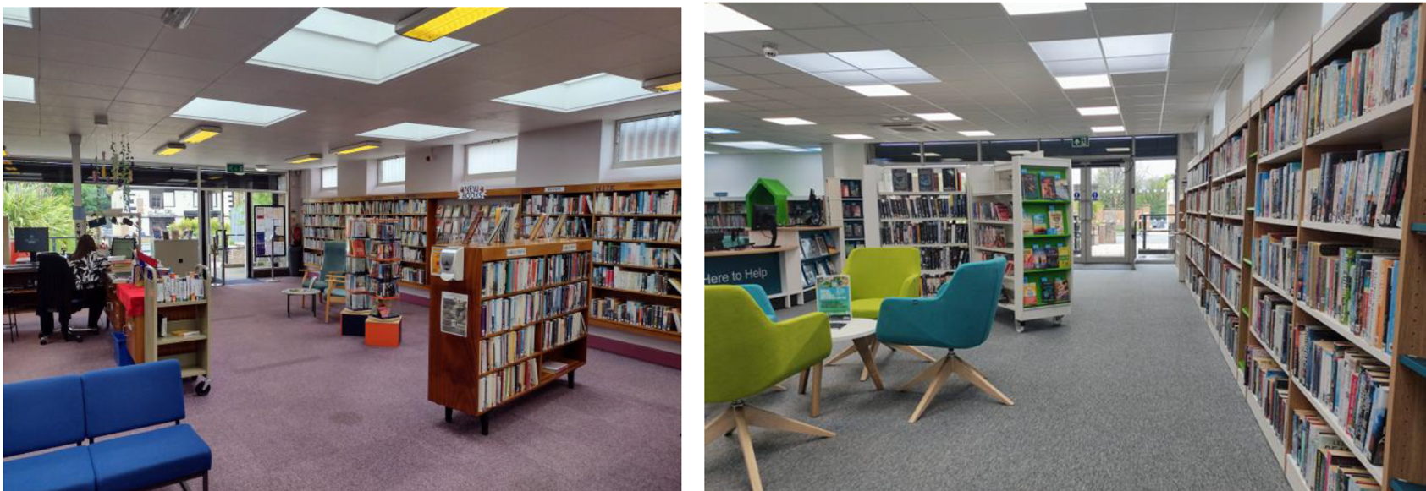
Before
After
Dodworth Library, Barnsley Metropolitan Borough Council
Notes:
-I thought it would be useful to show you some pictures of the work that has taken place to give you an idea/range of the work
-Barnsley libraries became pretty adept at making applications and were one of a number of service to receive more than one round of funding
-This picture highlights the change in feel , quality and welcome that people visiting Dodworth Library will now experience
-This picture doesn’t do justice to the range of work that was done
-The project involved a complete re-fit of the library, including the installation of a new heating system, windows, doors, flexible shelving and an accessible toilet, as well as new furniture.

Slide 10
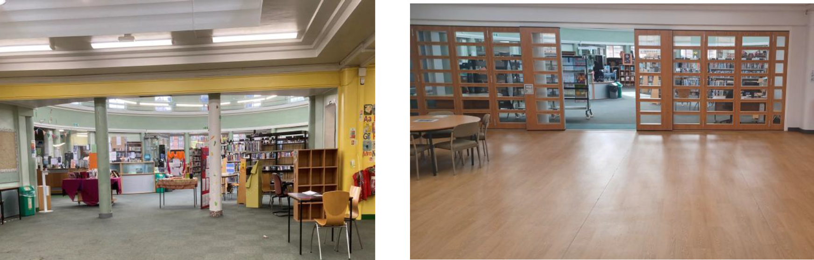
Before
After
St. Barnabas Library, Leicester City Council
Notes:
-LIF funding is also intended to allow more flexible us of library space that can generate income or allow greater community use.
-At St Barnabas Library Leicester City Council created a new Digital and Performance Suite.
-The refurbished wing was designed as a multi-use space, featuring 12 public PCs, a video editing room, film-making equipment, a performance area, and a viewing screen.
-It was intended to serve both individual users and local creative groups, with space and equipment available for hire.

Slide 11
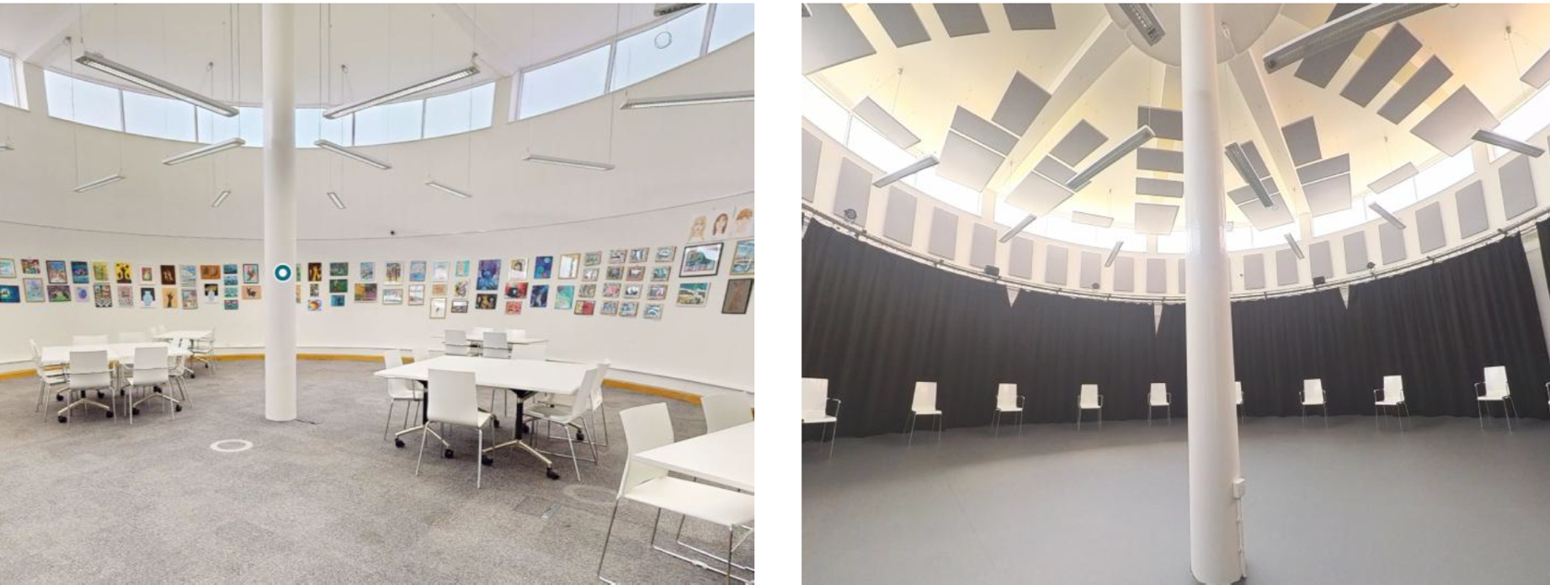
Before
After
Beckton Globe Library, London Borough of Newham
Notes:
-At Beckton Globe Library, Newham Libraries project transformed space into a flexible, multi-functional performance and community space.
-The project addressed a local lack of cultural and community venues in the south of the borough.
-The refurbished space now includes soundproofing, improved acoustics, lighting rigs, a sound system, projection capabilities, and flexible furnishings
-This now provides a much-needed resource for performances, community events, and educational activities.

Slide 12
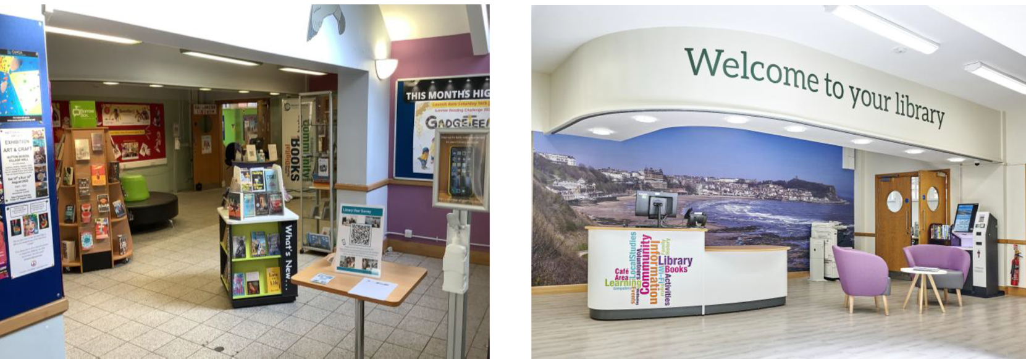
Before
After
Scarborough Library, North Yorkshire Council
Notes:
-At Scarborough Library in North Yorkshire the aim was to reconfigure the layout within a Grade II listed building
-It created a modern, multi-use space to meet a variety of community needs, improve access and create better working environments for partners, staff and volunteers.
-From this image you can see how they welcome for people visiting has improved significantly.

Slide 13
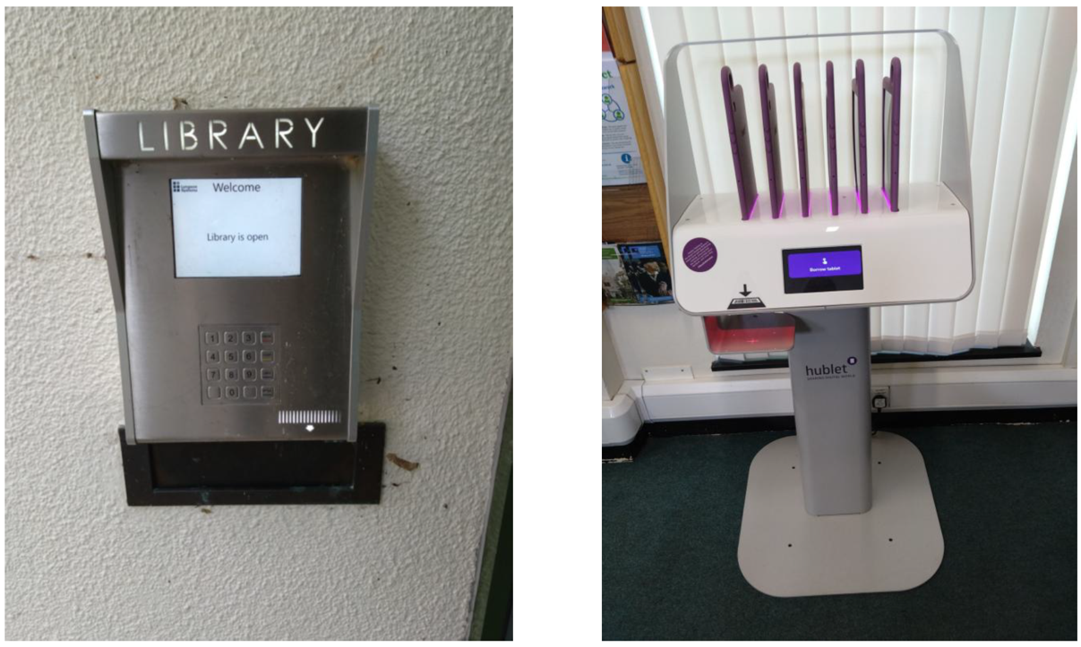
Out of hours access
On-site tablet lending
Tilehurst Library, Reading Borough Council
Notes:
-LIF is intended to support digital and tech projects as well
-Reading Council had a project that focused on: on-site tablet lending, off-site lending of Chromebooks (pre-loaded with data), and upgrades to Tilehurst Library to support out-of-hours community hire.
-These interventions were designed to increase digital inclusion, offer greater flexibility for community engagement, and address local demand for accessible public space.
-While modest in scope compared to later investment rounds, the project set the groundwork for broader ambitions, including a major central library relocation and a borough-wide library improvement programme under LIF Round 3.

Slide 14
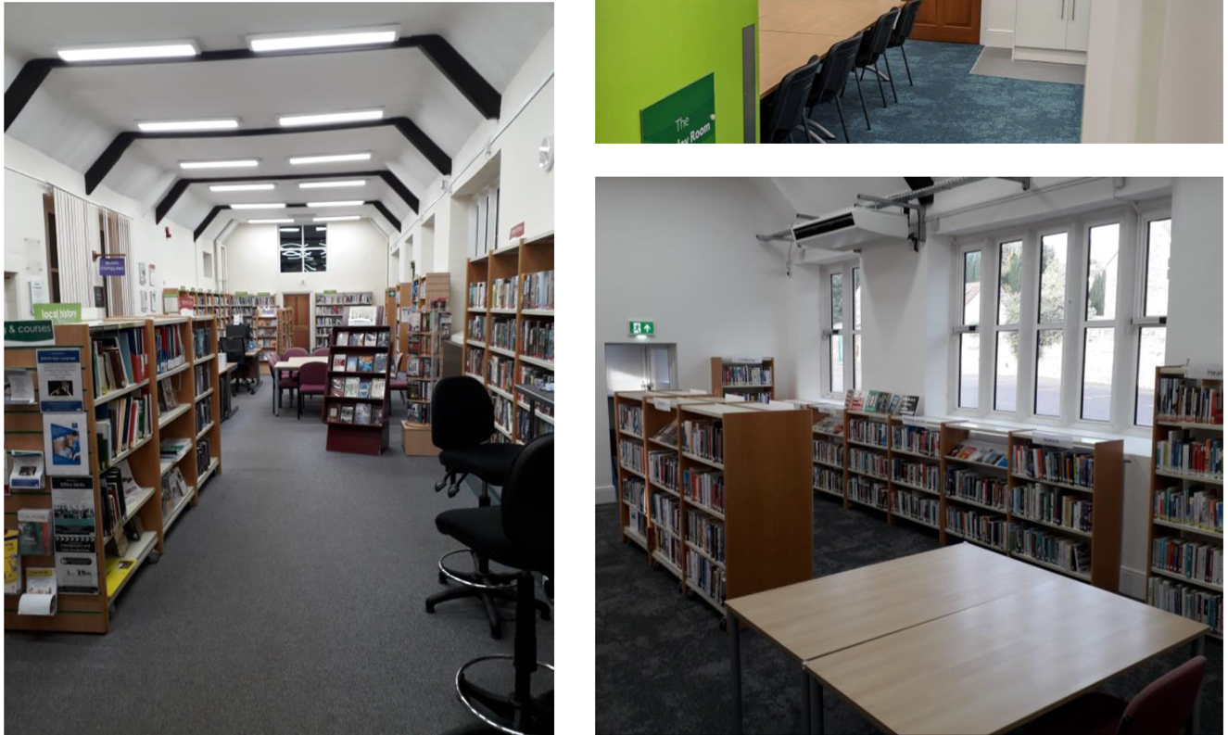
Before
After
Clevedon Library, North Somerset Council
Notes:
-A final example is the work that was done at Clevedon Library in North Somerset
-This involved internal alterations to create a community space and improve accessibility; energy efficiency improvements and works to the roof; and installing self-service technology to extend opening hours and increase library access.
-A colleague/our Director for Libraries visited this just after he started working at the Arts Council
-After visiting he reflected that whilst on paper it sounded like a straightforward refurbishment project being at the opening it really hit home the impact this space would have locally and the pride they felt in the new space
-There were aspirations to create greater community and creative space in the town and to work more closely with the local church, hospitality sector and Curzon Community Cinema

Slide 15
Libraries Improvement Fund (LIF) Round 5
£5.5 million for projects starting in 2027
Capital expenditure £50,000 - £500,000
Aims: sustainability, transformation, digital access, connect to communities and increase use.
Impacts: future-proof, improved satisfaction, diversify users, access to collections, digital access and collaboration.
Outcomes: more use by community groups, increase in users, more revenue, increased number of devices, updated operating systems, extension of available hours and increase in co-location.
Notes:
-The current round of LIF for projects to start in 2027 just closed last week to applicants
-The aims, impacts and outcomes will be the same as previous rounds
-Aims: increase the sustainability and potential for transformation, increase/improve digital access, connect libraries to communities and increase use.
-Impacts: future-proofed, improved satisfaction and perception, diversify users, increase access to collections, increase digital access and increase collaboration.
-Outcomes: more use by community groups, increase in users, greater access to makerspaces, more revenue, increased number of devices, updated operating systems, extension of available hours and increase in co-location.

Slide 16
Future Rounds
Announced in January 2026
Package of £1.5 billion to be invested in cultural organisations over a five-year period.
Included: £27.5 million for Libraries Improvement Fund
To support public libraries to upgrade their buildings and technology
No agreement on format or timing as yet.
Notes:
-We are still in the process of agreeing future rounds and the format they will take
-But this slide gives the broader context into which future rounds fit.

Slide 17
Lessons Learned
Time, time, time
Developing projects to RIBA stages
Match funding
Projects that are part of larger development projects
Fewer “digital” projects
Notes:
Time
-Libraries need adequate time to make an application
-There are complex internal sign-off processes needed to make, and application sand accept a grant
-In general, we need to be mindful that different authorities work in different ways and those applying have different levels of responsibility on what they can accept/sign-off on
RIBA stages
-This is a symptom of the above point but giving adequate time for projects to be developed to the relevant stage for us to be confident they can/will progress
Match funding
-A change with the current round is the requirement for match funding of 5%
-reflected the fact that due to the number of applications it became increasingly difficult to fund projects with a 100% ask for funding.
Parts of larger projects
-Previously we had seen projects that were part of bigger towns or levelling up funding as potentially being more beneficial this actually occurred as a risk.
-Projects that were part of much bigger capital projects risked being stalled or slowed byt delays and issues with the bigger project they were part of
Digital
-We saw projects that had digital elements, asks for equipment and upgrades but not many that were purely digital
-One was the Discover More tool developed by Suffolk Libraries prior to the council taking them back in house
-This is a social prescribing tool described once as “trip advisor for the soul”
-The lack of purely digital project probably in part reflects the demands/needs of the sector which is focused on buildings and infrastructure
-Mindful that this is capital money as well which puts constraints on the spend

Slide 18
Thank you
Laura Dyer
Deputy Chief Executive Places, Engagement & Libraries
Arts Council England laura.dyer@artscouncil.org.uk www.artscouncil.org.uk

