Slide 1

Design matters – our spaces can be as powerful as our services
Sonia Ramdhian
Chief Development Officer, CILIP
sonia.ramdhian@cilip.org.uk
17 June 2026

Slide 2
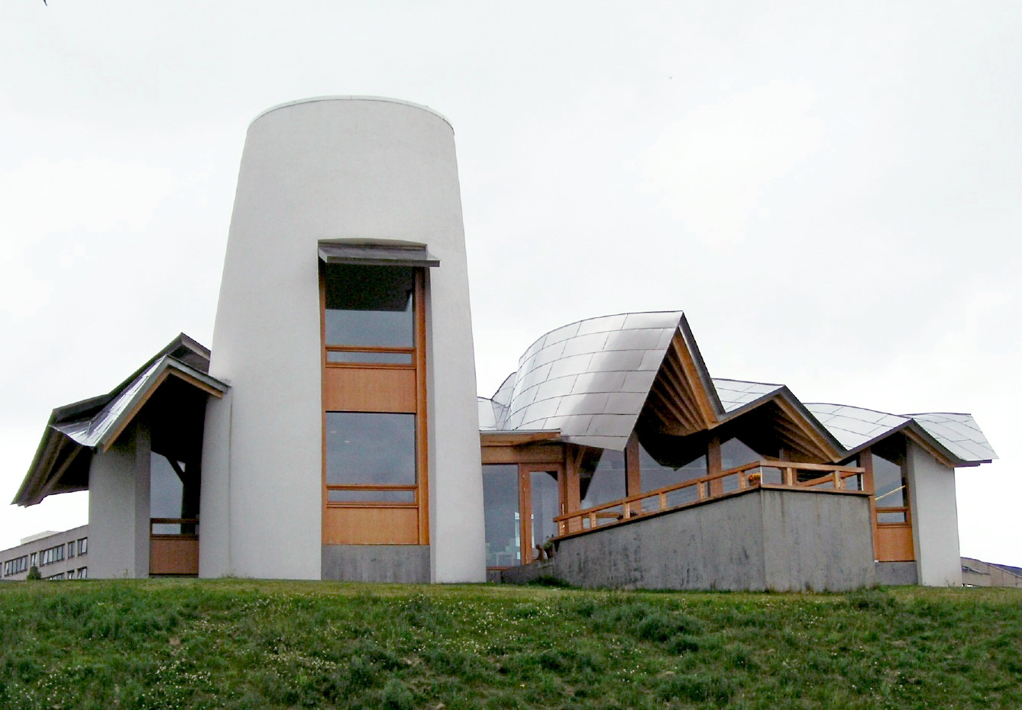

Physical space and emotional impact
“Everything you see is designed with you in mind. You won't see a reception desk, or signs on the walls; no name badges or uniforms. There are no clocks either, as we want you to feel you can stay for as long as you need, and come back as often as you like.”
https://www.maggies.org/our-centres/
Attribution: https://commons.wikimedia.org/wiki/File:Maggies_centre_Dundee.jpg

Slide 3
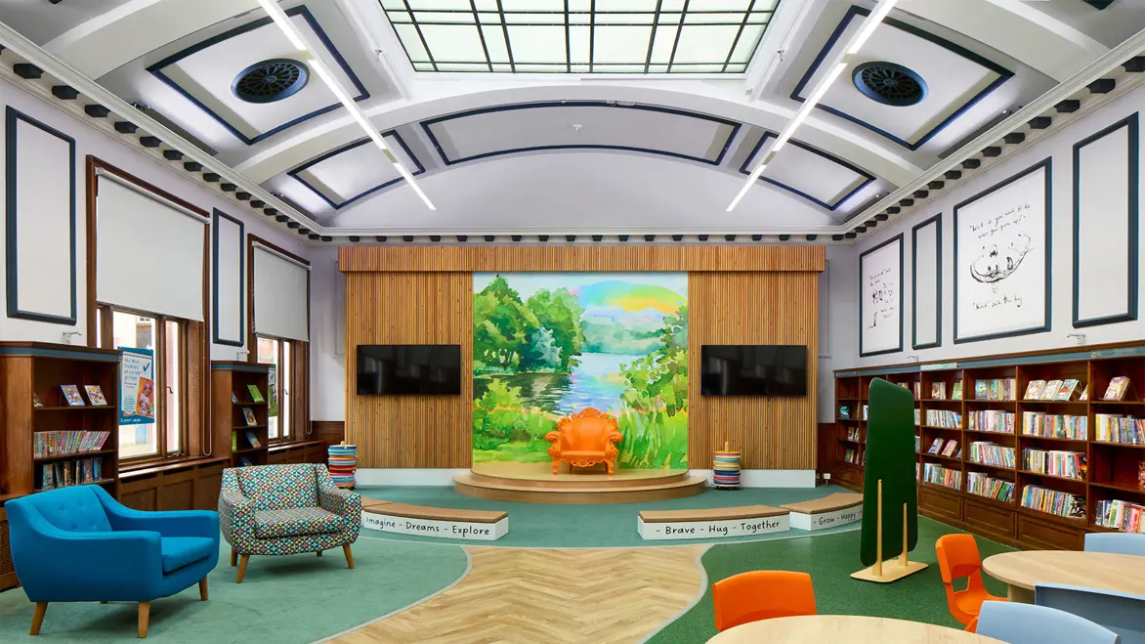
Physical space, sanctuary and discovery
Libraries have always served as safe spaces and sanctuaries, enabling children and young people to explore their identities, emotions, and the wider world. This role has been particularly pronounced following the profound impact of the pandemic and its lockdowns
Reading should not be perceived as an isolated pursuit; rather, it provides meaningful opportunities for connection that transcend barriers. Books act as bridges, linking individuals through shared human experiences. In this respect, reading supports mental health, nurtures the capacity to form healthy relationships, fosters empathy, and promotes an understanding of individual rights
Ultimately, reading for pleasure facilitates self-discovery
Source: Written evidence by CILIP Youth Libraries Group (RFP0091) submitted to the Education Committee Reading for Pleasure inquiry January 2026
Image: https://designinglibraries.org.uk/news/2025-news/the-perfect-modern-classic-in-darlington/

Slide 4

Physical space serving our ethical principles
The basis of libraries as universally inclusive public spaces is set out in the Public Libraries and Museums Act 1964
Public libraries were designed with the aim of providing safe, trusted and universally inclusive physical spaces, embedded in the heart of their communities. Although not every library is regarded as universally inclusive by their communities, this should remain our ambition, in keeping with our ethics.
In the case of schools, the library serves as a vital ‘third space’ for learning, self-discovery and development beyond the classroom.
In prisons, the library similarly acts as a non-judgmental and inclusive space for learning and self-development

Slide 5

Physical space for our future
Green Libraries Manifesto– working together for people and planet
A shared vision: to lead by example through our own environmental actions and use our power and reach to inform and inspire people to take positive action and build resilience in the diverse communities we serve.

