Slide 1
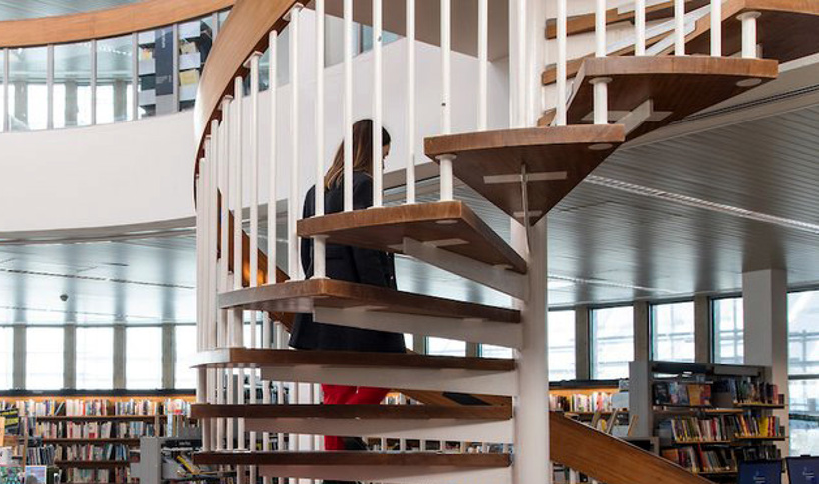


Public Libraries as Critical Social Infrastructure
Patricia Aelbrecht and Melissa Turgut
Public Space Observatory, Geography and Planning School,
Cardiff University

Slide 2
Our presentation
Two interconnected ESRC-funded research projects in partnership with Camden Libraries
Explores public libraries as critical social infrastructure
Project 1: Social value of libraries in everyday practice
Project 2: Libraries as urban commons and contested public spaces

Slide 3

Project 1: Social value of libraries in everyday practice

Slide 4
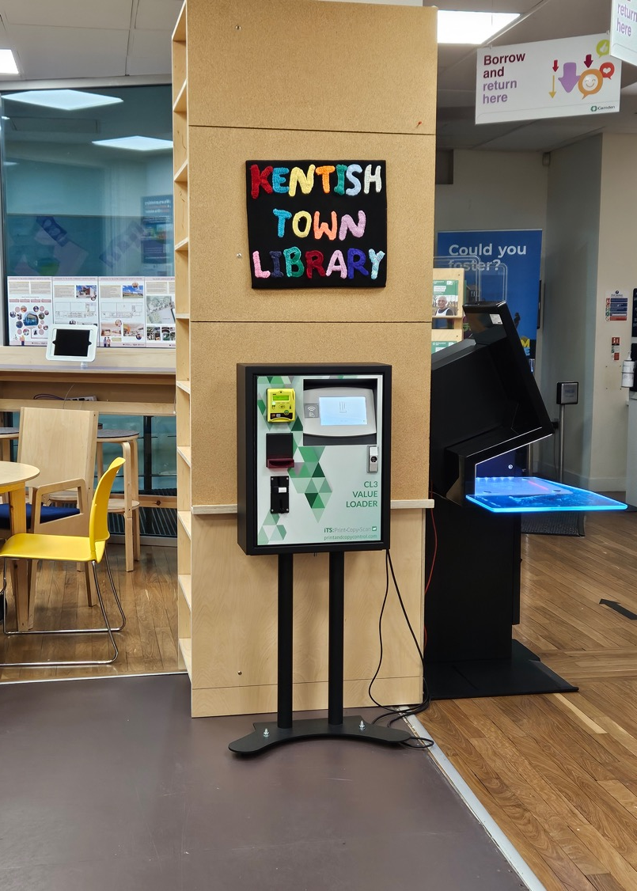
Understanding the Social Value of Libraries
How do we recognise the social value of libraries?
Libraries as learning spaces, community hubs, and service providers
Research focused on Kentish Town Library
Library value is everyday, practical, and necessary
Libraries stabilise daily life for many users

Slide 5
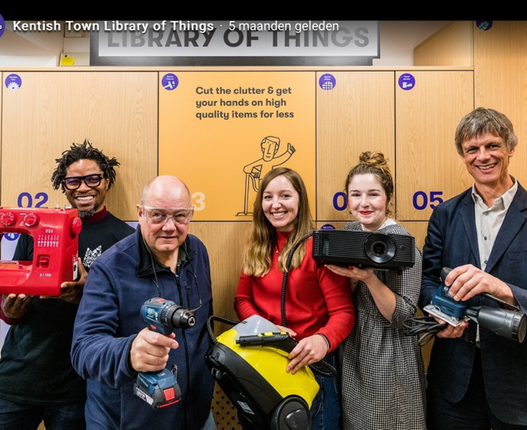
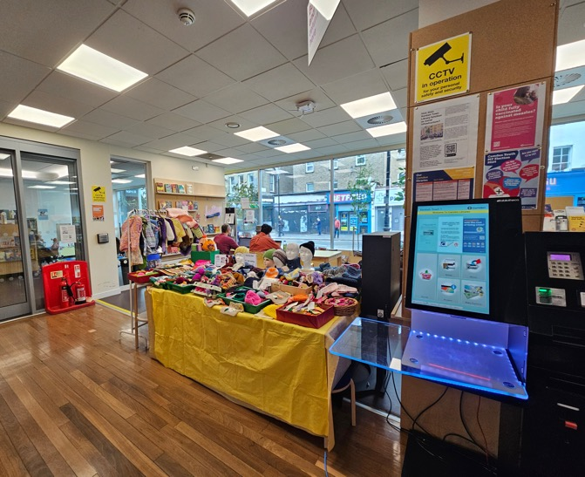
What Do We Mean by Social Value?
Traditional measures: programmes, attendance, partnerships, outcomes
Invisible forms of value: quiet workspaces, warmth, WiFi, legitimacy without spending
Observed prolonged occupation and habitual visitation
Libraries function as extensions of home
Social value lies in the stability, support, and sense of belonging it provides.

Slide 6
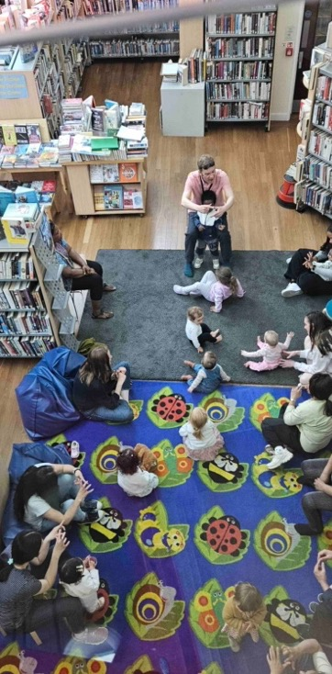
Belonging Is Practiced, Not Designed
Over 80% of 100 respondents said the design did not reflect local identity
Belonging emerges through repetition and familiarity
Predictable routines and familiar faces create attachment
Belonging develops through ordinary repeated presence
The library works because it is reliable
That is social value.

Slide 7
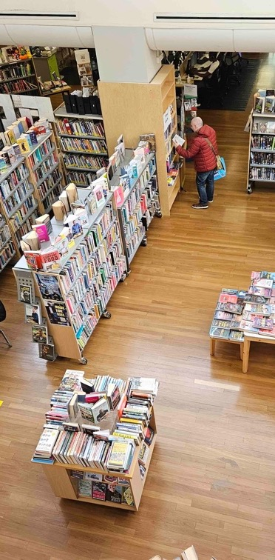
Inclusion Is Material
Inclusion depends on material infrastructure
Free entry, seating, WiFi, toilets, flexible spaces, staff mediation
These features form the infrastructure of inclusion
Challenges include overcrowding, privacy, and unequal feelings of welcome
Staff labour plays a central role in sustaining inclusion
That labour is part of the library’s social value.

Slide 8
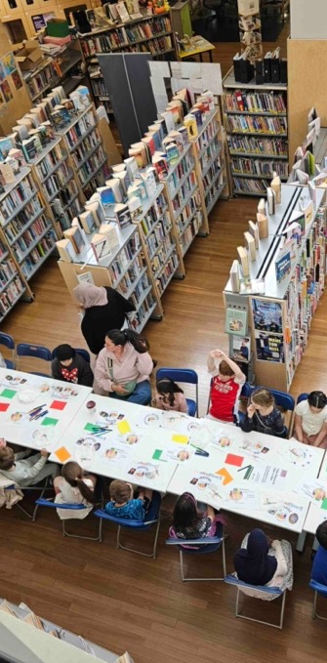
Participation Without Visibility
Visible participation includes volunteering and co-produced activities
Many users do not describe themselves as participating
Routine and repeated use may itself constitute participation
Social value lies in relational continuity and predictable return
Participation may not always be visible institutionally
Social value as a relational continuity

Slide 9
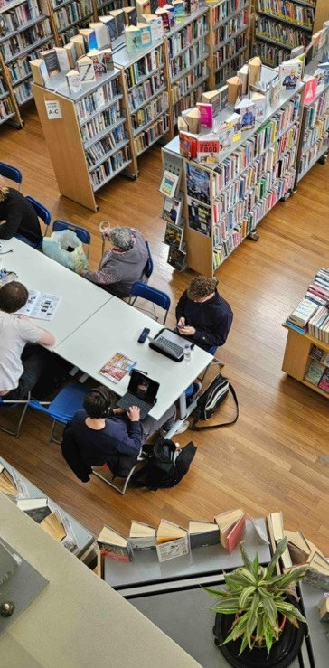
Recognition Is Present - But Partial
Libraries accommodate diverse users and needs
Recognition emerges through coexistence
Representation through design and programming remains partial
Belonging is strong but inclusion remains fragile
Social value is spatial, negotiated, and produced daily

Slide 10
Final Reflection
Kentish Town Library like most Camden Libraries receives over 100,000 visits annually
Libraries absorb social needs under conditions of housing and digital pressure
Libraries provide infrastructural, not only cultural, value
Current metrics miss everyday forms of social reliance
Key question: What would be lost if they were no longer here?

Slide 11

Project 2: Libraries as urban commons and contested public spaces

Slide 12

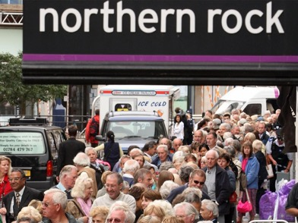
UK Context: Policy Logic
1990s – Early 2000s
Libraries for lifelong learning, knowledge accessibility
Early 2000s --- 2001 Northern Disturbances
Policy Logic: Social tension «parallel lives» results from insufficient community interaction.
Libraries and community cohesion (Cantle,2001; Home Office,2002)
2010s --- 2008 financial crisis, 2010 Coalition government, severe local community cuts
Policy Logic: The state cannot provide everything; communities must be resilient.
Libraries and community resilience (Cabinet Office,2010; Localism Act,2011; Hastings et al.,2015; IFS,2019) )
Recent
Policy Logic: Strong places require strong social infrastructure.
Libraries as social infrastructure (DCMS, 2020; ACE, 2020)
Uberoi, V. (2024, August 12). I worked in the Home Office during the 2001 riots – these are the mistakes the UK government must avoid. The Independent.
Where is:
The language of cuts?
The language of inequality?
The language of austerity?
Morris, S. (2017, September 14). UK banks are smaller and poorer a decade after the 2007 financial crash | The Independent. The Independent.
Notes:
Thank you, Patricia for posing that crucial question: What would be lost if libraries were no longer here? To answer that directly: what would be lost is not just a building full of books, but the very last standing, decommodified sanctuary of public life. Today, I want to take that question forward by examining how the UK policy logic masks structural inequalities, and why we must reconceptualise public libraries as active, and politically generative commons-in-the-making.
+Let us first examine how the official policy logic around libraries has shifted over the last three decades. In the 1990s, the discourse focused on lifelong learning and knowledge accessibility. Following the 2001 Northern Disturbances, the logic shifted toward 'community cohesion' to mitigate social tensions. By 2010, under the Coalition government and severe local cuts, a new logic of 'community resilience' emerged, subtly implying that communities must survive on their own. Most recently, libraries are framed as vital 'social infrastructure’.

Slide 13
UK Context: Evolving Roles
FROM
Institutional repositories of knowledge with the traditional roles of book lending, reference services, and study places
TO
Essential social infrastructure (Klinenberg, 2018)
Sites for digital inclusion (Bertot et al., 2010),
A meeting place (Aabø et al., 2010)
A safety net amidst crisis (Klinenberg, 2018; Peel & Lloyd, 2024),
Warm banks building social connections and inclusion (Rabaiotti et al., 2024), and
Resistance spaces that help struggling residents (Aptekar, 2019).
Library positions at the intersection of neoliberal urban policies and its role as an “infrastructure of care” (Mattern, 2014) for marginalised groups under conditions of austerity (Peel & Lloyd, 2024)
Informal community centers that absorb uncovered welfare responsibilities
Notes:
+Because of these budget cuts, the empirical reality of what a library actually does has completely transformed. We have moved FROM institutional repositories of book lending and reference services TO essential social infrastructures and frontline safety nets amidst crisis.
+As highlighted by scholars like Klinenberg, and supported by foundational works of diverse scholars, libraries have been forced to become 'warm banks' building social connections , digital inclusion sites , and informal community centers that absorb uncovered welfare responsibilities under sustained austerity.

Slide 14
Depoliticisation?
These narratives may depoliticise libraries by presenting them as:
• neutral service institutions
• tools for social management
• spaces of consensus
*This risks obscuring their role as political public spaces.
Does framing libraries as social infrastructure subtly shift responsibility for community cohesion, social inequalities, austerity onto local space rather than structural policy?
Are they compensating for shrinking welfare systems?
Are they expected to repair damage caused by economic policy?
Are they being romanticized as soft repair mechanisms?
Notes:
+However, this transformation brings a significant danger: Depoliticisation. Mainstream policy narratives tend to present libraries as neutral service institutions, tools for social management, or spaces of consensus.
+This risks obscuring their true identity and potential. We must critically ask: Does framing libraries as soft 'social infrastructure' subtly shift the responsibility for social inequalities and austerity onto local spaces rather than structural economic policy? Are they simply being romanticized as soft repair mechanisms expected to fix the damage caused by systemic state retreat?

Slide 15
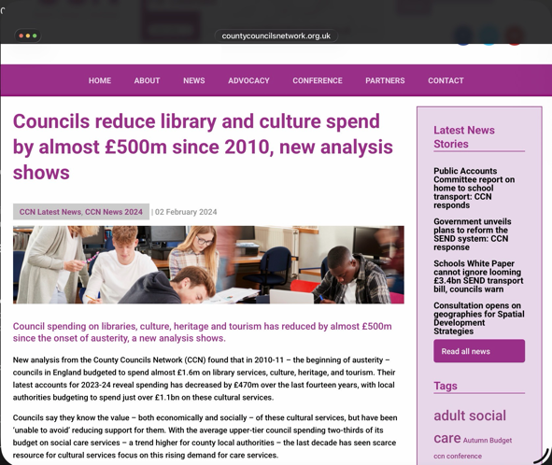
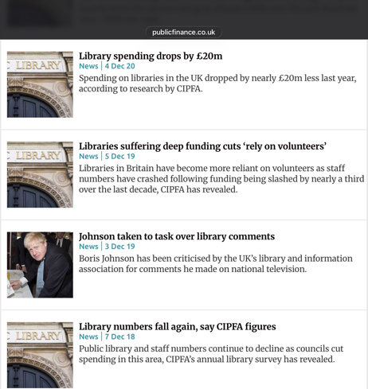
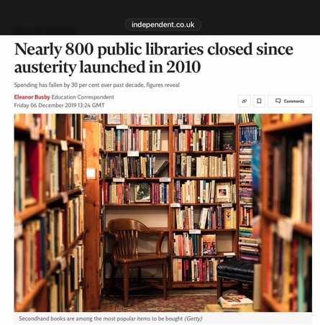
Austerity and Institutional Pressure
Despite their symbolic recognition in policy:
• Library funding has declined significantly
• Services have been restructured
• Staff numbers have fallen
Key figures (England):
• Spending fell from
£1bn to <£750m
(2009–2019)
• ~800 libraries closed (~17%)
• Staff reduced from
24,000 to 15,300
The Guardian (2018)
Yorkshire Bylines (2022)
Surrey County Council (2024)
Staffordshire County Council (2024)
Notes:
+To understand the depth of this pressure, we must look at the hard numbers. Despite their symbolic recognition in policy, public library spending in England fell significantly from 1 billion pounds in 2009 to under 750 million by 2019.
+This fiscal starvation resulted in the closure of approximately 800 library branches—which is nearly 17% of the total network —and paid library staff dropped drastically from 24,000 to 15,300. This quantitative background demonstrates that libraries are forced to deliver far more with aggressively fewer resources.

Slide 16
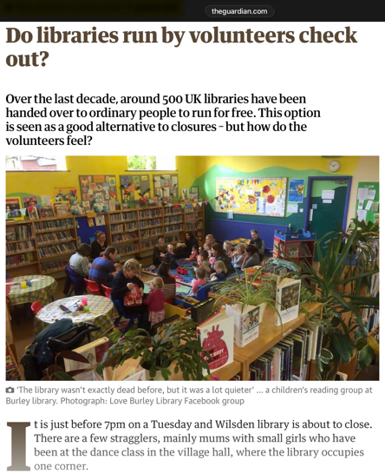
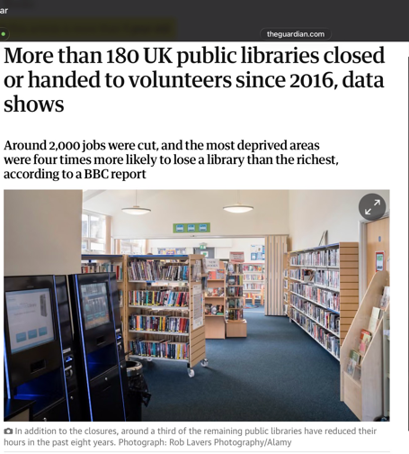
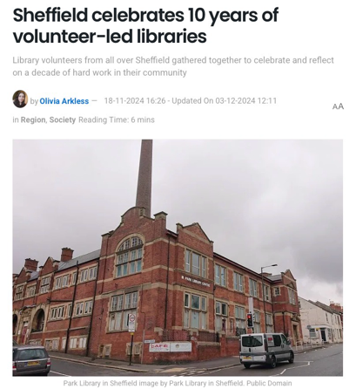
Changing Governance Models
Austerity has also reshaped library’s governance:
• Volunteer-run branches
• Community-managed libraries
• Hybrid governance models
*Libraries increasingly rely on community participation.
community-led libraries:
• Bradford – Wilsden, Denholme, Wrose
• Sheffield – 16 branches preserved through volunteer support
• Jesmond Library (Newcastle)
• Kensal Rise Library (London)
*Some councils formalised community partnership models.
CIPFA (2019)
Libraries Connected (2022)
Independent (2024)
Government Business (2018)
Notes:
+As a direct consequence of austerity, library governance models have been fundamentally reshaped. To survive, libraries are increasingly forced to transition from council-run facilities to volunteer-run branches, community-managed libraries, or hybrid governance arrangements.
+We see this across the UK: from Bradford substituting closed branches with local volunteers , to Sheffield preserving 16 branches through volunteer-led support , to community-managed models like Jesmond and Kensal Rise. This structural shift proves that libraries now heavily rely on bottom-up community participation just to keep their doors open.

Slide 17
Libraries today can function as commons-in-the-making (quasi-commons spaces):
• Partly state-provided
• Partly community-produced
They involve:
• Volunteer labour
• User-led programming
• Hybrid governance arrangements
LIBRARIES
URBAN COMMONS
RECONCEPTUALISING LIBRARIES AS ACTIVE AND POLITICALLY GENERATIVE SPACES
A commons perspective helps re-politicize social infrastructure.
It raises questions about:
• whose needs are supported
• whose participation is enabled
• how contestation emerges
*Libraries become contested public spaces
Notes:
+This bring us to the core conceptual contribution of my PhD, where I bridge these pressures with urban commons literature. I argue that public libraries today function as 'commons-in-the-making'. They exist in an ambivalent state: partly state-provided, but partly community-produced through volunteer labor, user-led programming, and hybrid arrangements.
+A commons perspective helps re-politicize social infrastructure. It shifts our analytical lens to ask: Whose needs are supported? Whose participation is enabled? How does contestation emerge? It transforms the library from a top-down service tool into a dynamically contested public space.

Slide 18
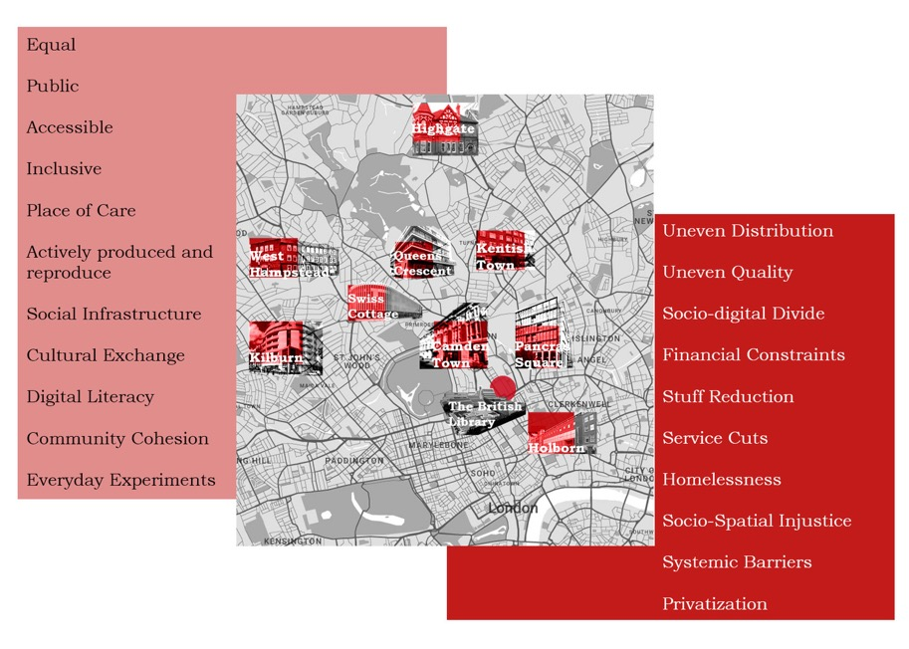
Camden Libraries as a Case Study
Despite pressures:
• community-led initiatives
• volunteer-supported programmes
• digital inclusion workshops
• Library of Things
• Green Library Hubs national programme
Camden Libraries remain spaces of
public interaction and engagement.
Public libraries are simultaneously:
• socially valuable institutions
• constrained by austerity
• potential sites of civic contestation
Camden Libraries are exceptional in terms of avoiding the extreme financial challenges (and their detrimental consequences for residents) experienced by many other councils across the country with their robust financial planning focused on preventative services, strengthening our asset base and embedding services within communities.
Review of the Council’s Medium Term Financial Strategy (CS/2025/14)
Notes:
+To explore this framework empirically, my research partners with Camden Libraries in London. Camden is a highly unique case study area. According to the Council’s Medium Term Financial Strategy, Camden has exceptionally avoided extreme library closures through robust financial planning focused on embedding services within communities.
+Yet, as a global metropolis core, Camden is a microcosm of extreme socio-spatial polarization. Public libraries here stand as one of the last decommodified public sanctuaries where people can exist not as consumers, but as citizens.

Slide 19
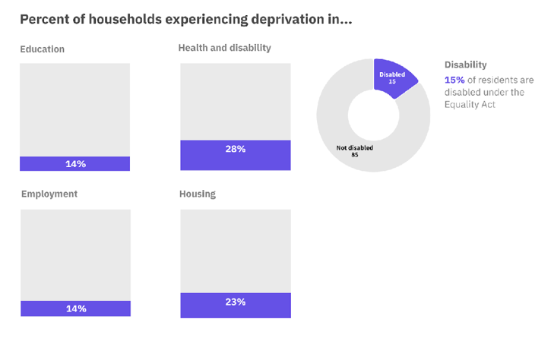
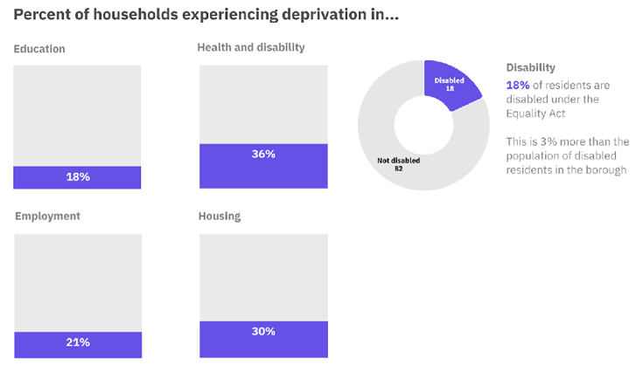
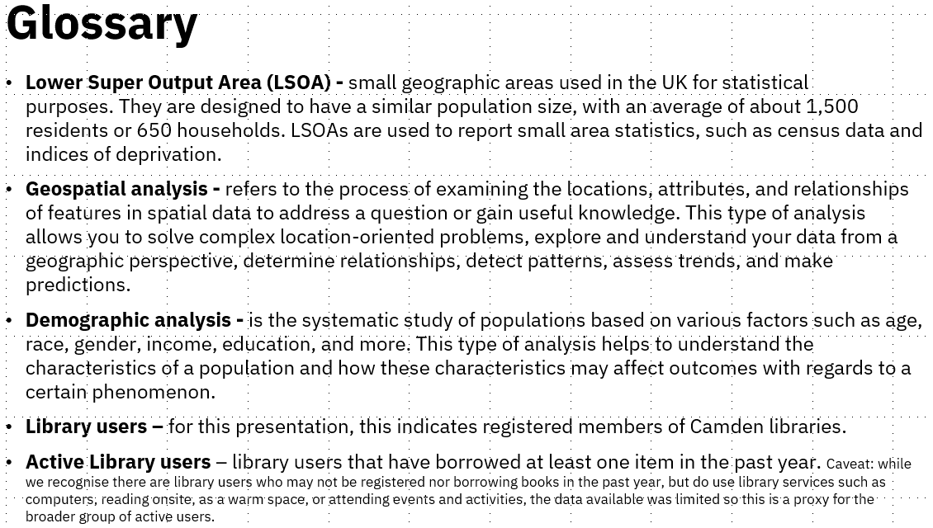
With employment deprivation 1.5x higher than the borough average, these libraries act as critical socio-economic refuges
Verrucci, Cheng and Shinwell (2024)
Notes:
+Now, let us look at the empirical data from Camden Council’s geospatial analysis conducted in 2024. Pancras Square Library sits right at the heart of King’s Cross Central where is a hyper-gentrified commercial zone occupied by global tech giants like Google and YouTube. Yet, physically adjacent to this wealth are pockets of historic working-class deprivation and council estates like Somers Town.
+Crucially, Camden Council’s 2024 geospatial analysis highlights a profound baseline: the rate of employment deprivation among residents within the library catchment areas is 1.5 times higher than the Camden borough average. Pancras Square registers an alarming 21% employment deprivation score compared to the borough's 14%. It acts as a literal 'contact zone' or public living room where these two contrasting worlds coexist but rarely otherwise interact.
+While Camden Council’s internal quantitative report provides an invaluable demographic baseline, it explicitly notes a major methodological limitation in its Glossary and considerations. Their data is a proxy limited to registered active users who borrowed at least one book in the past year.
+The council explicitly acknowledges that their data cannot capture the hidden personas or demographic data of visitors who are not borrowing but rely on the library as an unconditional warm space, or for digital and computer access.

Slide 20
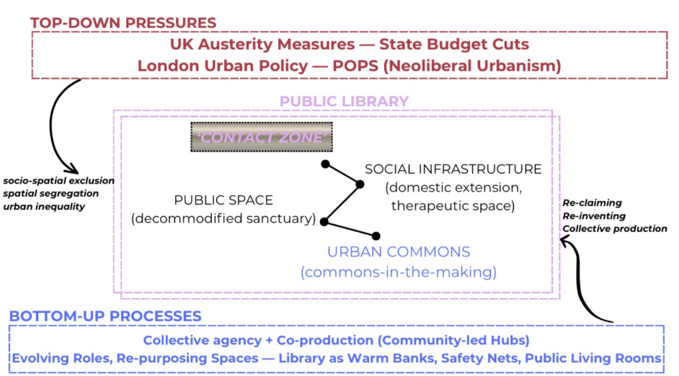
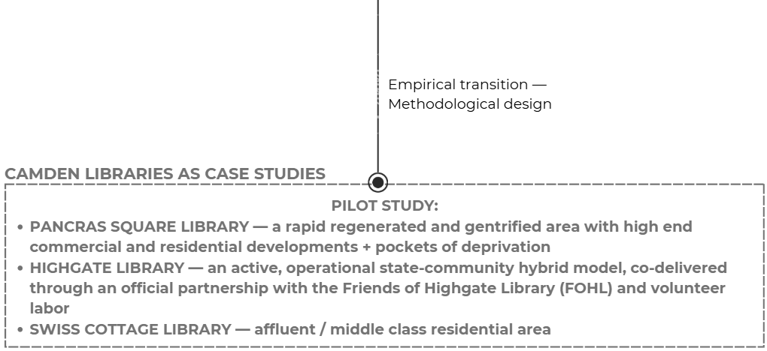
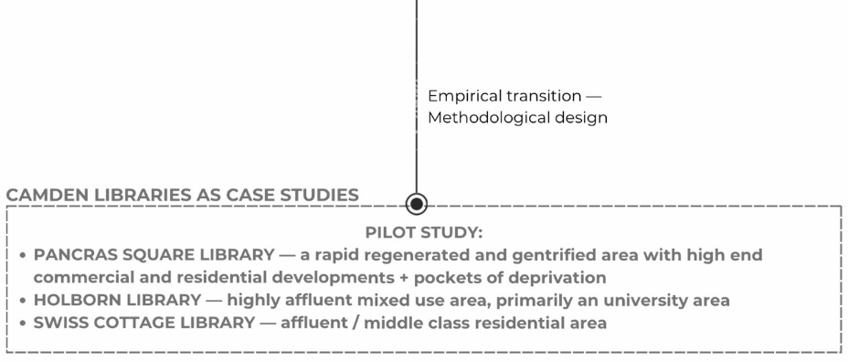
Notes:
+This is exactly where my research steps in to hopefully complete the picture.
+To capture this invisible data, this empirical design translates the dialectic framework into action across three contrasting socio-spatial catchments: First, Pancras Square Library, where top-down commercialisation collides with working-class claims. Second, Highgate Library offers an active, operational hybrid model where Camden Council provides the core infrastructure, but the physical spaces and programming are continuously co-produced and delivered through the volunteer-led labor of the Friends of Highgate Library and third, Swiss Cottage Library, situated in an affluent middle-class residential enclave.
+Because social infrastructure is inherently context-specific, comparing these diverse catchments allows me to qualitatively observe how spatial commoning, coping mechanisms, and bottom-up collective practices alter across different classes and multicultural geographies.
+To conclude, by shifting our analytical focus away from top-down transactional statistics, such as book loan counts, and looking instead at the live production of social value, this I aim to reposition public libraries. Libraries are not merely coping mechanisms for a retreating state, but essential, adaptively co-produced spaces where communities actively build socio-spatial resilience. Thank you, and I look forward to your feedback.

Slide 21
Thank you ☺

